Slide 1
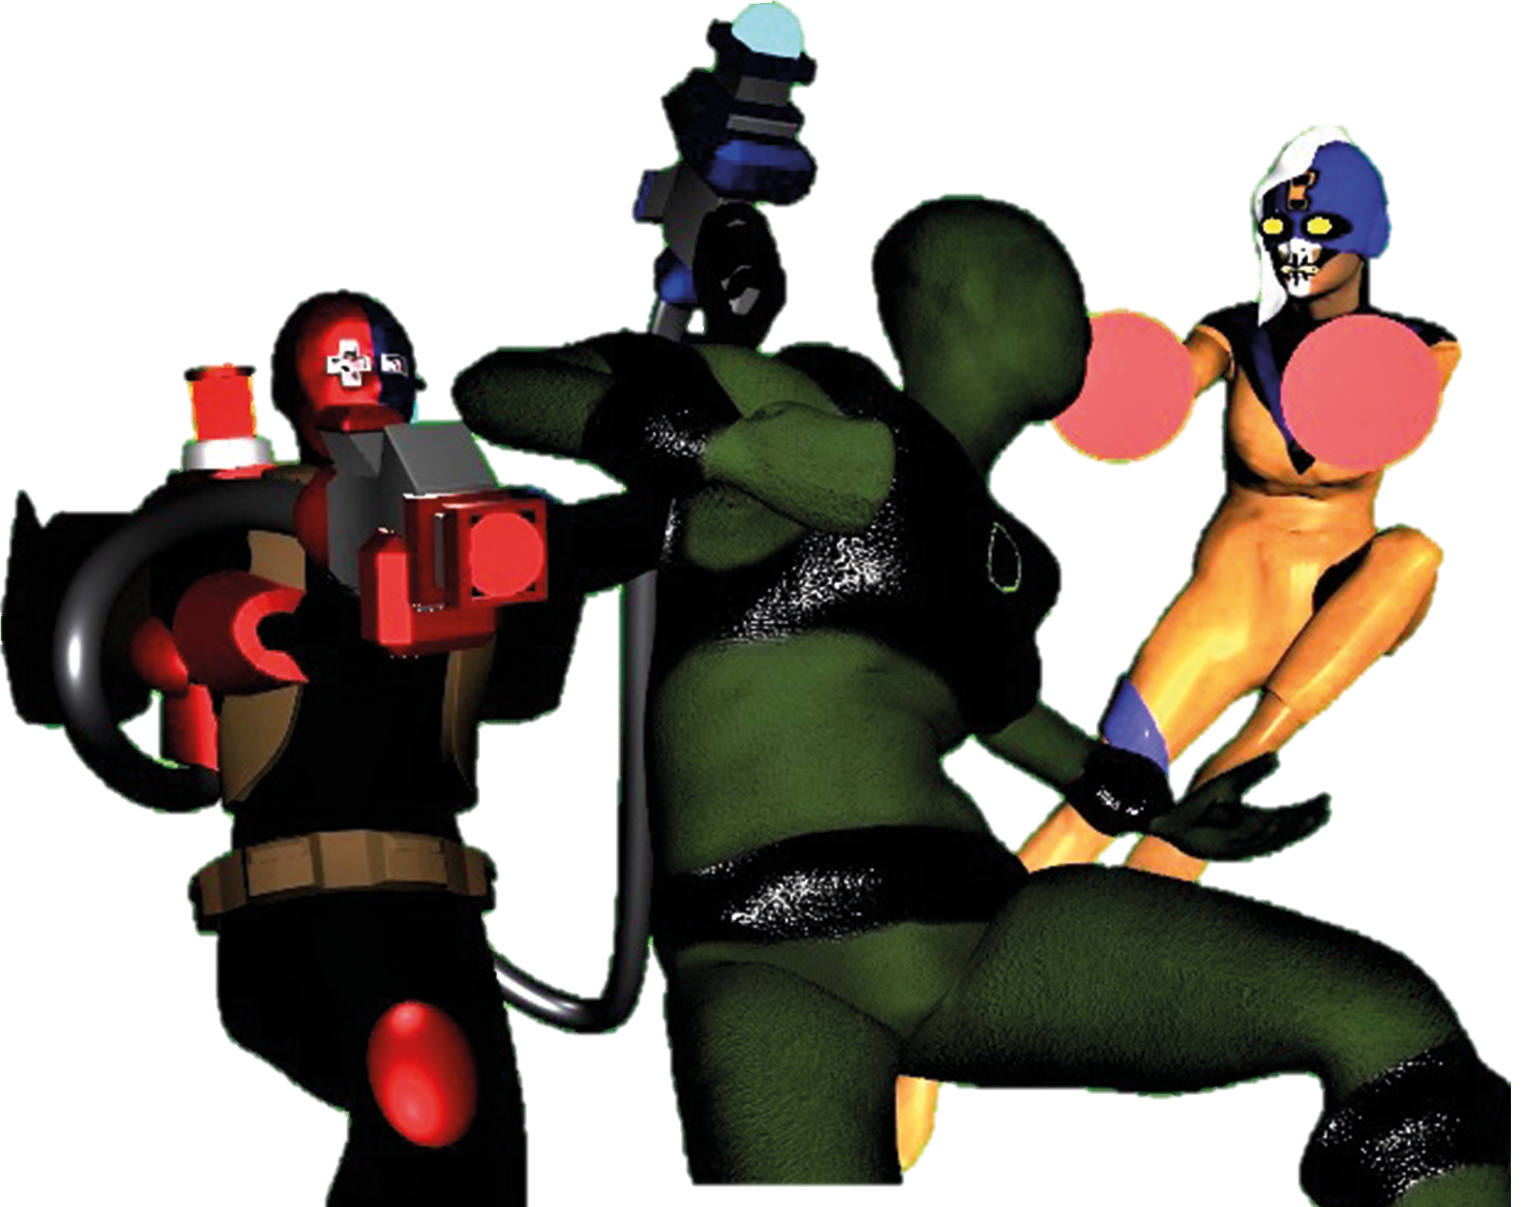
Rory E. Martin
Density
REM’s
The Container Heist
Design
Deck

Slide 2
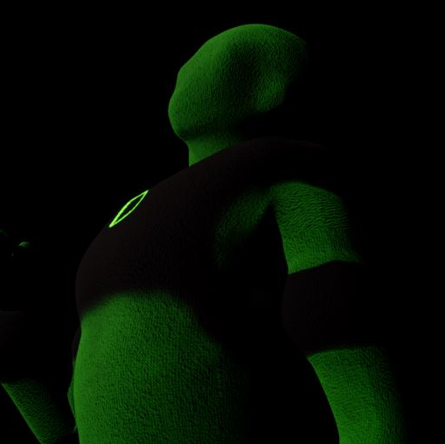
Table of Contents
Prologue
Rory E. Martin……………………..…2
The story so far……………………...3
Density…………………………………..4
Attractor………………………………..6
Blaster Woman………………………8
Warehouse 964…………………....10
Environmental Assets……………11
Showcase……………………………..12

Slide 3
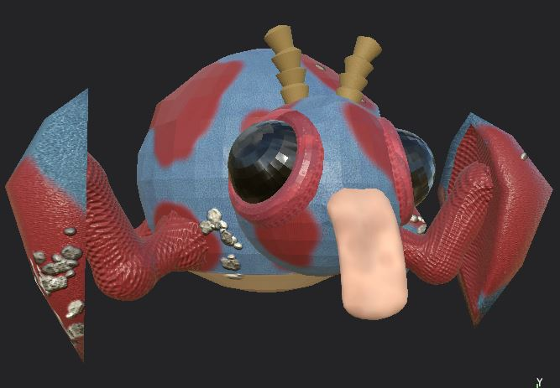
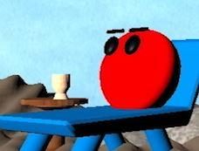
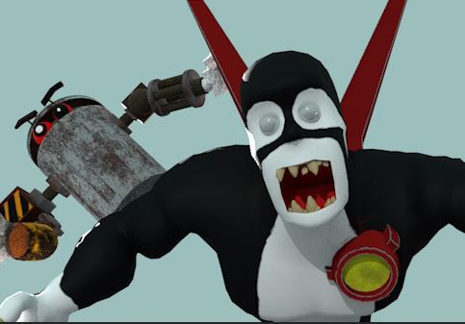
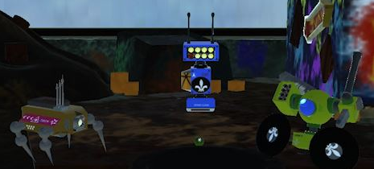
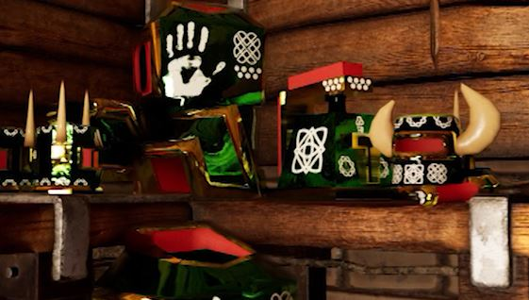
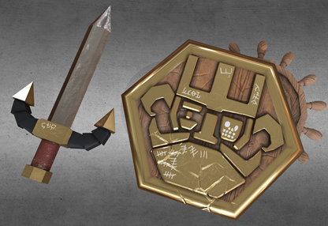
Rory E. Martin
Rory Edward Martin possesses a creative mind that has used his vast knowledge in film and comic media to now specialize in 3D animating. His skills primarily are developed in animating 3D models. This can either be in pre-visual work or full final animation incorporating the full range of subjects i.e.: creating environmental assets like a moving crane or driving car, to fully fledged characters with emotive eyes and natural movements. He is very passionate about the projects he works on and will always persevere to make sure a scene is exactly right.
While animation is his main field of proposed employment, he is also capable of developing creative ideas for both storytelling and design work, helping flesh out and build any world or personal journeys for clients. In his main areas of interest, it helps that he has an encyclopedic knowledge of a vast range of creative works, from the likes of Marvel and DC Comics to Warhammer 40000 and through to Star Wars, SpongeBob and many more.
In addition, Rory is very versatile and has the full suite of animation techniques. He is capable of working in every area of the production process (such as modeling, lighting, texturing) which can be helpful in smaller organisations or in reinforcing areas that need additional staffing.
He is also hard working, well mannered, friendly, content to work in a team or independently, and is always willing to help others. Good at following project briefs he can happily work within any parameters and timeframes as set by the client.
Contact detail are included below. Please feel free to reach out get to know Rory and see more of his animation work and other elements like his CV.
E-Mail: rorymartin74@icloud.com
Phone Number: 07921 517370
ShowReel:
Website and Portfolio:

Slide 4
‘The world needs great heroes even if it past their prime.’
49-year-old Noelani Jane is many things to many people. He’s a loving husband to his wife Kaulani, a good father to his teen daughter Lani and a proud bar owner in las Vegas. If all goes well for the next 5 years, he will finally return home to Hawaii, a place where his daughter never been.
After a violent attack one fateful night, Noelani found himself changed, with the ability to alter his density and form, moving though walls or standing as an unbreakable pillar. This secret he kept between him and his wife, hoping to continue with the plan of returning home, until many young students including his sweet Lani broke into violent acts, leading to their imprisonment. Believing that these kids who had previously been model citizens were being controlled by a outside force, Noelani takes to the streets under the hidden identity as Density to find the truth and soon finds himself trapped in the superhero life
In his quest to clear his child’s name, the ‘green ghost’ has encountered many unrelated challenges. He’s has foiled attempted robberies by the magnetic tech of Attractor, avoid a full-scale political assassination carried out by the mercenary Blaster Woman, grounded the winged thief Night-Sails and stopped the family bar from being taken by the cruel and shady business lord, Hank Henderson of Henders Inc.
The city of Las Vegas might be on the rise when it comes to peace and safety, but crime still has deep roots and not everyone knows how far those roots go down . Even now, with the rising of meta-humans, advances technology, living history and even things from the stars themselves, something else is stirring, unseen by all, threating to bring everything under its control.
Just now however, a silent alarm has been set off in a private warehouse on the desert border.
‘When duty calls, a good heart, reluctant mind or not, will answer this young man’s game’.

Slide 5
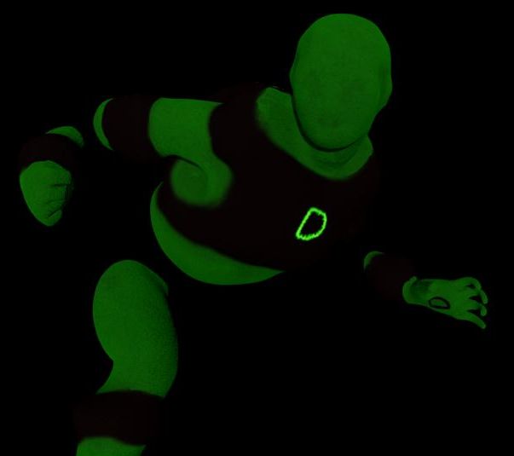
Density
After one week of bad events outside his control, Noelani Jane finds himself as the new protector of Las Vegas. He may say he’s too old to be a superhero, he may say he is only doing this until he saves his child, but in truth his heart is too great to allow this old man to abandon people if he has the power to help. Whether he likes it or not, this dad will safeguard the city as only a parent can.
Name: Noelani Jane
Age: 48
Powers: The ability to alter the state of the density of his body to phase though objects like a ghost, or form an unmovable statue, unbreakable to all physical and energy damage. Ghosting can affect people and small objects in contact with him during transformation. Both forms put stress on his body and reduces breathing, requiring him to return to a normal state every so often. (i.e., 2 minutes of powers need 30 seconds break on average). Tribal athletics on his home island, skilled him in both boxing and acrobatics.
Design: Density wears a green morph suit with black bands, bands and a crop top incorporating a green ‘D’. His overall look is meant to reflect the simple design of the old comic superheroes, staying clear from the overly complicated designs found too commonly today.
The two colour scheme and lack of face detail will help him be eye catching and be developed into many artistic styles.
Animation Information: Density’s power is great for moving around the area with great safety and stealth. This offers him excellent battlefield control and use of the environment, enabling him to set traps and ambush the enemy before driving back out of their reach. As someone who has lived most his life as a regular man, Density is tired and annoyed that fate has thrown him in this superhero life. In many ways he is too old for this, to the point where it affects him in the field (e.g., headache, lack of breath, sore bones). However, with age comes the wisdom and knowledge of experience. He can see things that only an old father and a husband. This means that he uses brain over brawn to win fights, whether by phasing out of the foe’s sight to strike them where they are weakest or by rescuing people in danger by finding the safest exit.

Slide 6
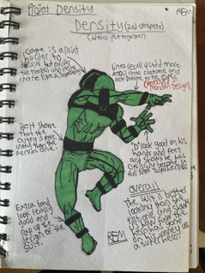
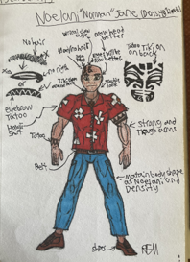
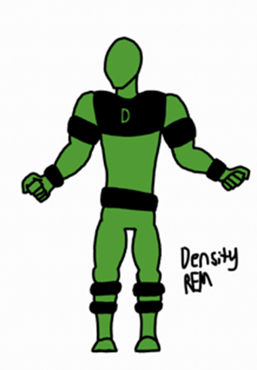
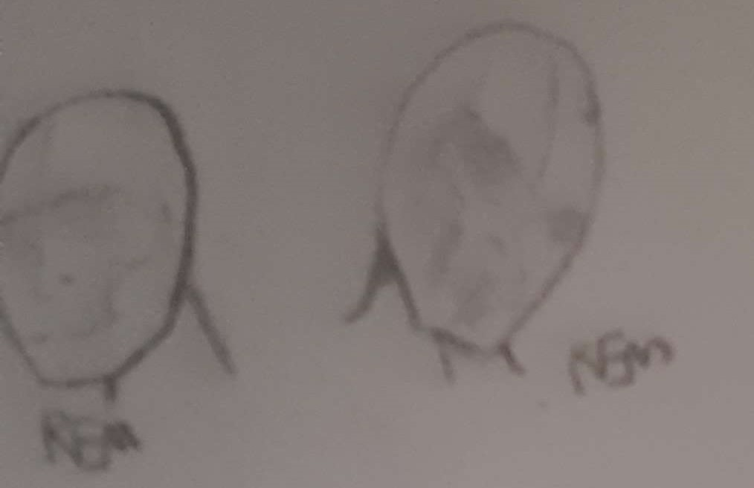
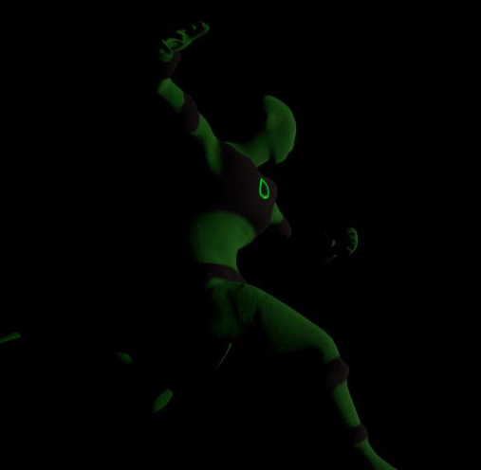
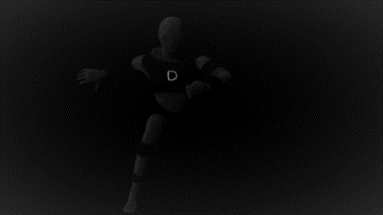
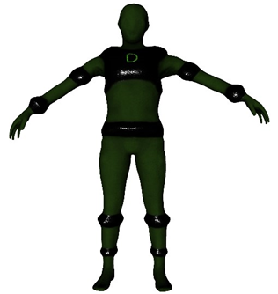
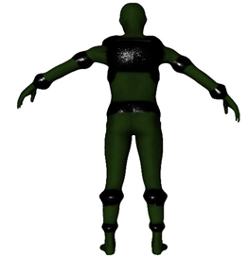
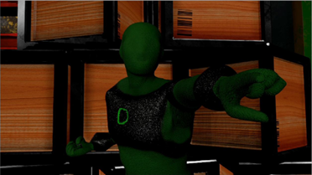
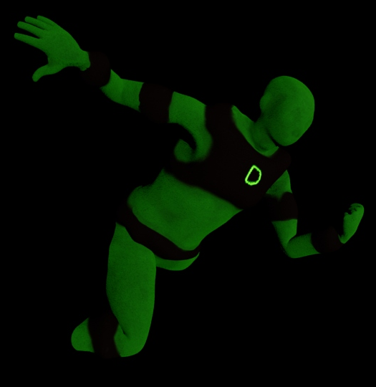
D

Slide 7
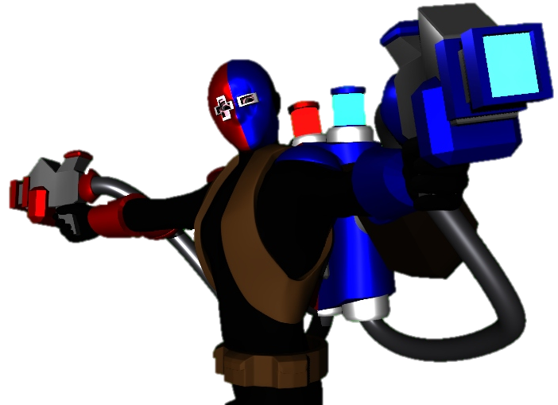
Attractor
Name: Professor McCoy Garfield
Age: 30
Powers: Uses a mixture of guns and other gadgets to deploy a special chemical compound known as Magnet-Gel. Magnet-Gel comes in two versions, Plus-Red and Minus-Blue and they also come in different forms (i.e.: Liquid, Gas, Solid). These mixtures create magnetic forces between each other allowing great weights to be moved with ease as Red and Blue must always come together. If one of the compounds can’t move an object the other is increased in speed and strength and so on hitting another object propels them towards each other (E.g., if Blue can’t move a wall, a car hit by Red will cause them to be attracted faster and harder together). Speed and overall power depends on how much of each mixture was applied. His Professor title reflects a very high intelligence in science, especially in chemistry.
Design: The colours and eye hole shape on McCoy’s mask reflects the Positive and Negative attributes commonly associated with magnetic forces. His metal plates, heavy backpack and guns are all held together with pipes, belts and straps. This is to demonstrate his command of technology and use of gadgets profiling him as an inventor.
Once the leading mind in the field of magnetic forces, the future looked to be lauding Professor McCoy Garfield the modern Einstein. However, after an investor’s showcase went disastrously wrong due to a fault in his proto-type causing an explosion he was revoked of his title, funding and became a laughing-stock. While a peaceful man at heart and the idea that his work could save so many lives this mocking ringing in his mind caused him to go down the road of crime. Using his knowledge to invent powerful magnetic weapons, he only steals whatever he needs to complete his research. He hopes one day it will win back the favour of the world and forgive him of the crimes he is “forced” to commit to deliver his dream.
Animation Information: Attractor works closely like a mage or magic user. He is not confident in close combat as the heavy equipment on his back significantly limits his movement. He constantly monitors the environment for opportunity, looking for traps and areas enabling hm to control the battleground, always keeping the upper hand over his foes.
Mac is a man who only commits crime to fund his research and is a survivor. He is reluctant to inhabit this life, is very timed and spooked easily. He also does not aim to kill in his crimes and panics if he thinks he has killed someone.

Slide 8
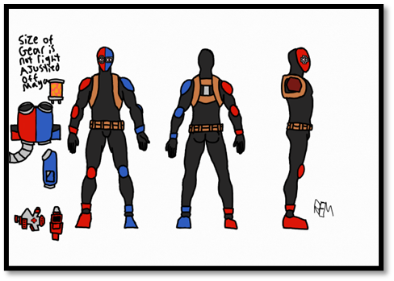
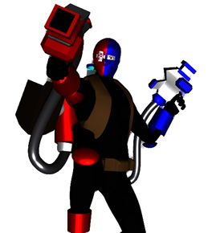
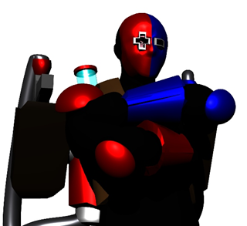
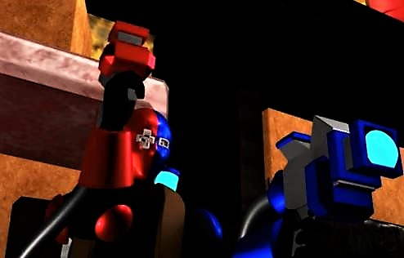
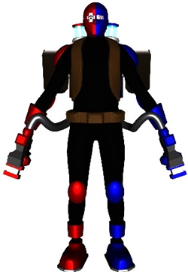
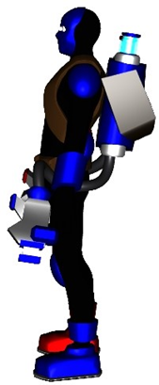
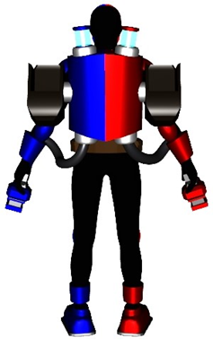
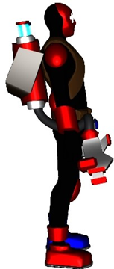
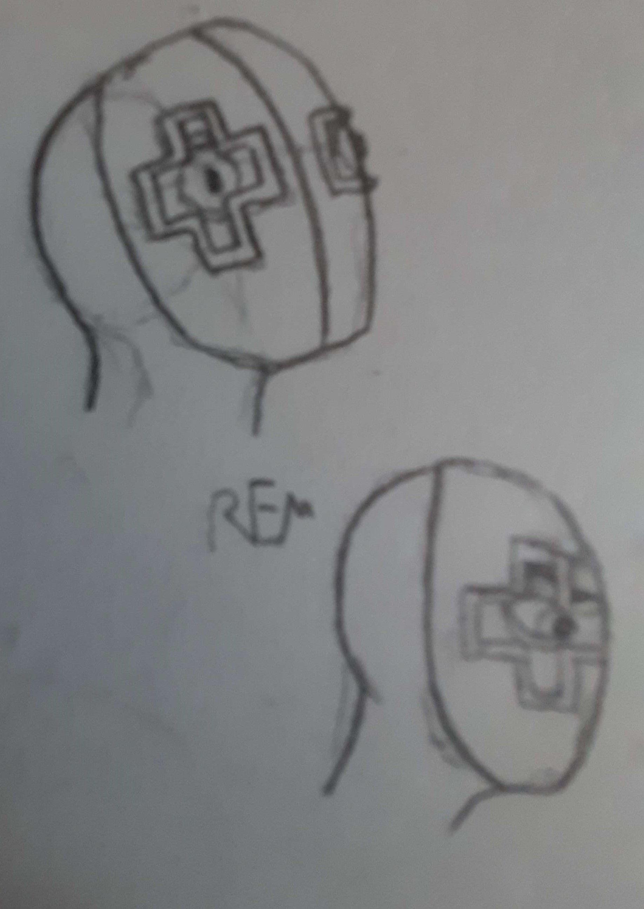
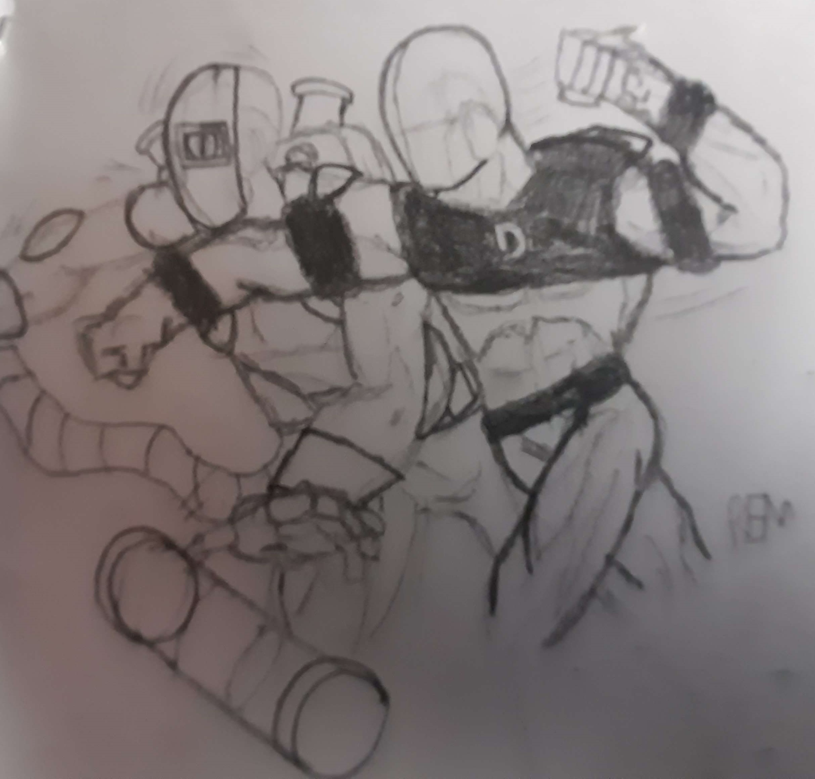
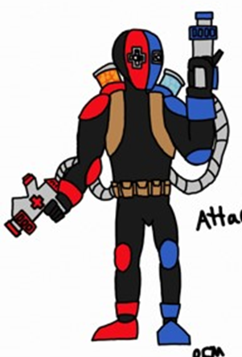
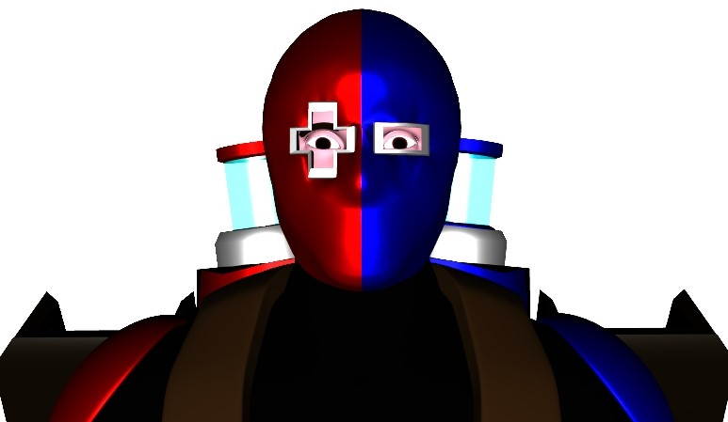
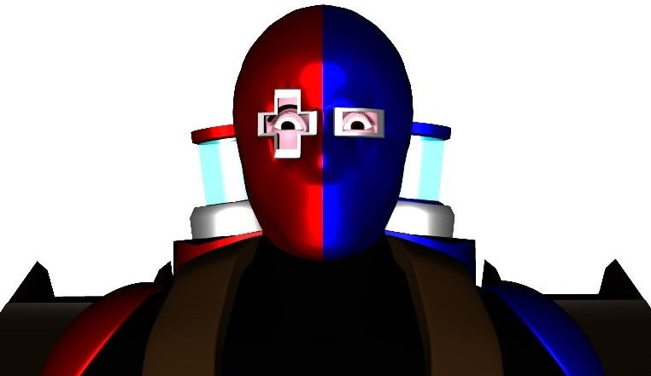
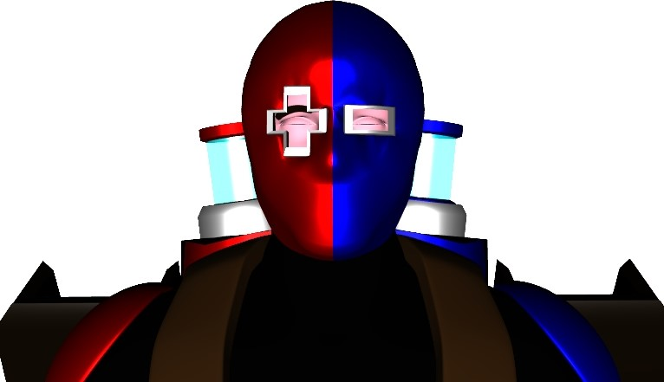

Slide 9
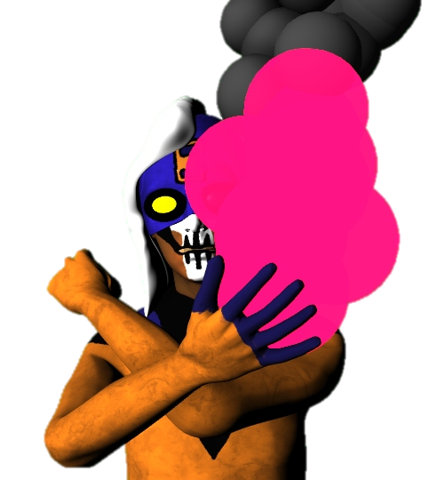
Woman
Not all the details of Veronica Cruz’s past are known by agencies like CIA and MI6. They know she was once a street orphan brought up in the back alleys of Mexico City. At the age of seven she was recruited by an illegal arms group, developing her to become their ultimate gun for hire. They know at some point she escaped, most likely killing the people who experimented and tortured her for years. However, even with what little is know about her life, one thing remains, she is a highly skilled and dangerous global mercenary whose tasks are completed to a rigorous professional standard not making her a lucrative living but eases the pain of her tortured soul.
Name: Veronica Cruz
Age: 20
Powers: Generate energy blasts from her body, altering this power in many different forms of projectiles: from rapid fire, shotguns, snipe, beams, She can also control the power of the delivery, from stun to disintegration. Use of the power requires more charging for higher levels. Expert fighting skill and a near inhuman agility due to years of her mercenary training since childhood.
Design: As with the character Density, the simple look is mean to be both eye-catching and easy to understand. The costume reflects that wore by the sliver age comic villains, with the iconic skull make up tying her back to her role as a gun for hire. This combined with her ‘punk’ hair style, gives the character a more aggressive look.
Animation Information: Unlike the others Blaster Woman is precisely trained for every real combat scenario. She fights with great skill and if hit is very quick to recover and immediately retaliate. Her abilities make her a ‘run and gun combatant’, e.g.: back flipping off walls while keeping her foe pinned down with her own cover fire. Her hand-to-hand combat is vastly better than the other two characters with more agility incorporating round house kicks and her specialty of a rising kick after an uppercut.
Her training has given her a laser like focus on the mission and she is not afraid to hurt anyone who gets in her way. However, she is prone to frustration and rage, leaving her to at times act sloppily which is out of character. She is also struggling to find her place in the world and how to live now that she is free for the first time in her life.
Blaster

Slide 10
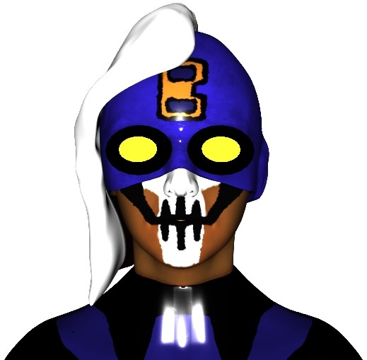
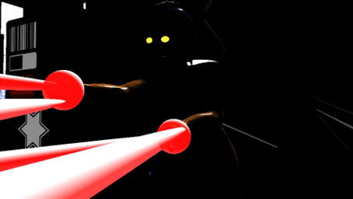
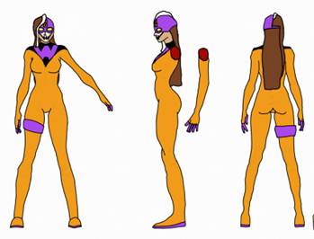
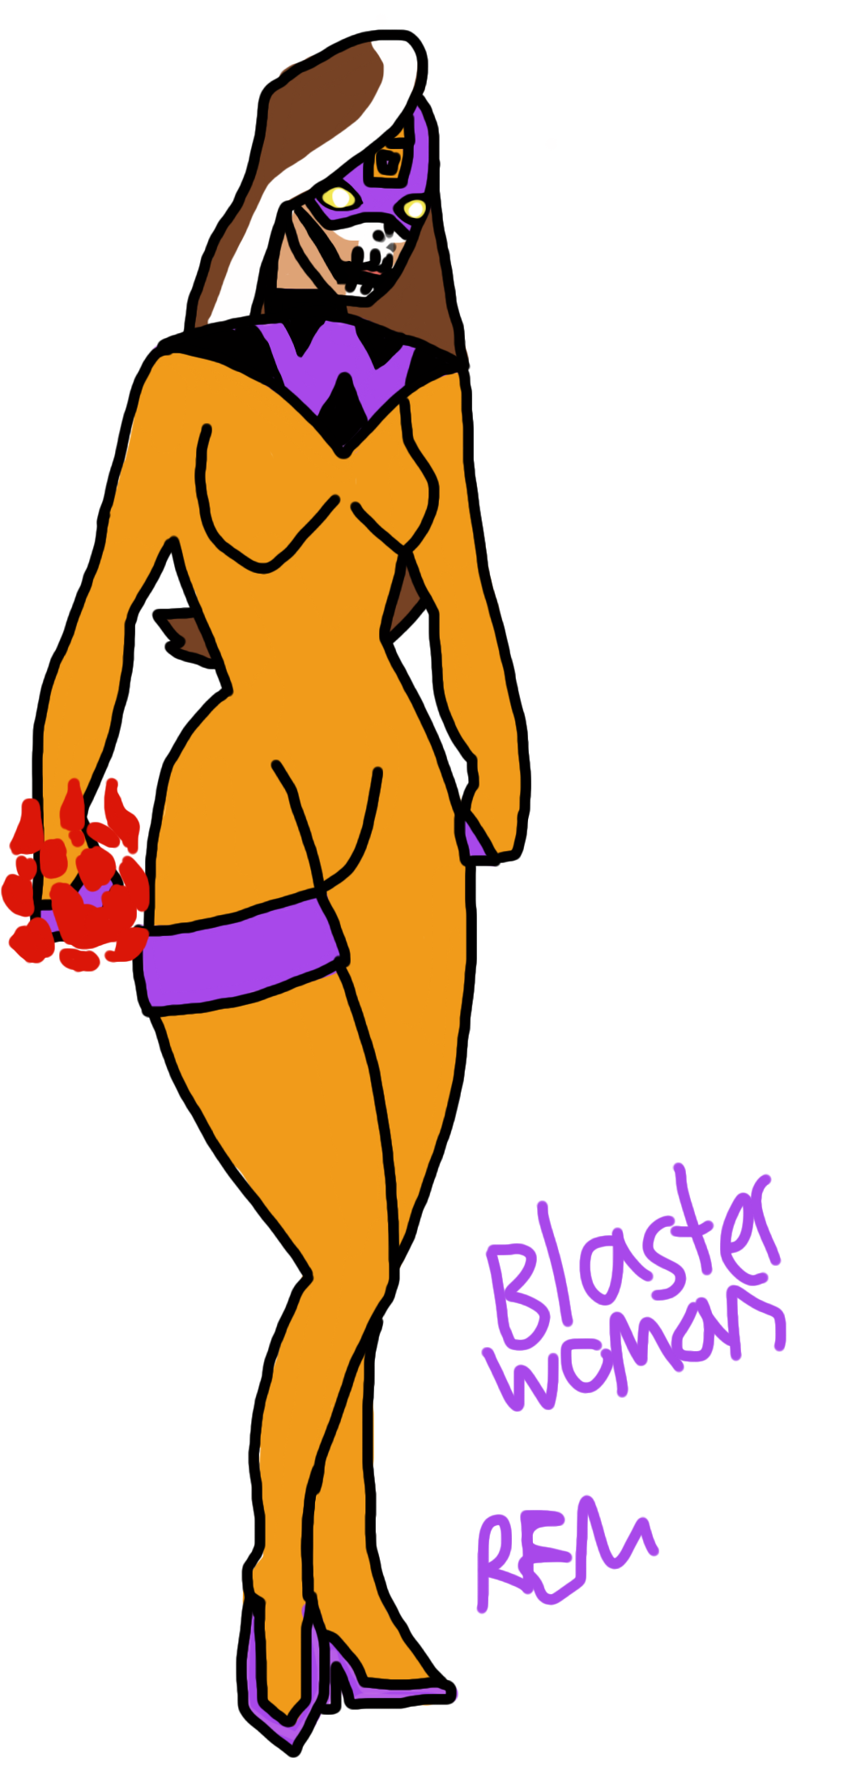
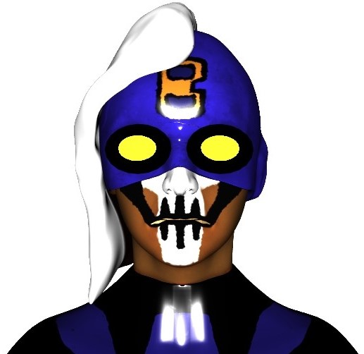
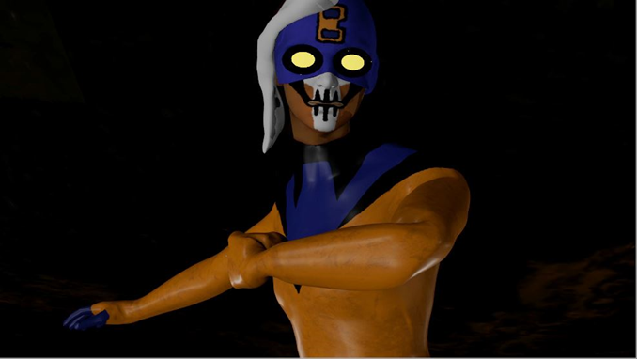
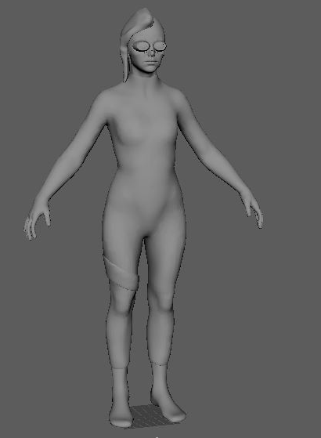
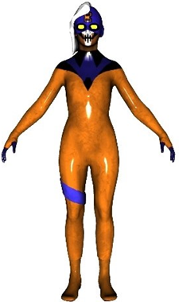
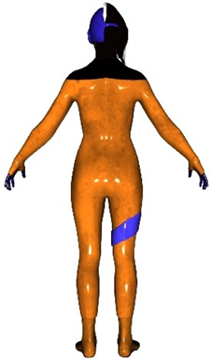
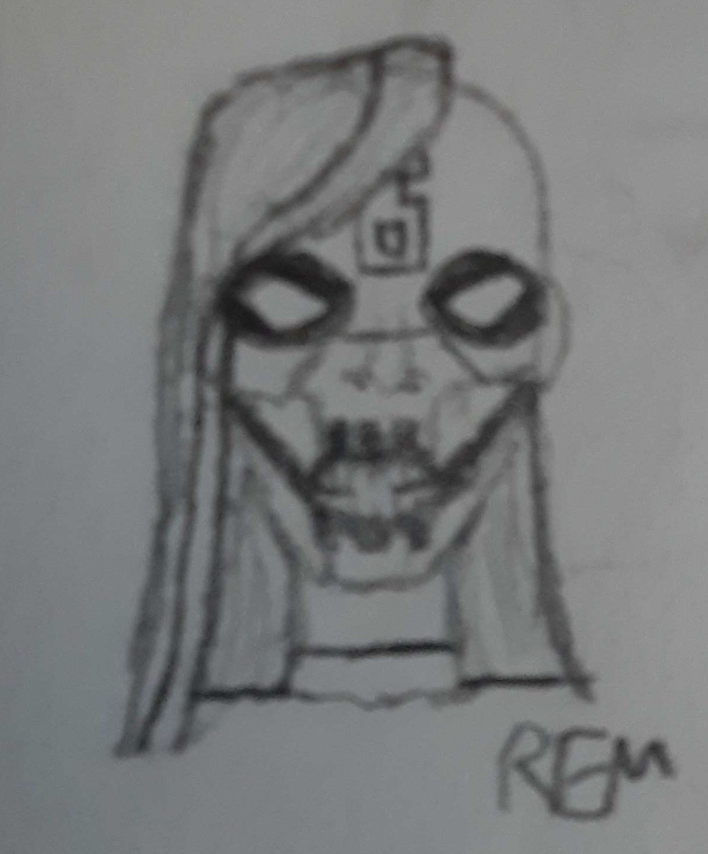
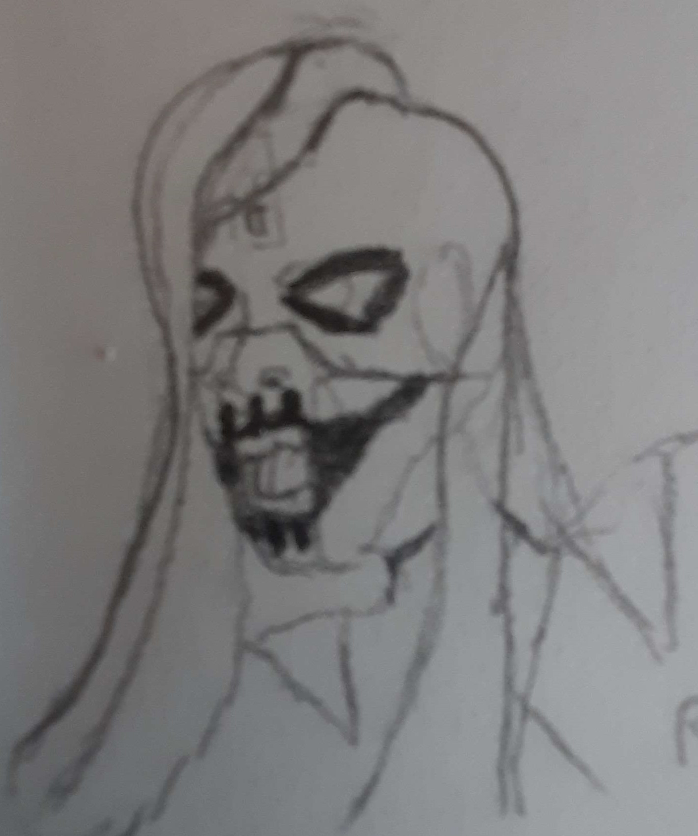
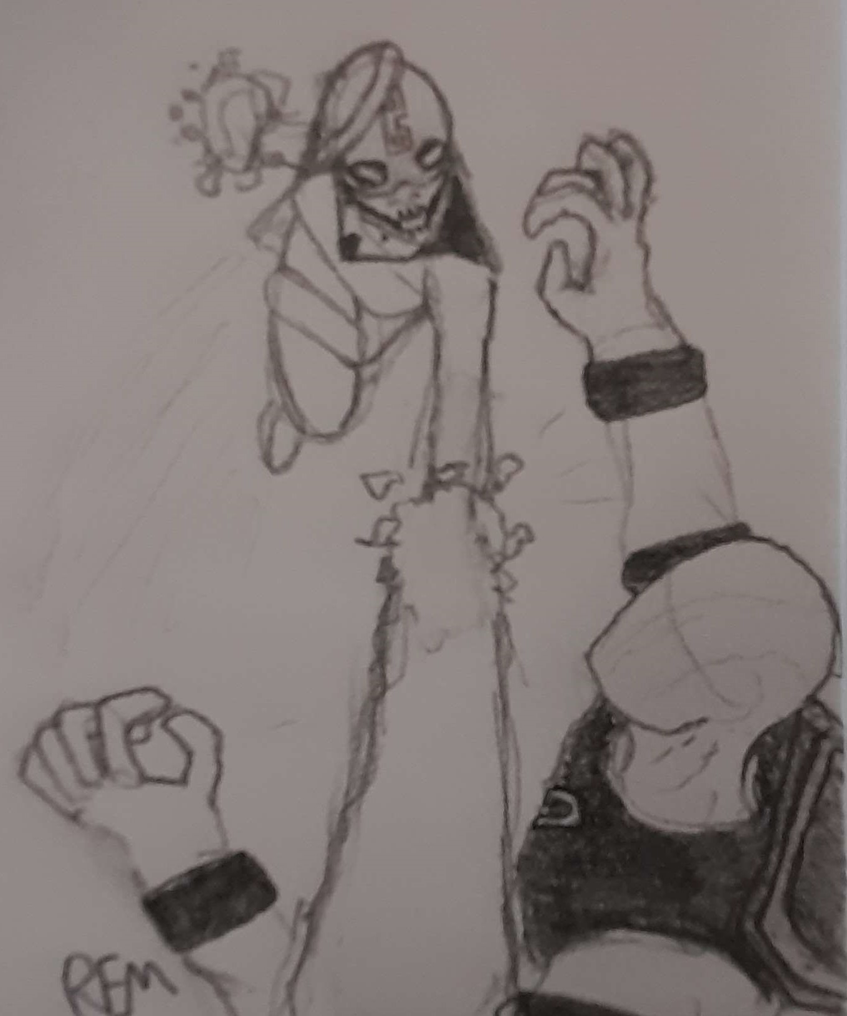

Slide 11
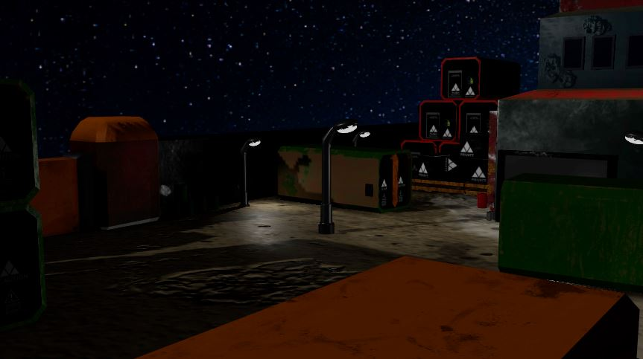
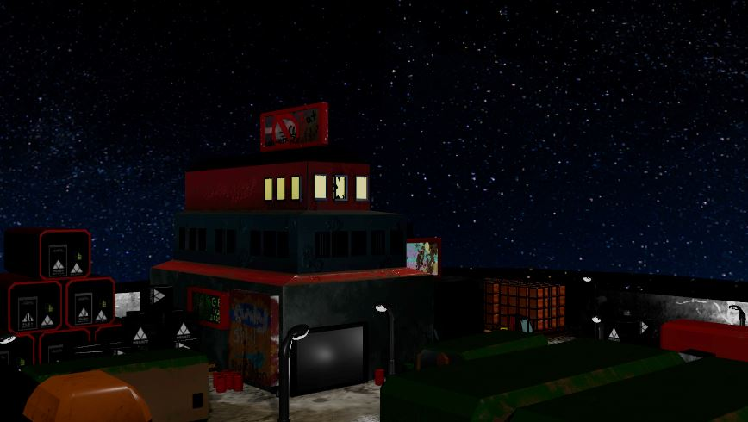
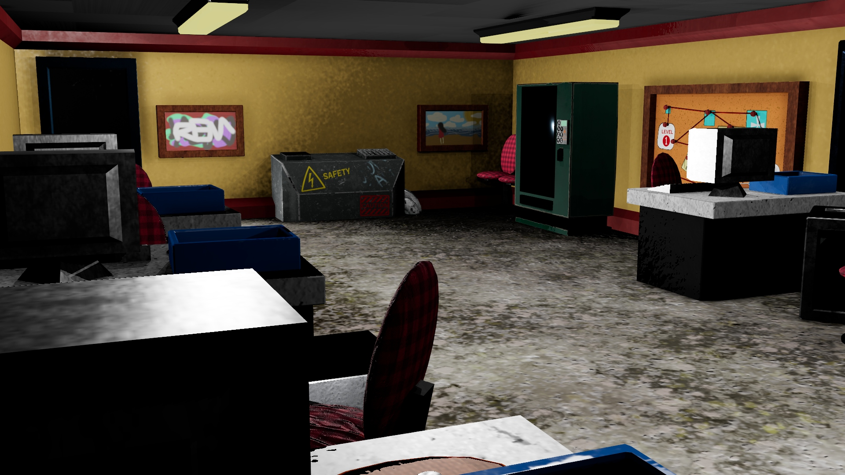
Warehouse 964
A warehouse is one of the may locations Density will encounter in his career as a crime fighter. WH 964 is the one that stars in this animation. Located on the outlying desert near the city, both the outside and the inside storage area is displayed as a badly lit rough working environment, with machinery and storage units covered in dirt, oil and flaking paint. In contrast the second floor containing the offices is brightly lit, clean and better organized with rows of desks, computers and good decor. It still maintains its locations DNA in that it has an exposed power generator in the room and concreter floors. The warehouses storage unit contains a great number of places to hide and objects that the characters can use in their fight.

Slide 12
Environmental Assets

Slide 13
Show Case
YouTube Link to the DENSITY ANIMATION EP1 : https://www.youtube.com/watch?v=NjIYeRiDf1o

Slide 14
D

