Slide 1
Semester 1 - IxD301

Slide 2
My portfolio site…

Slide 3
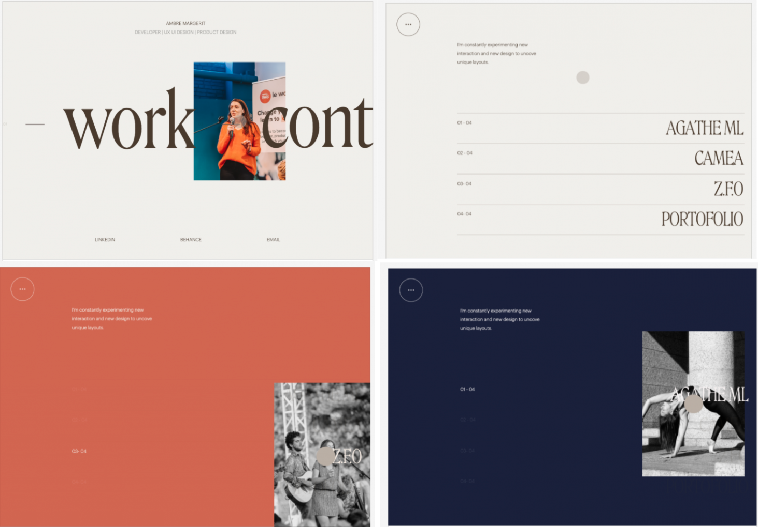
Sources of Inspiration…

Slide 4
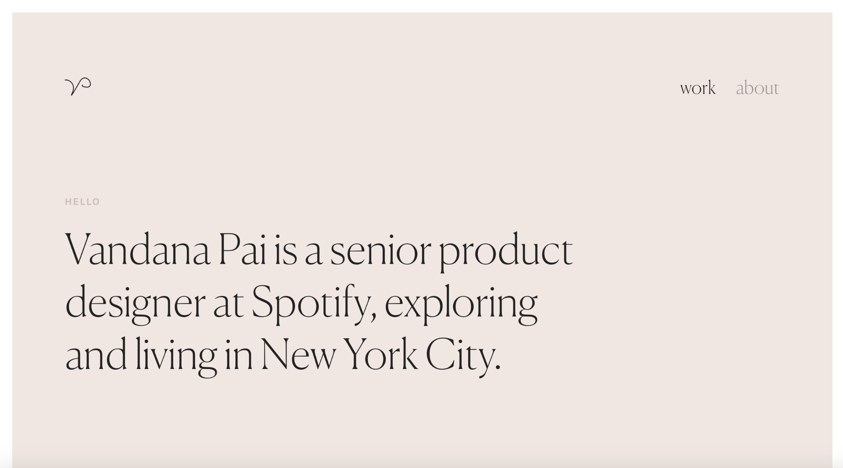
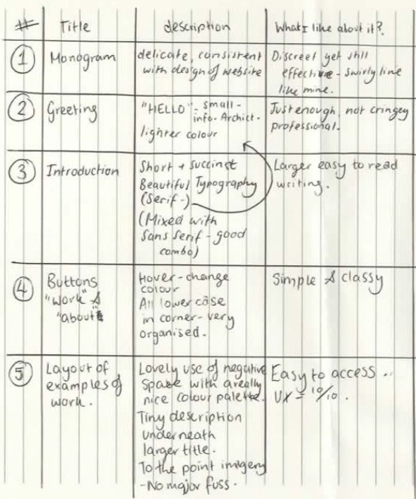
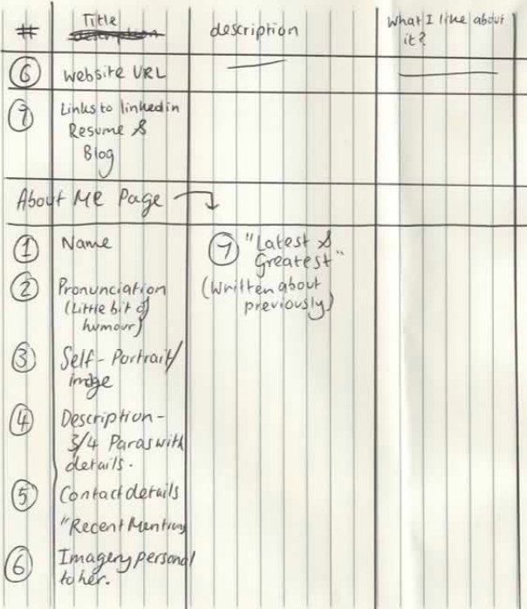
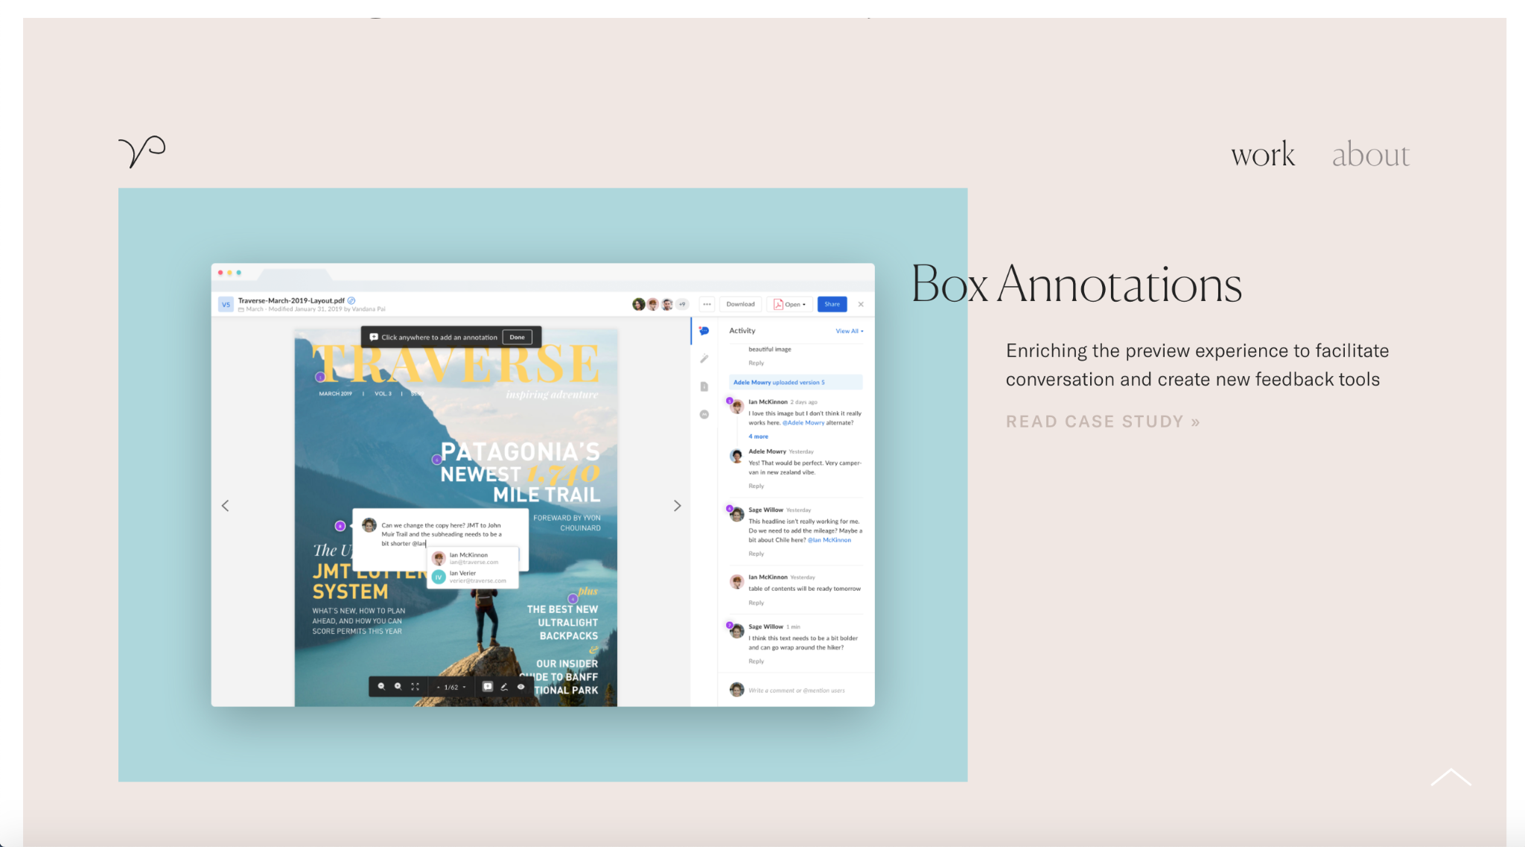
Content Audit

Slide 5
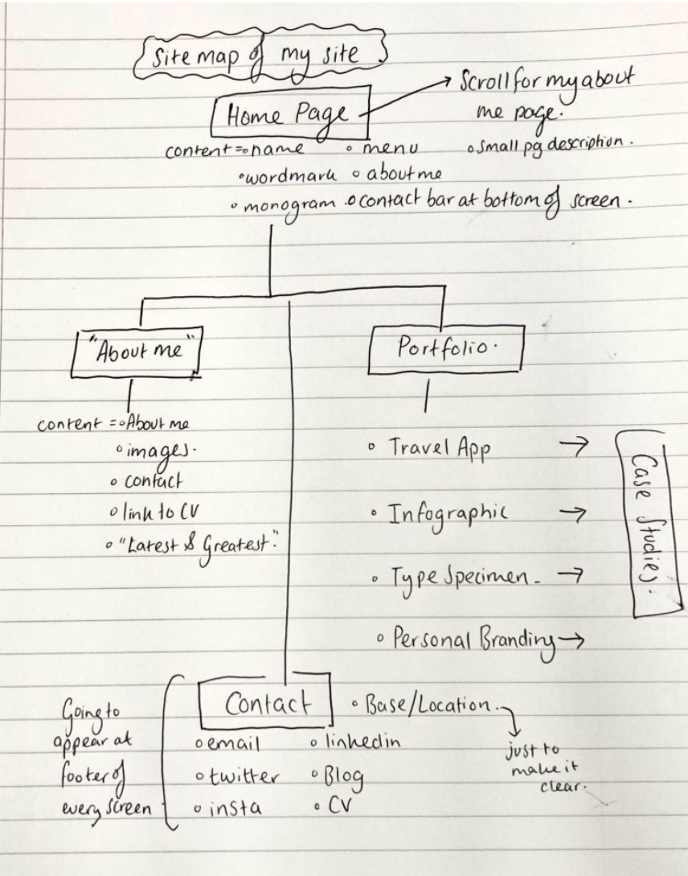
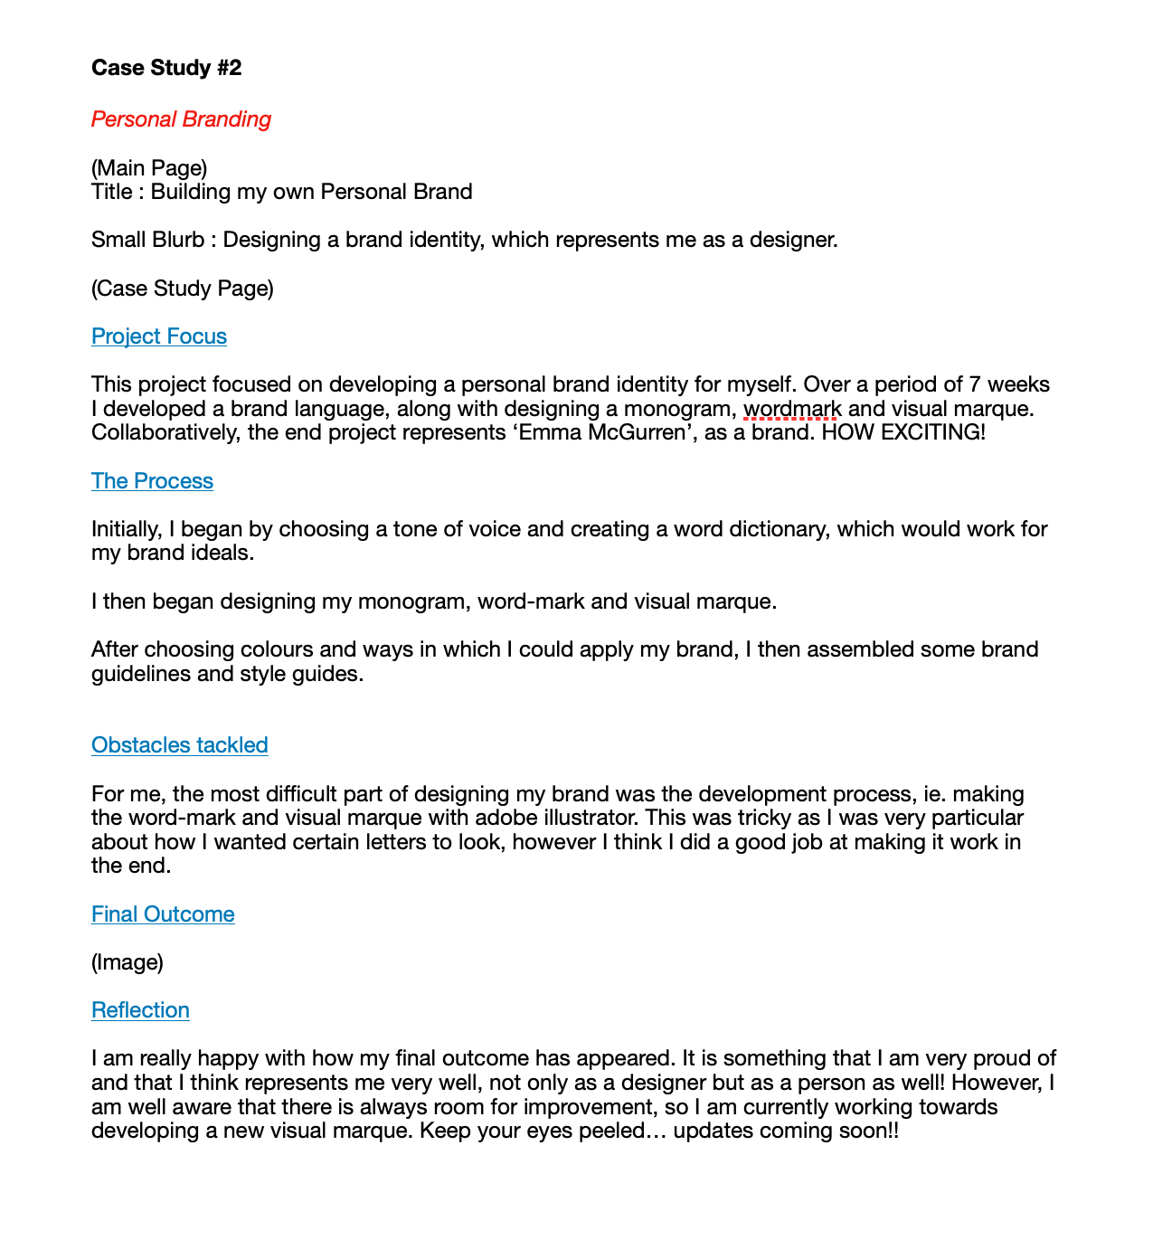
Curating my content…

Slide 6
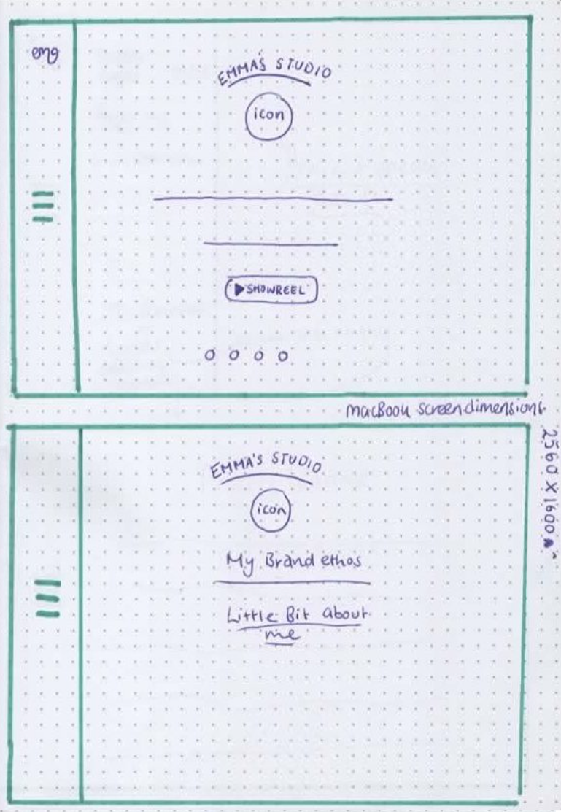
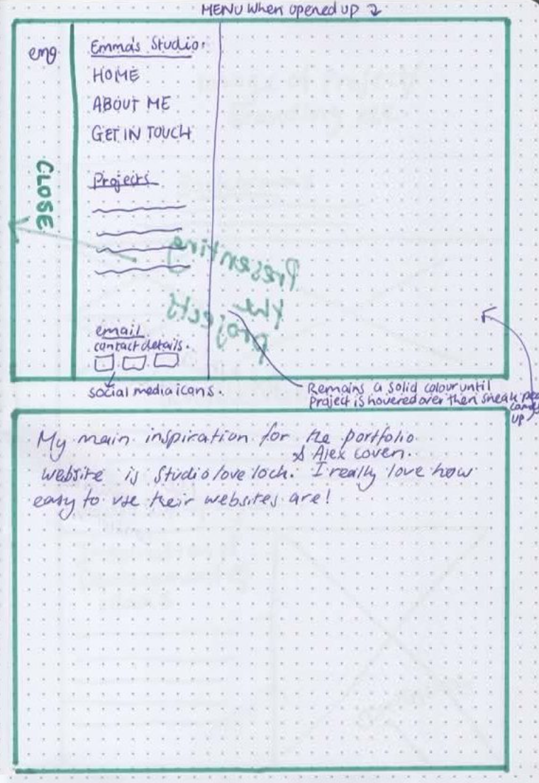
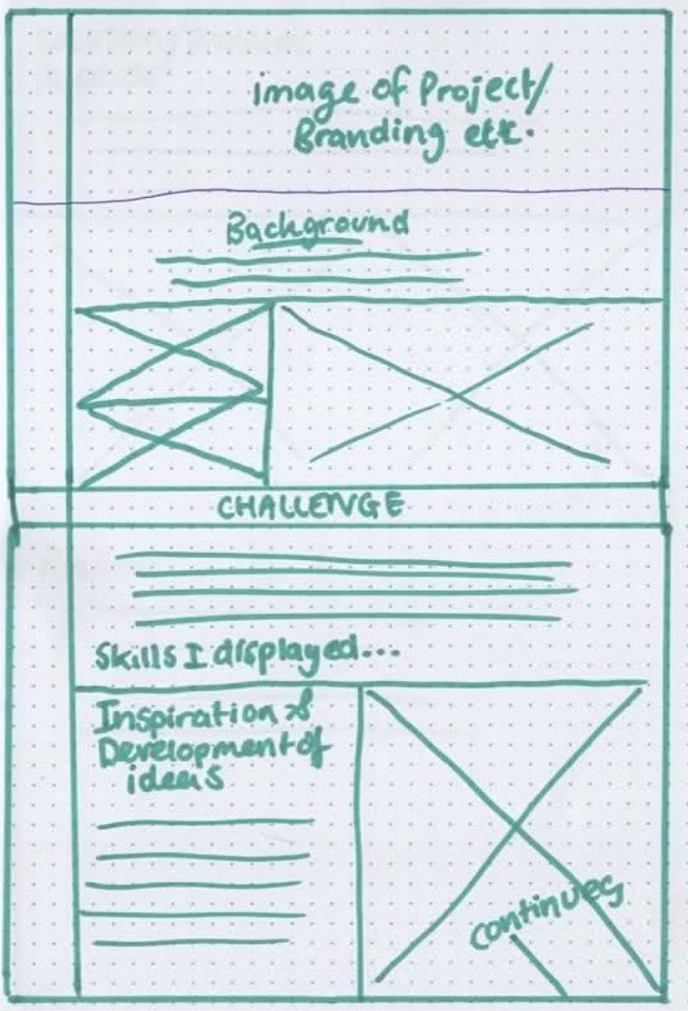
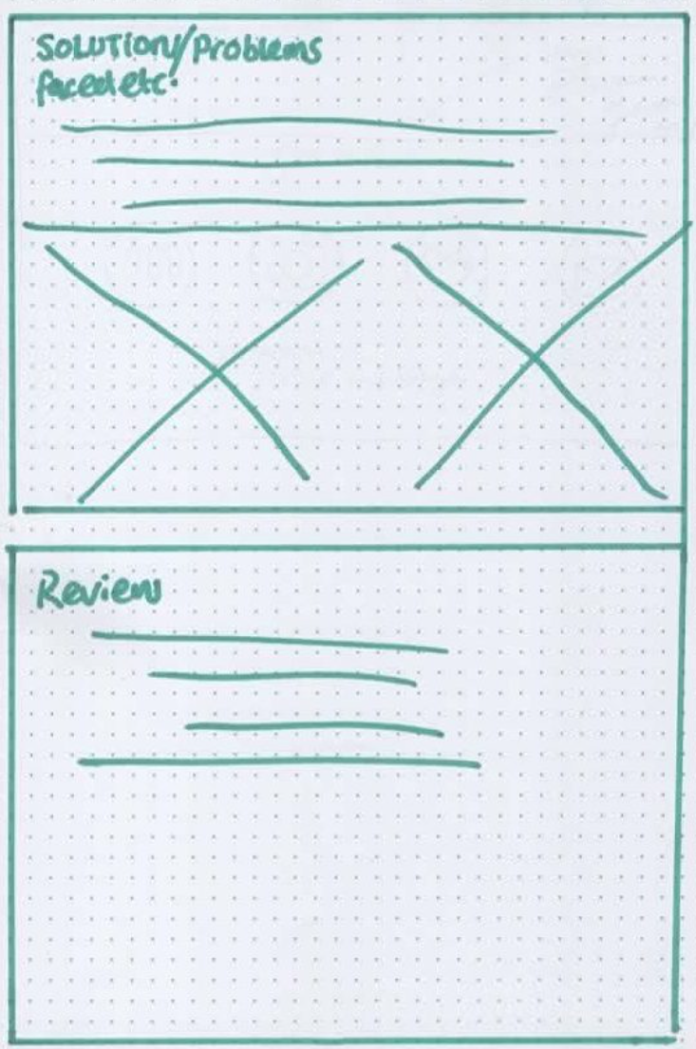
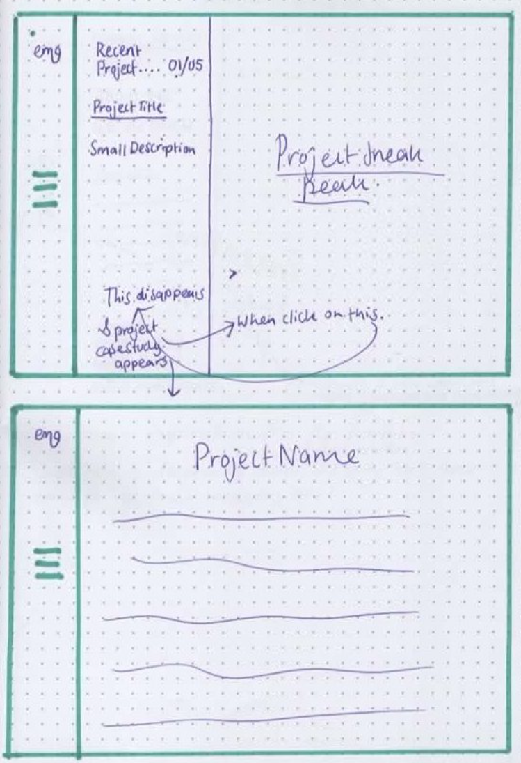
Putting pen to paper…

Slide 7
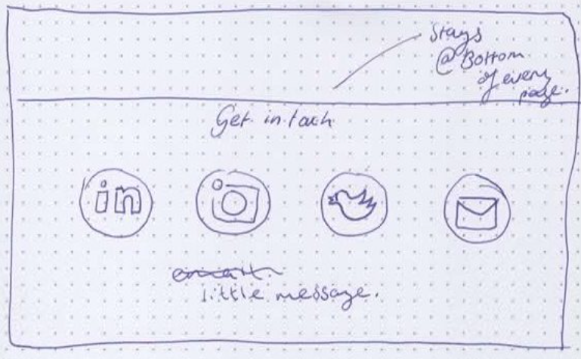
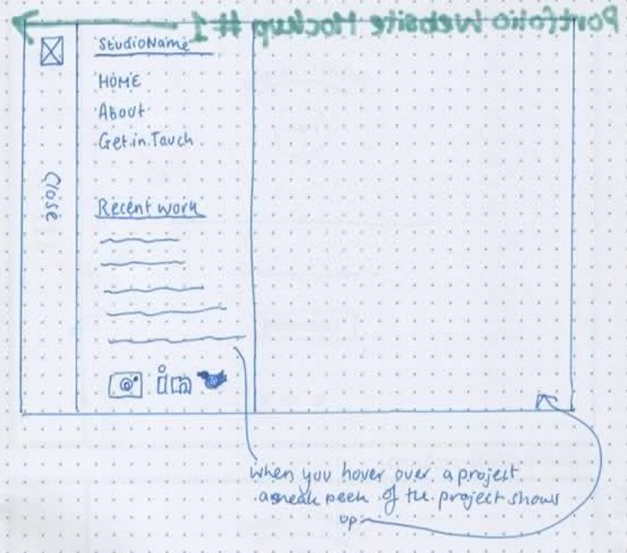

Slide 8
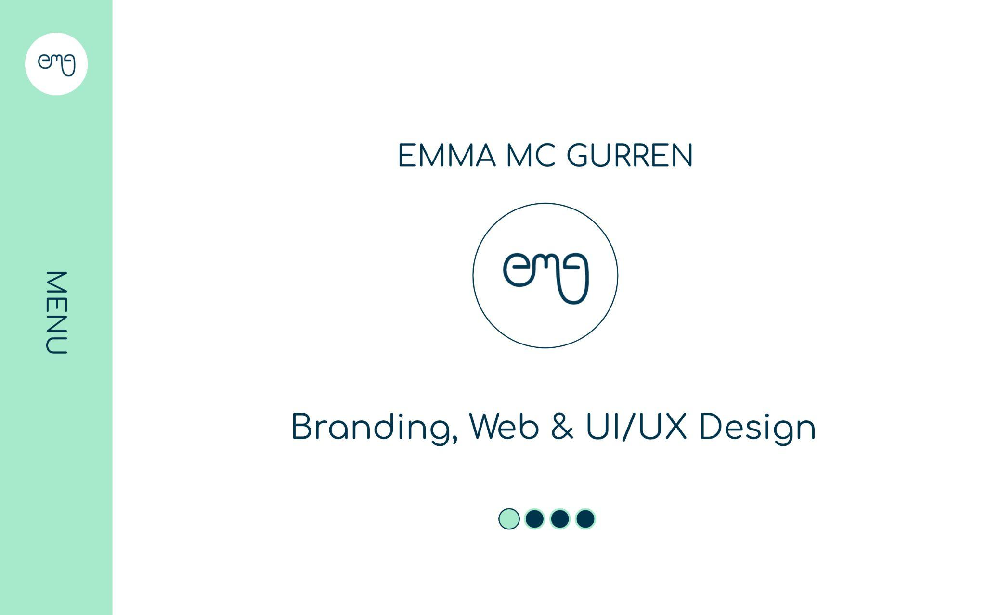
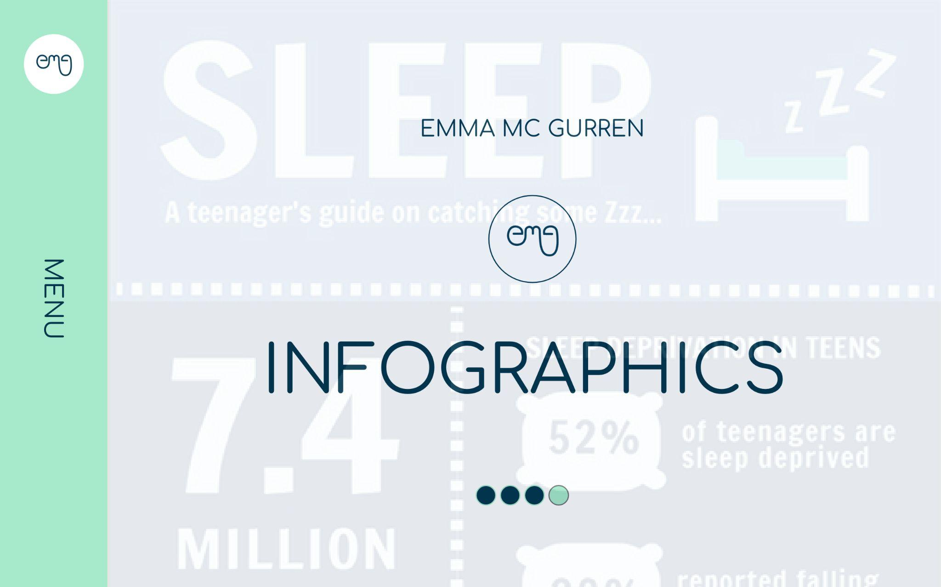
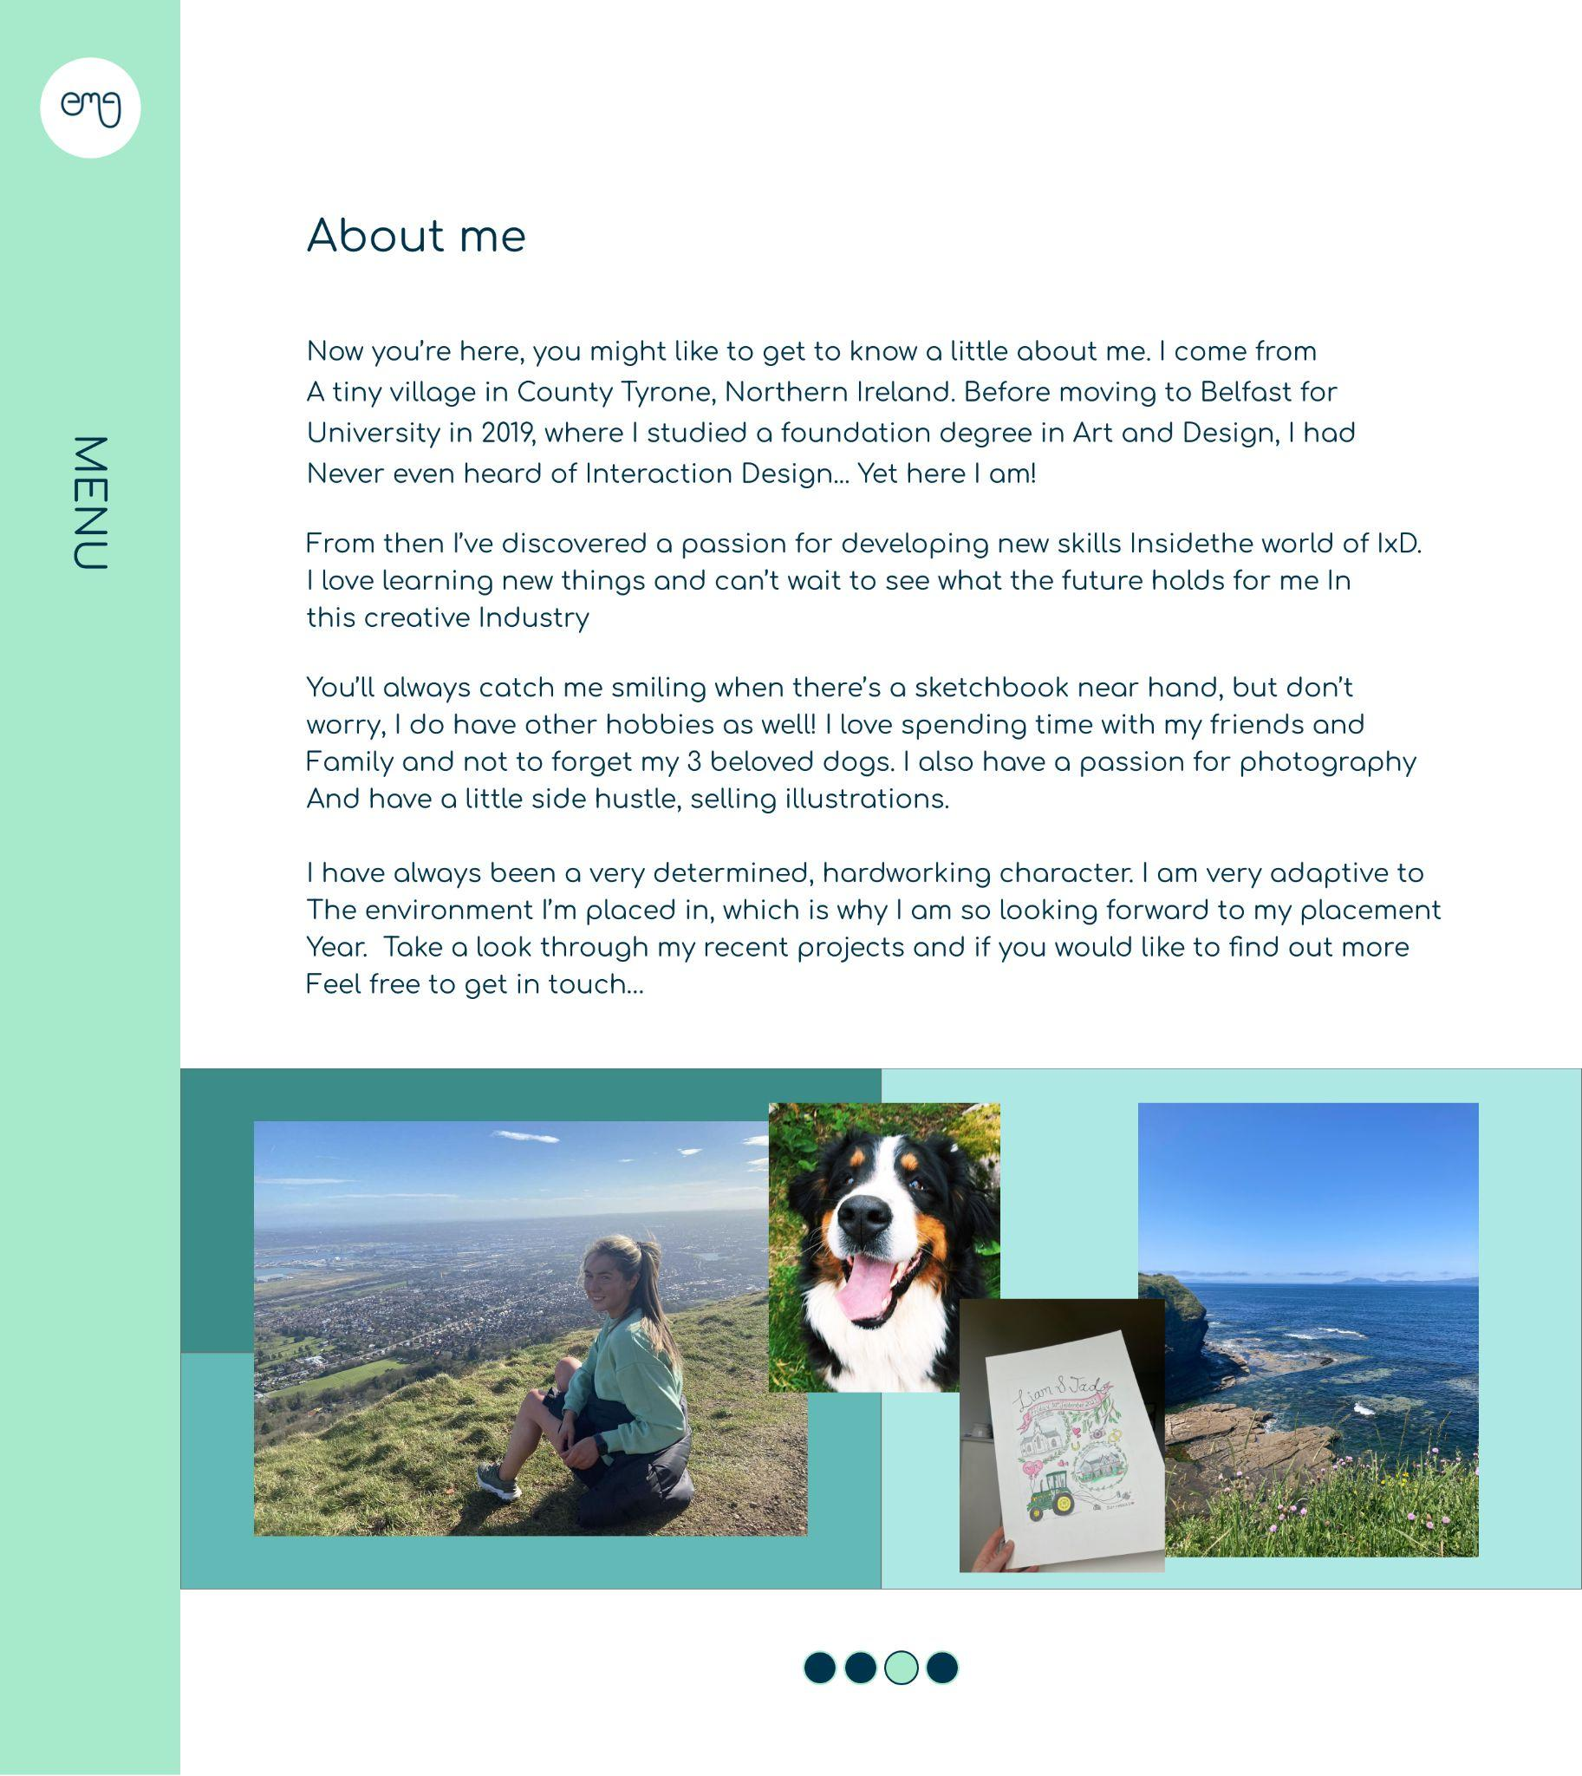
High Resolution Mockups

Slide 9
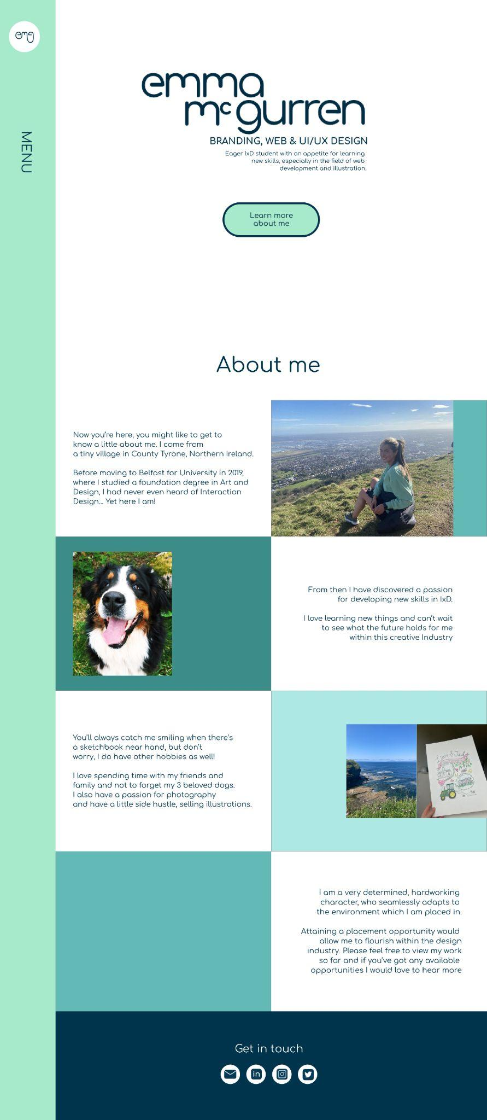
High Resolution Mockups - Round 2

Slide 10
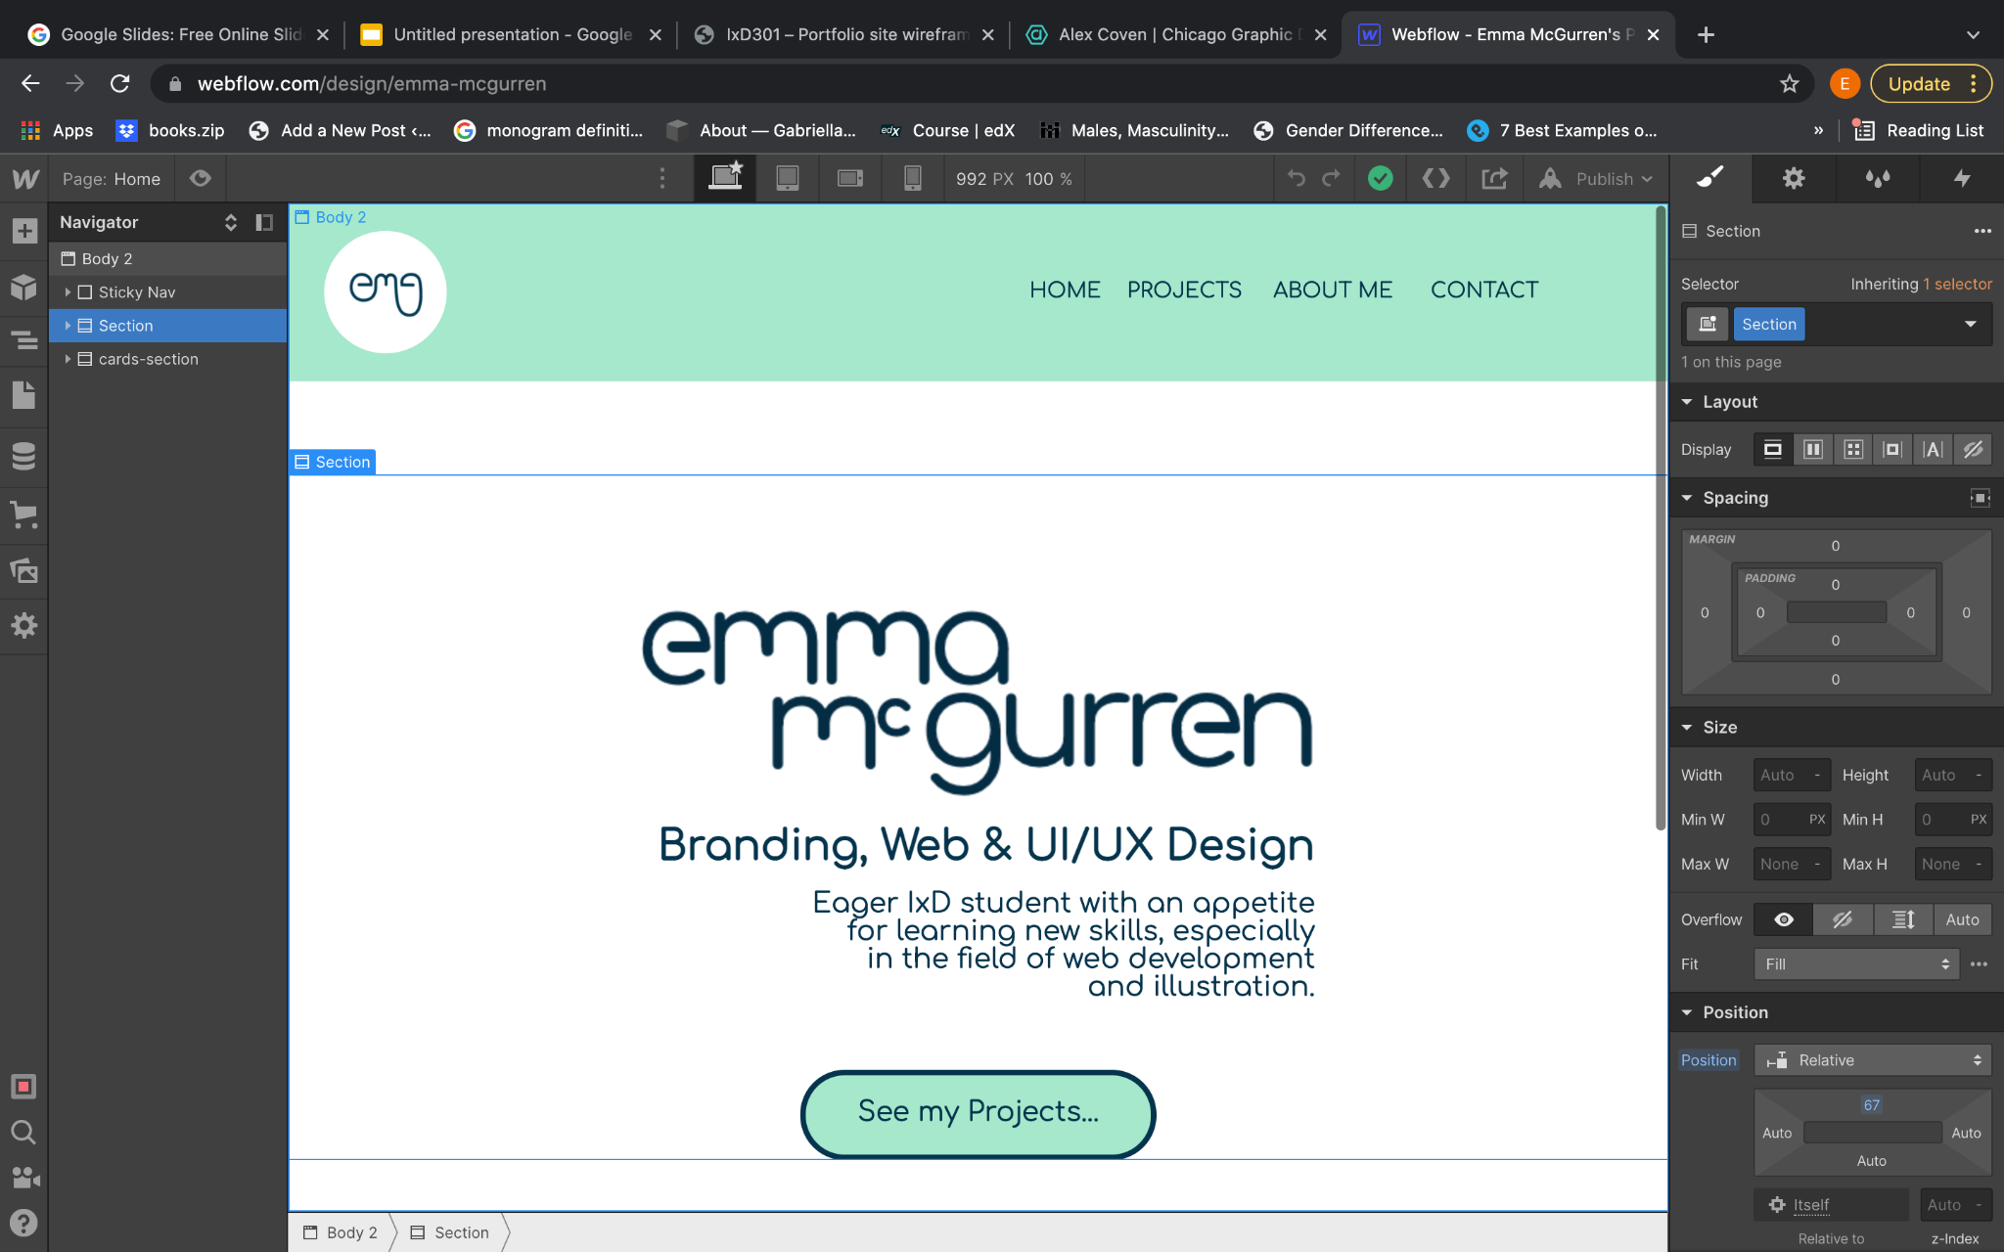
Getting familiar with Webflow…

Slide 11
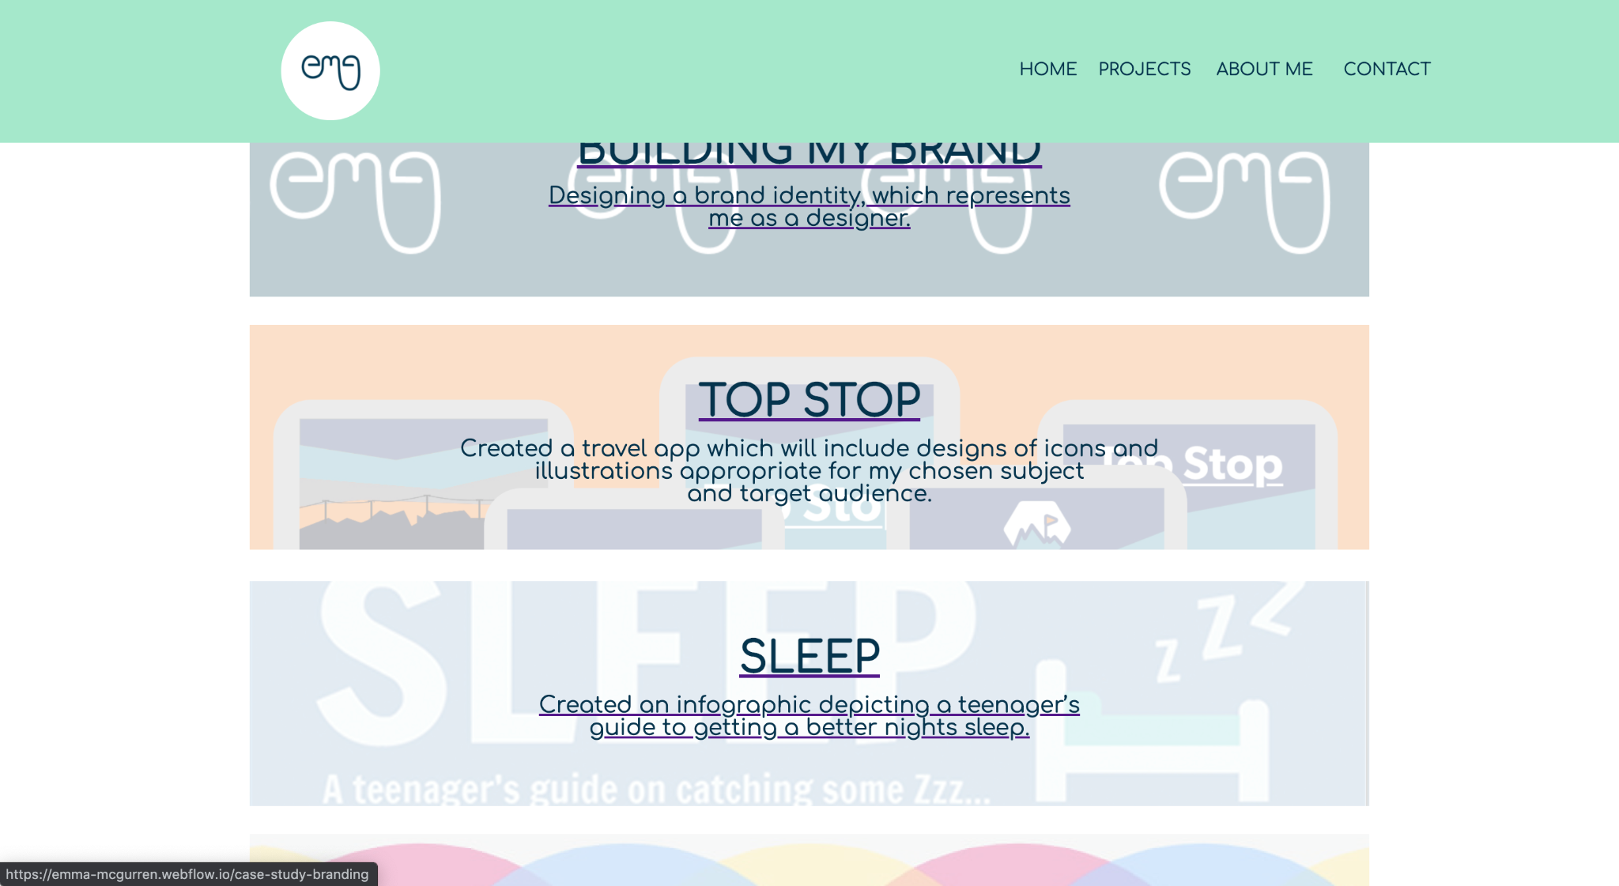
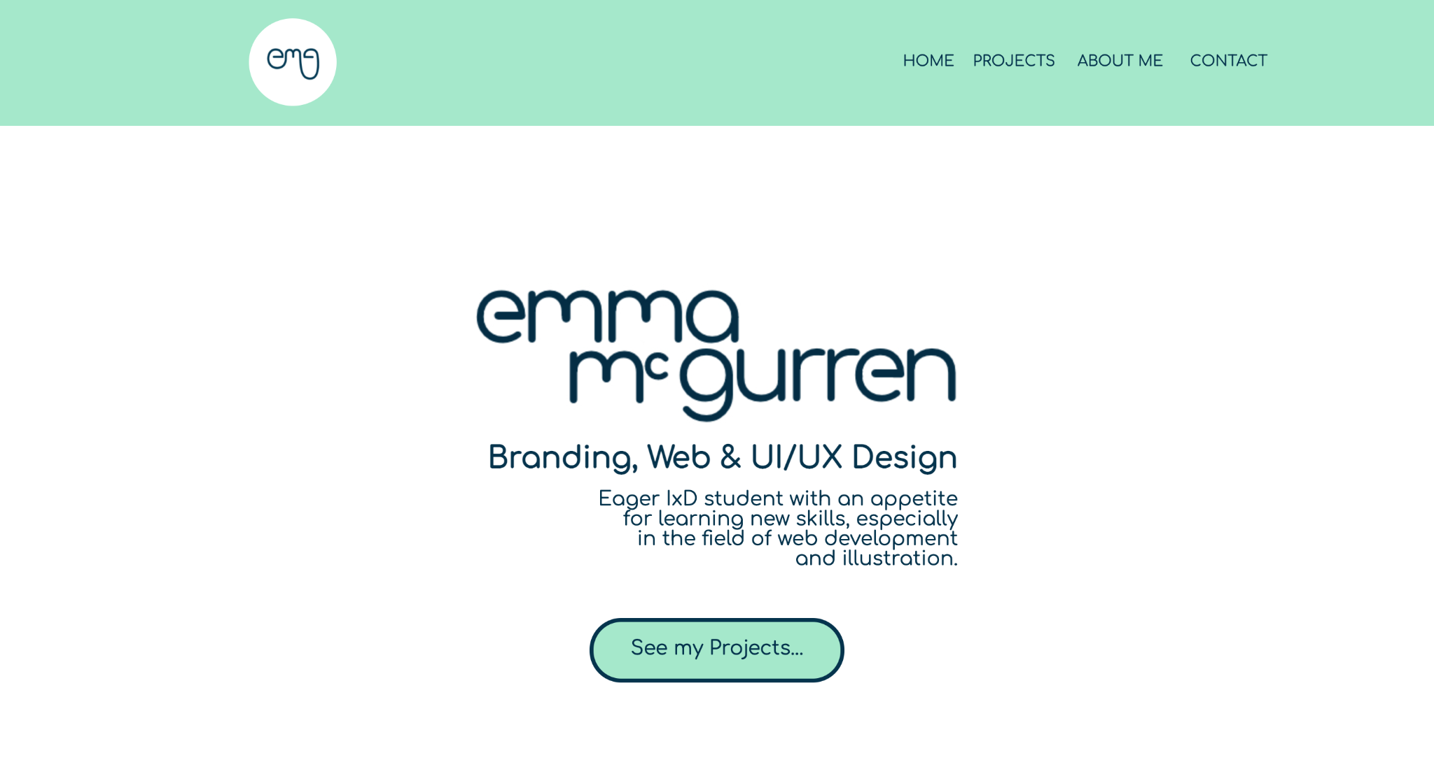
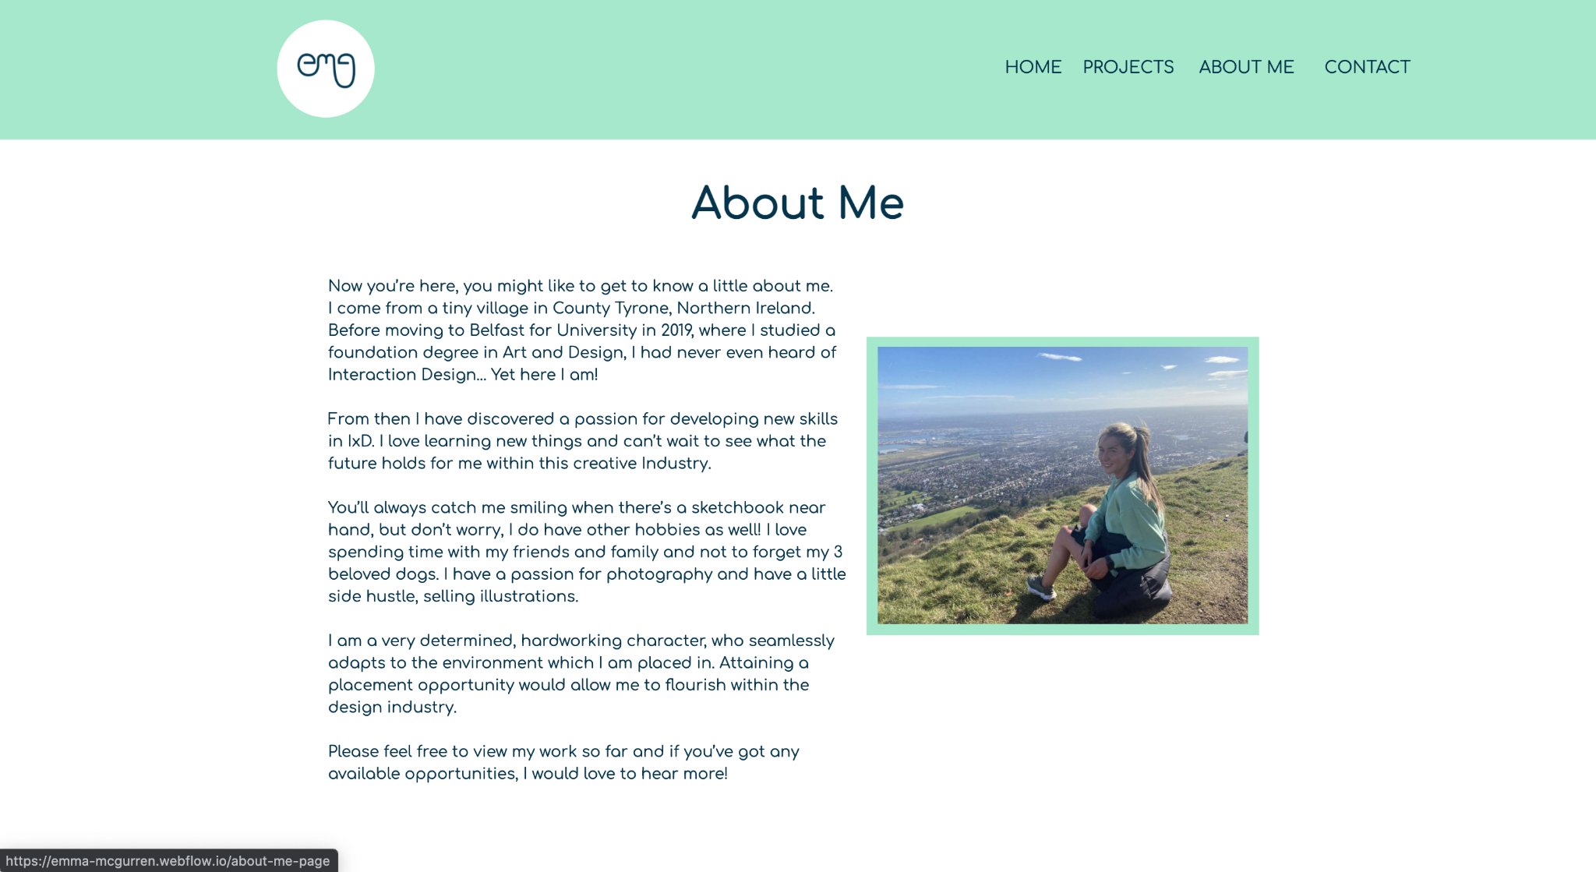
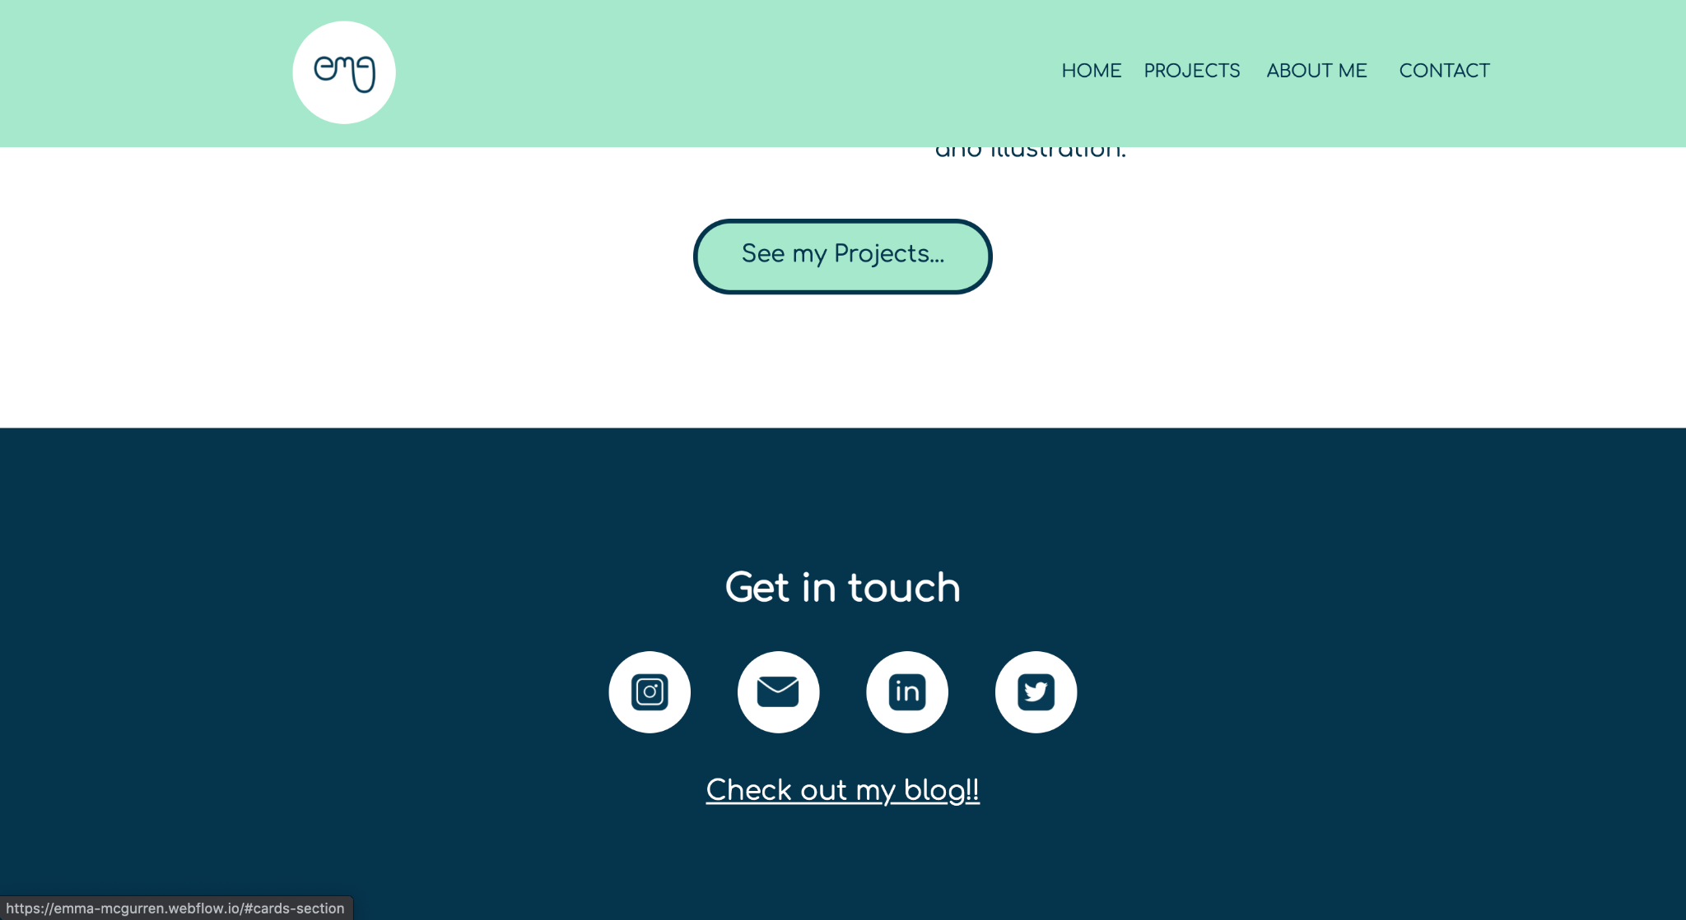
My site so far…

Slide 15
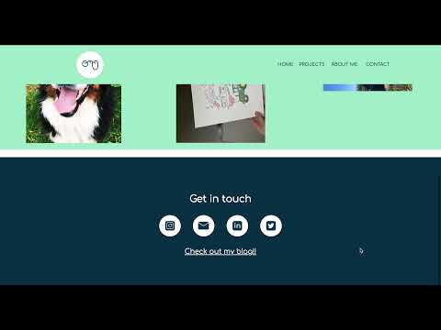
https://youtu.be/aDHA7K3opS4

Slide 16
Portfolio site reflection…
I am really happy with how my portfolio turned out. There are some minor adjustments that I need to adjust. I am excited to keep broadening my site, through adding ongoing projects.
I am really loving using WebFlow and feel that it was a great way for me to build my confidence.
I just need to work on my approach to responsive design, which I am going to work on over the christmas break.

Slide 17
The Elements Project…

Slide 18
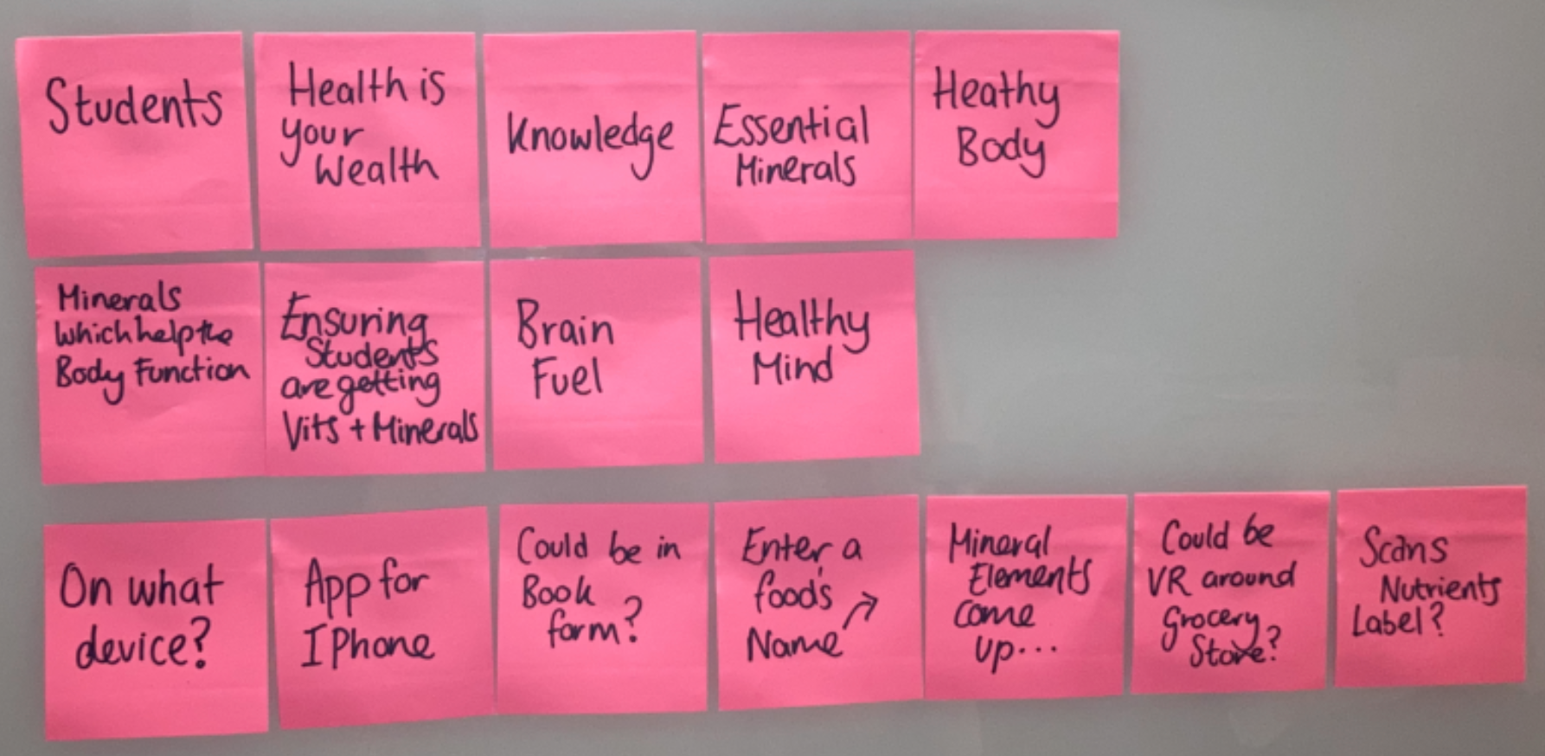
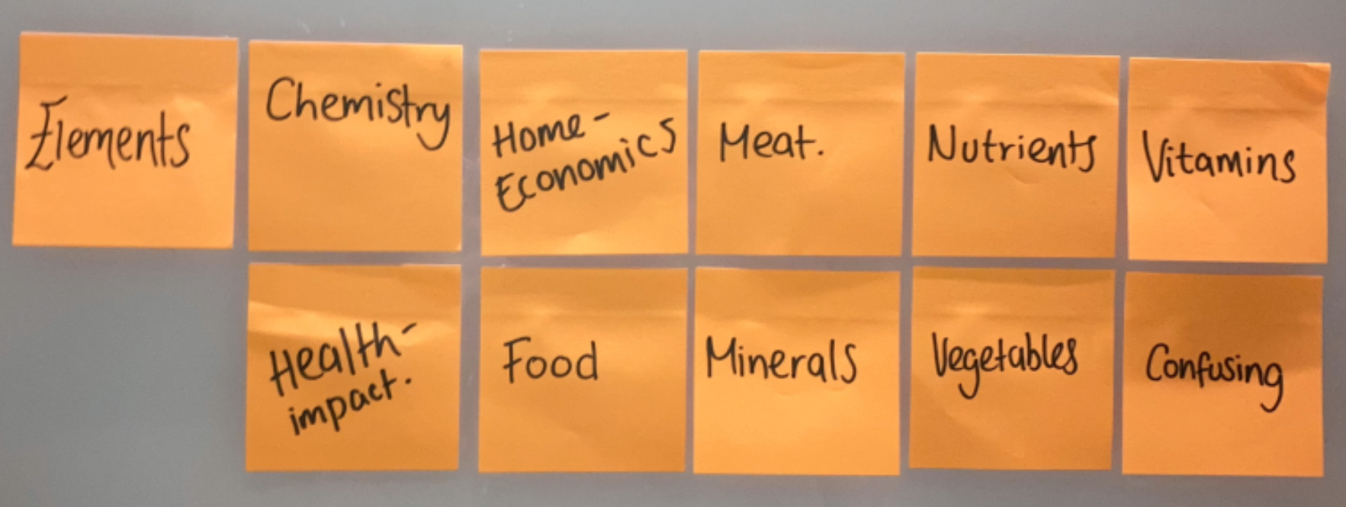
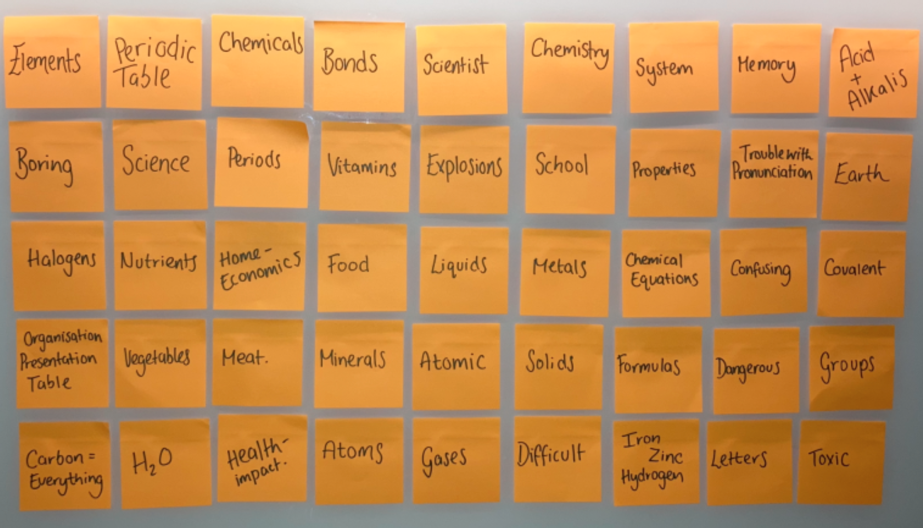
Idea Generation…

Slide 19
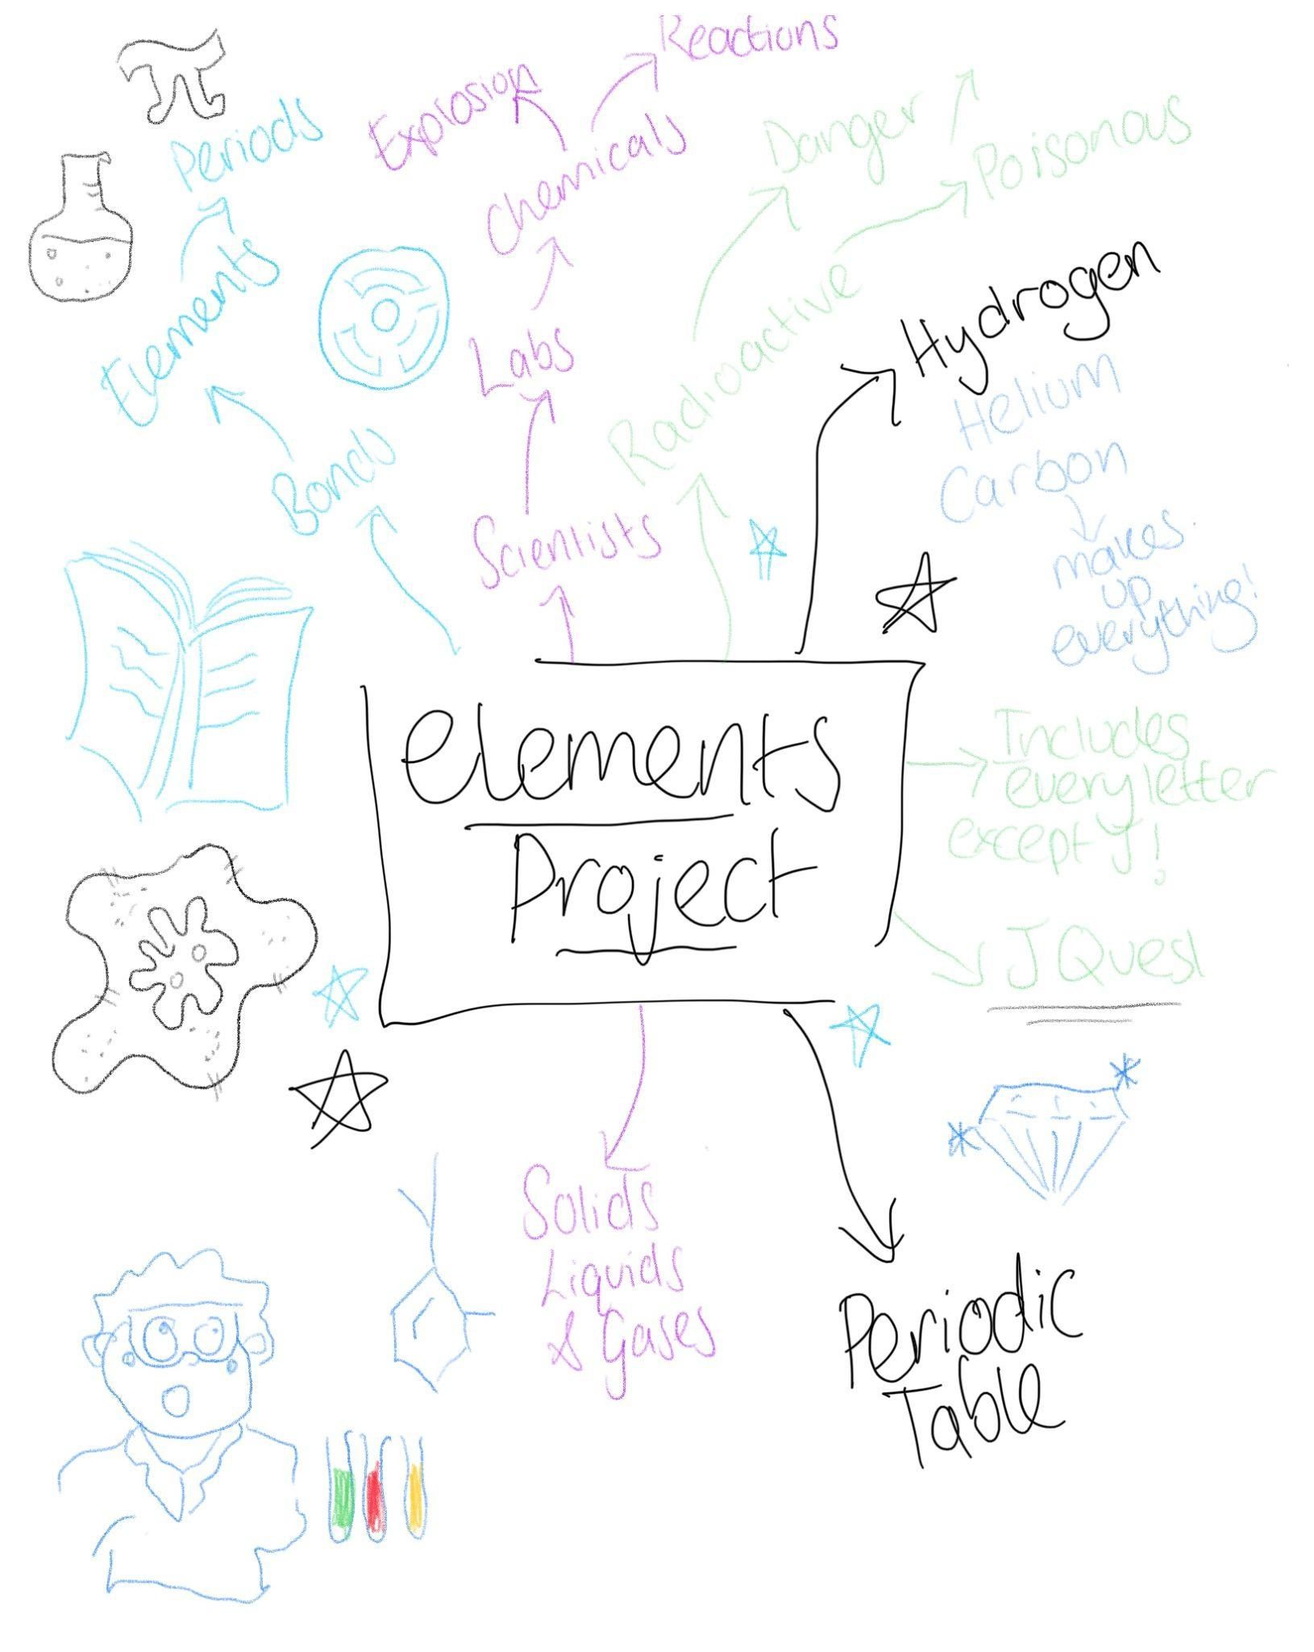
Idea Generation…

Slide 20
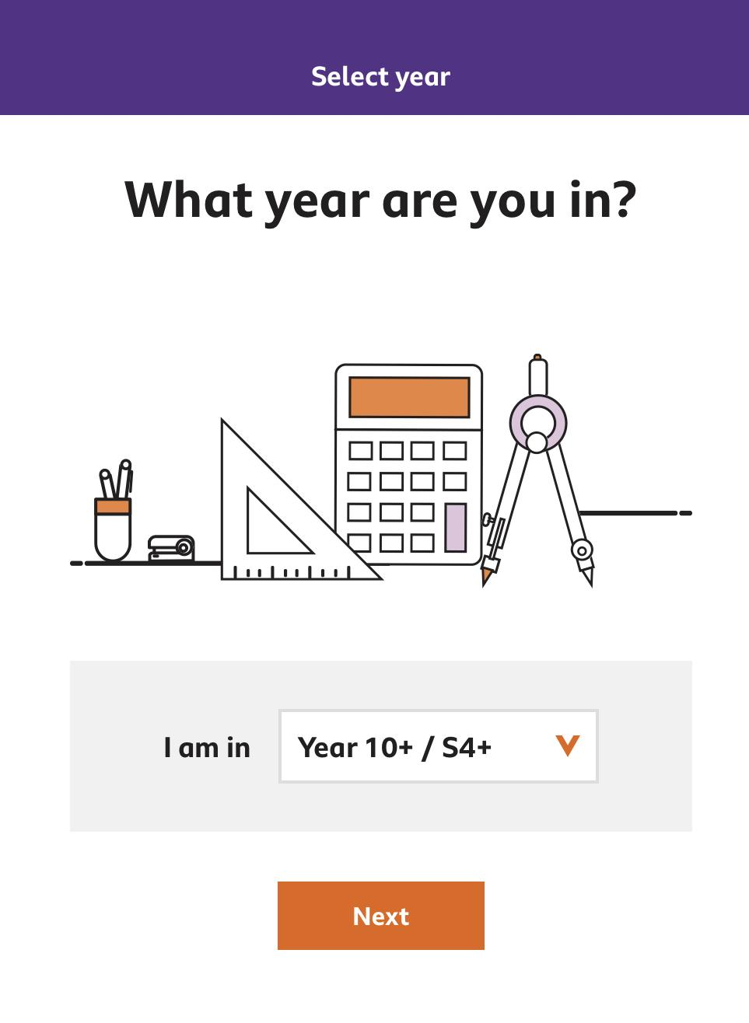
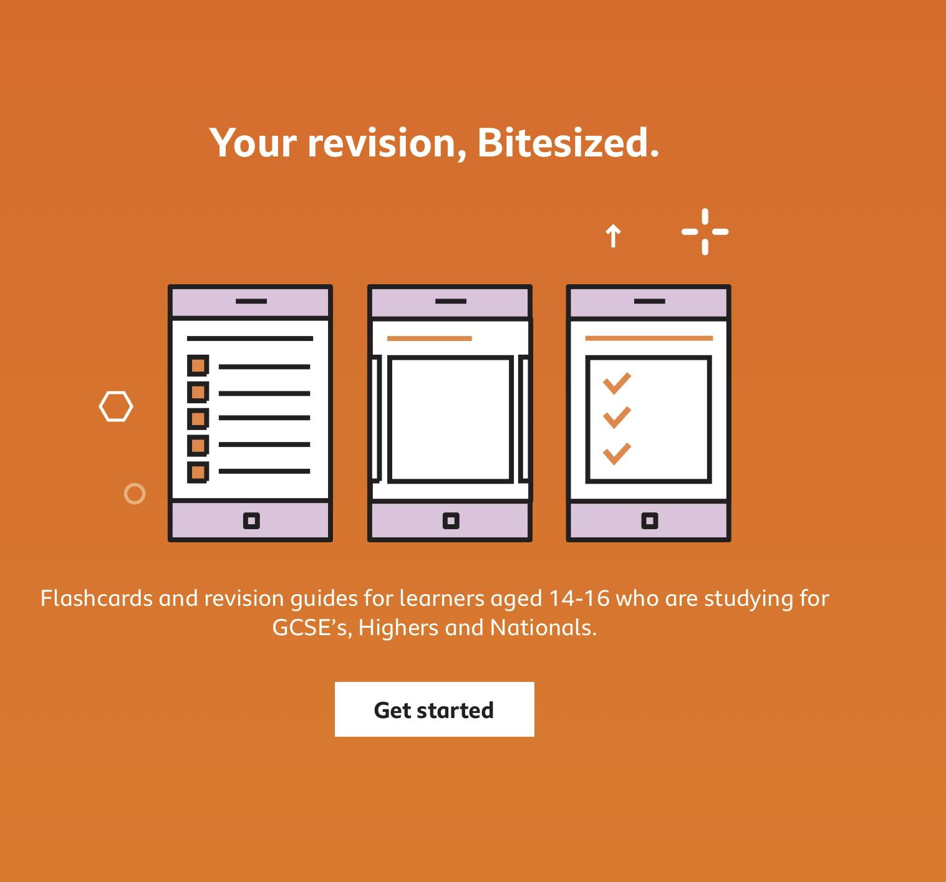
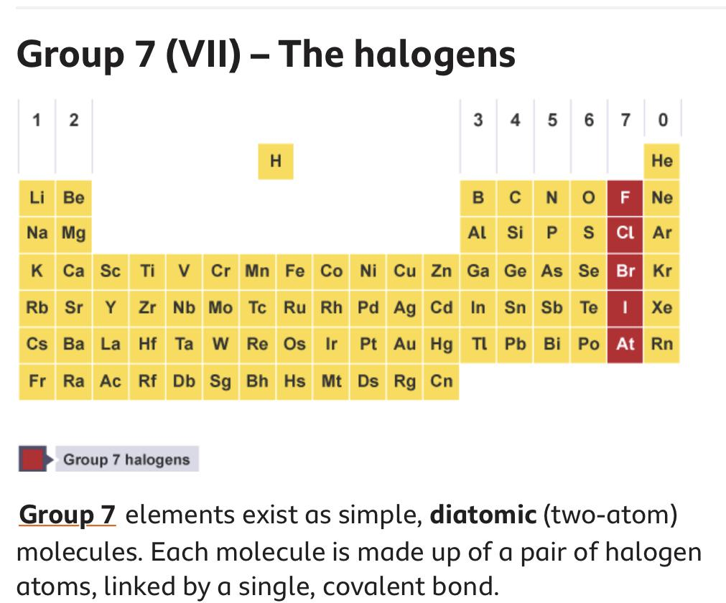
Inspiration…

Slide 21
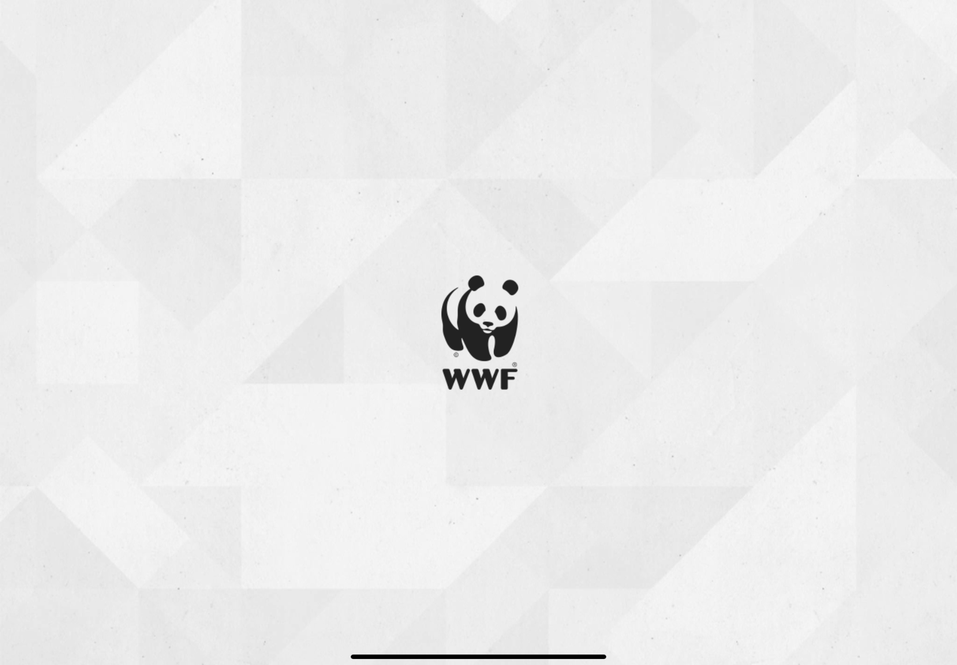
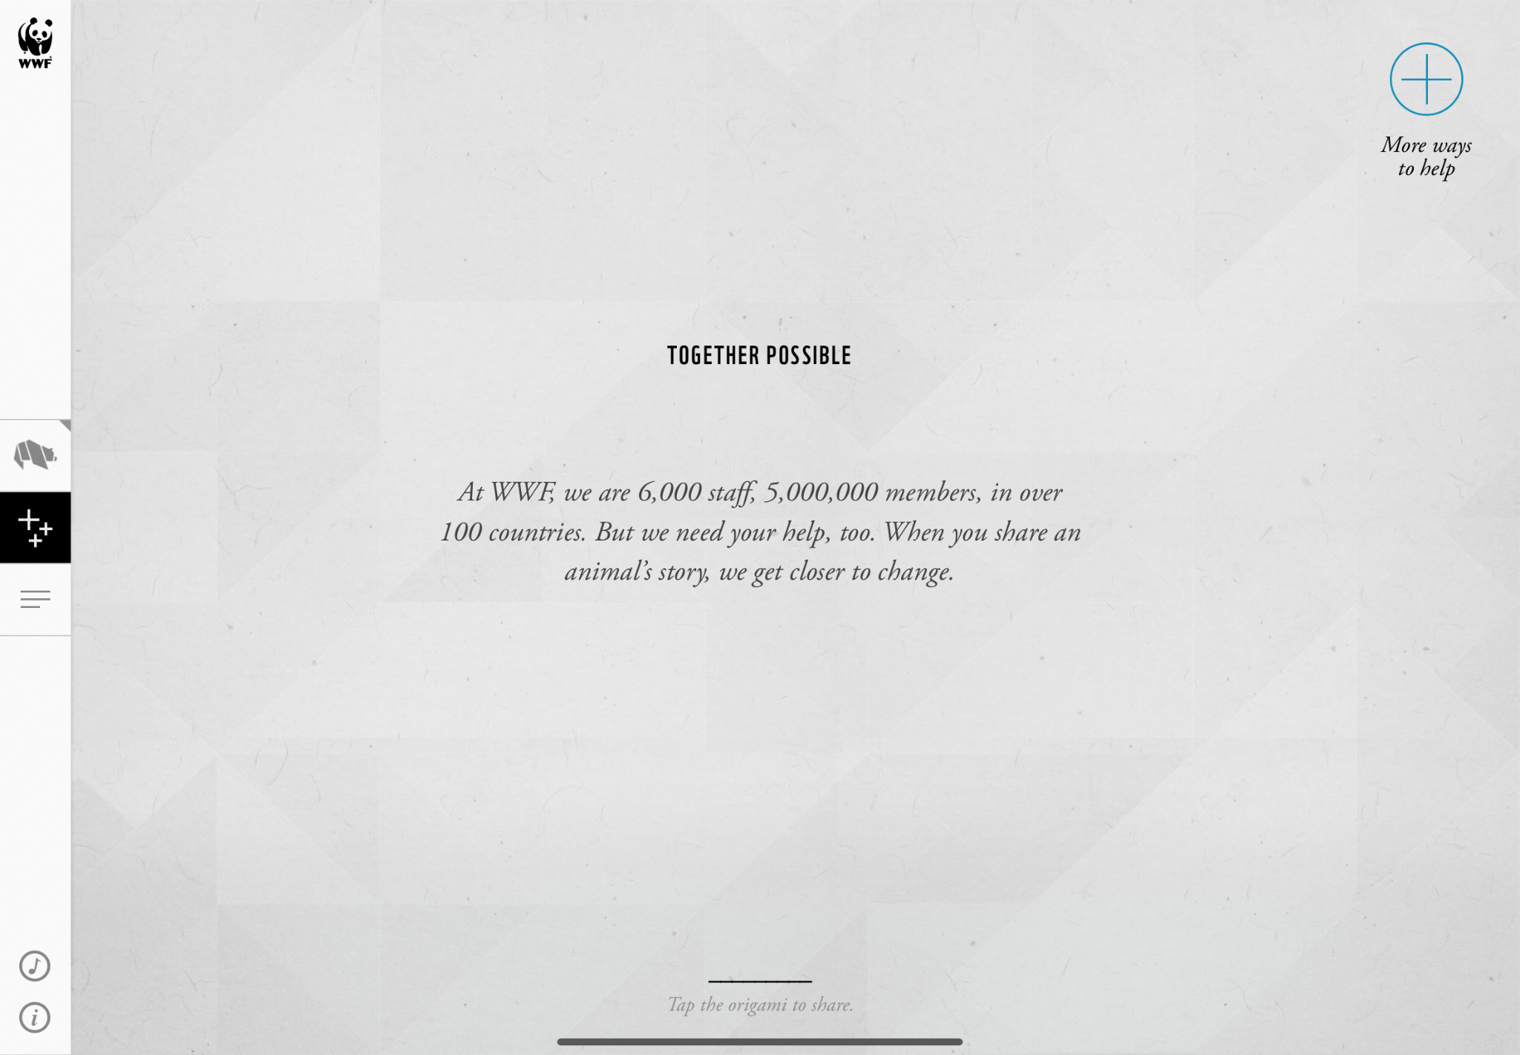
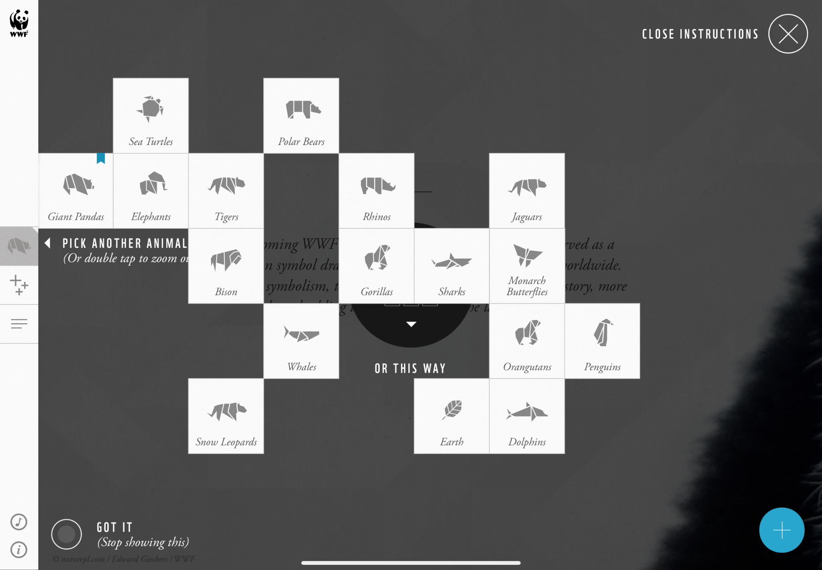
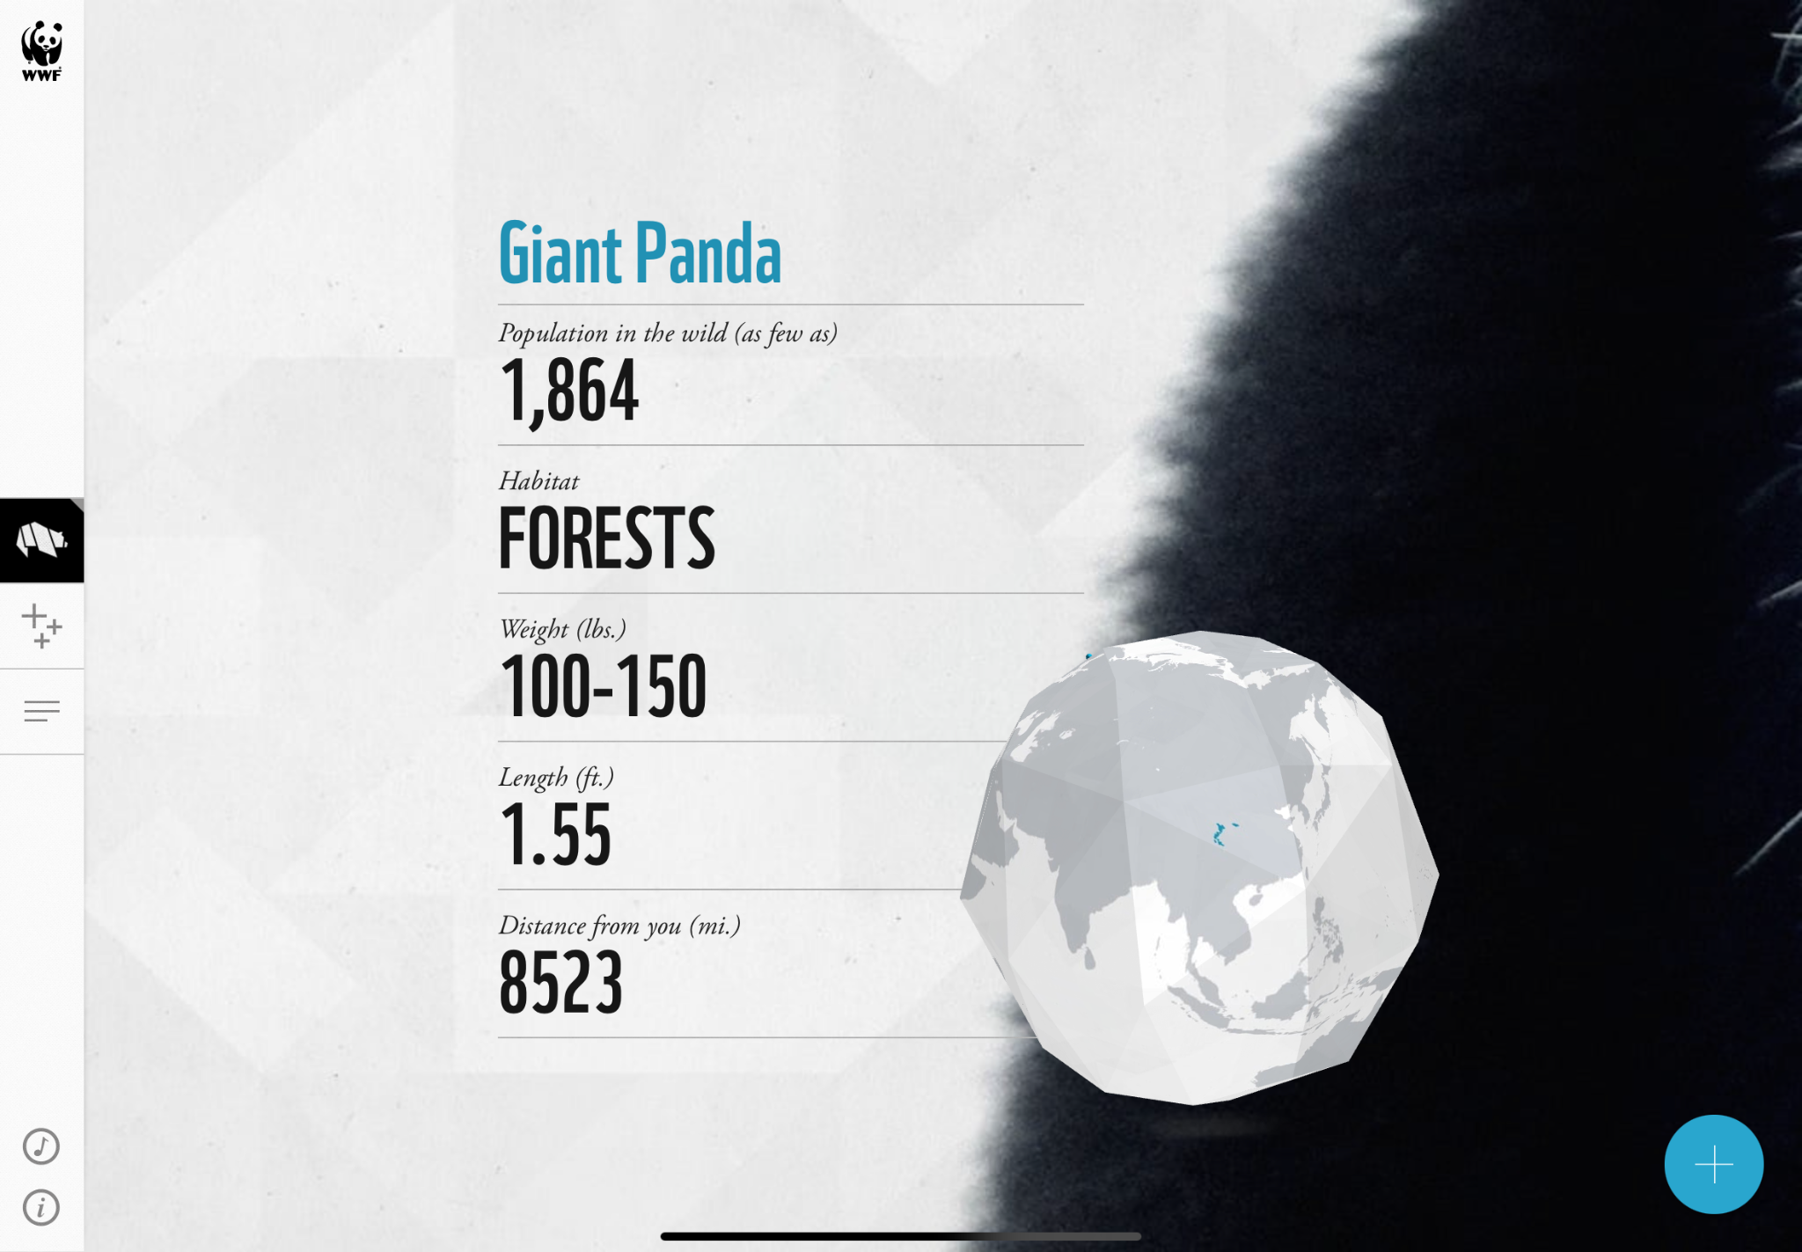
Inspiration…

Slide 22
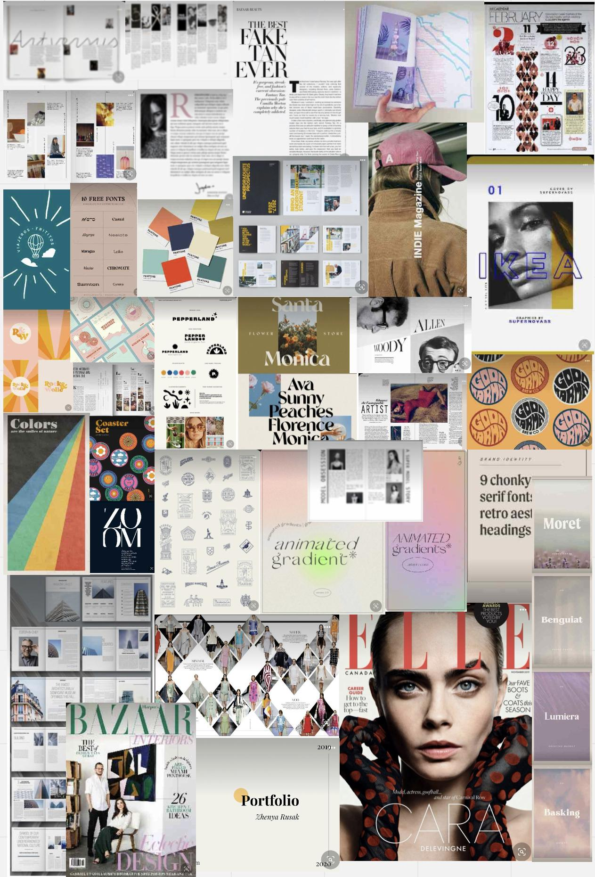
Finding a style…

Slide 23
Who is it for? User Personas and Research
I chose the target audience “Students, between the age 14-18”
GCSE & A-Level
Interactive app for the iPad which would benefit visual learners when learning about the periodic table of elements

Slide 24
Who is it for? User Personas and Research
User Interviews (Students and Teacher)
Research on visual learners
Survey for GCSE/A level students on their personal opinion and experience of the periodic table.

Slide 25
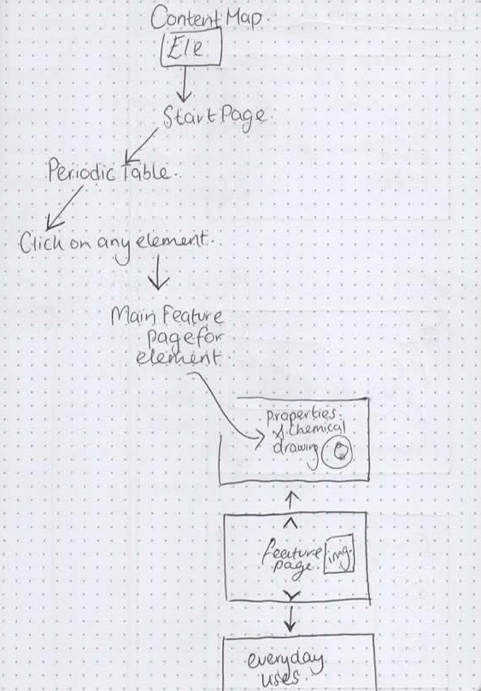
Content Mapping

Slide 26
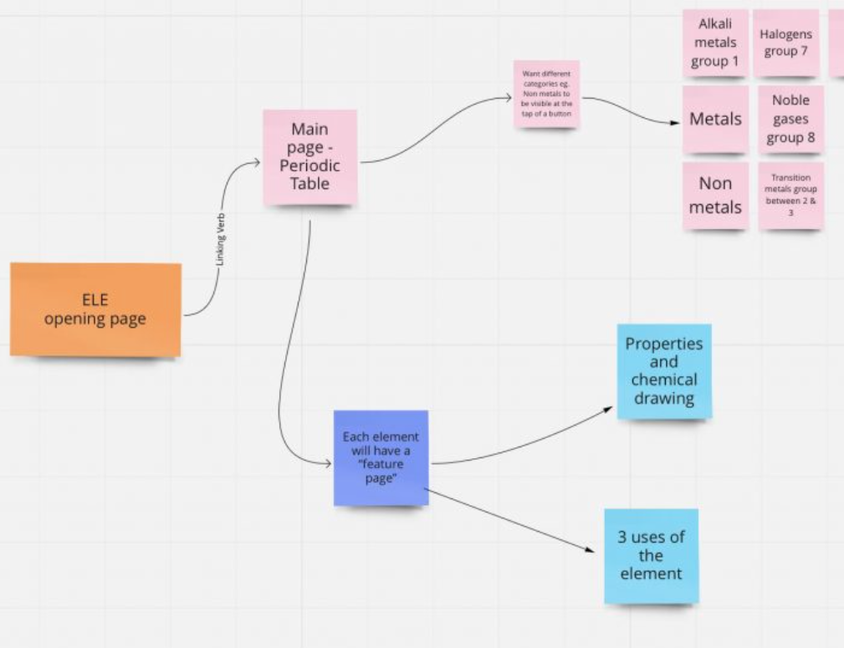
User Flows

Slide 27
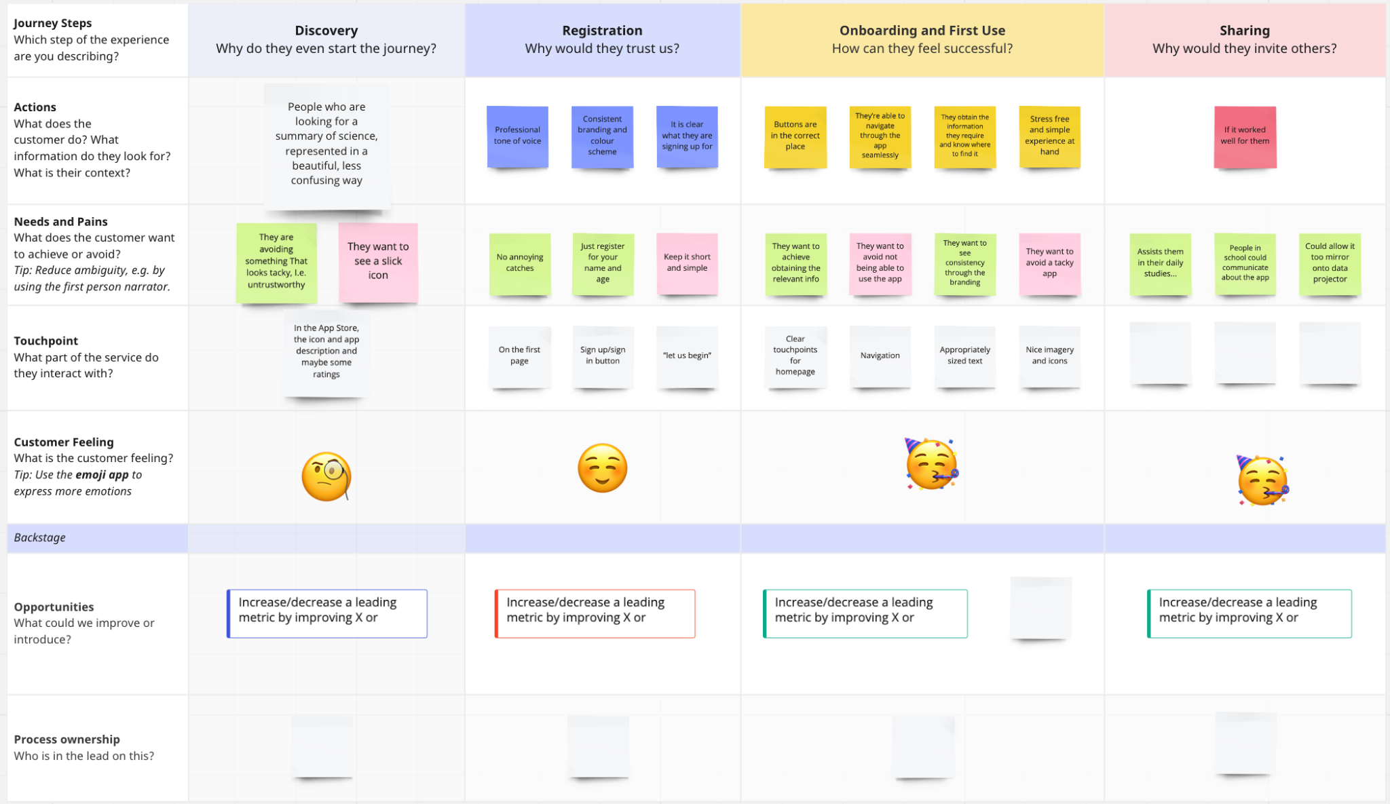

Slide 28
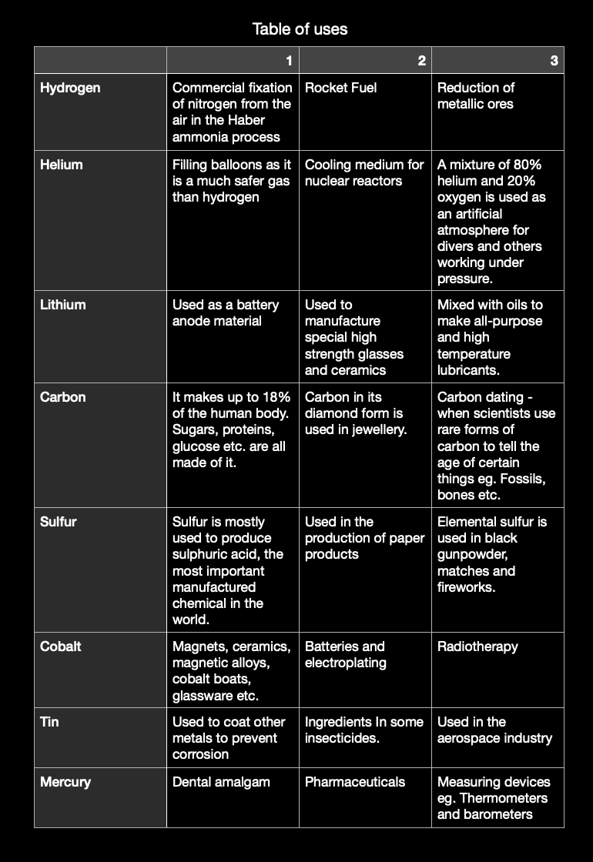
Content Curation

Slide 29
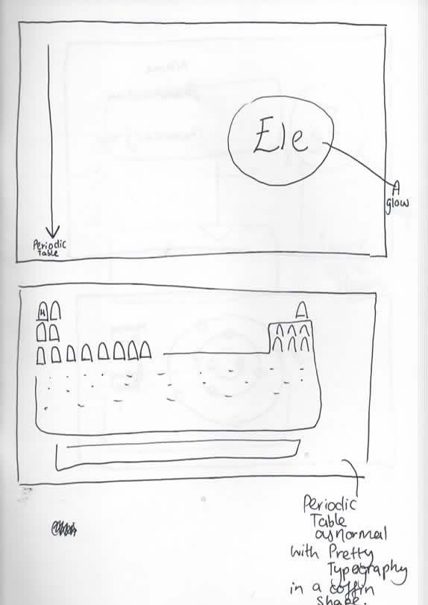
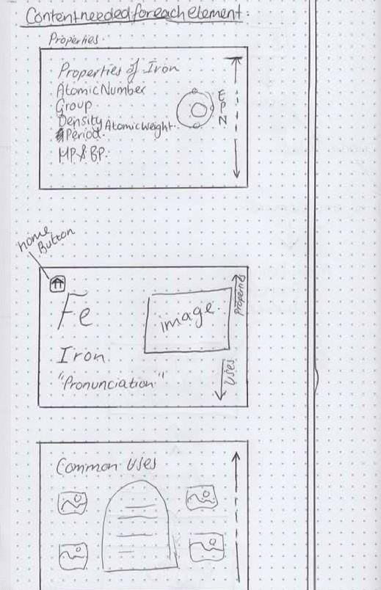
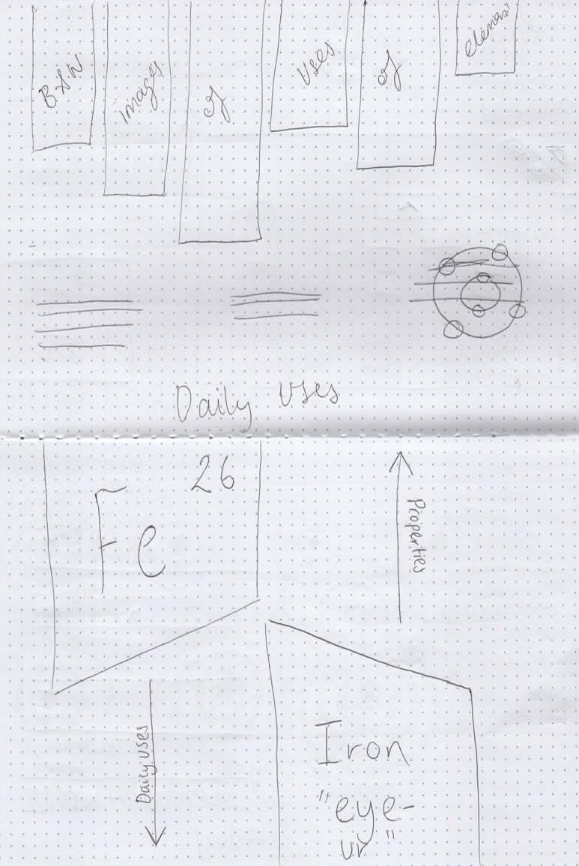
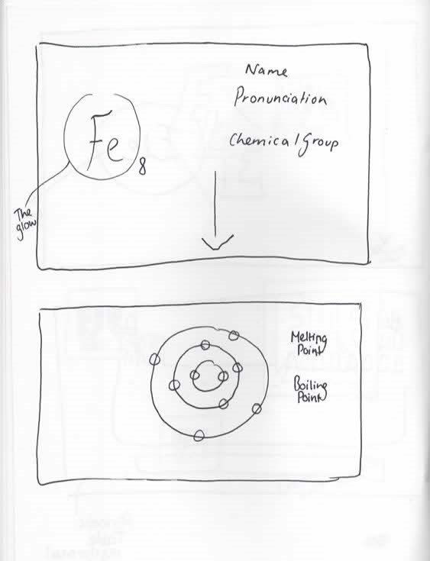
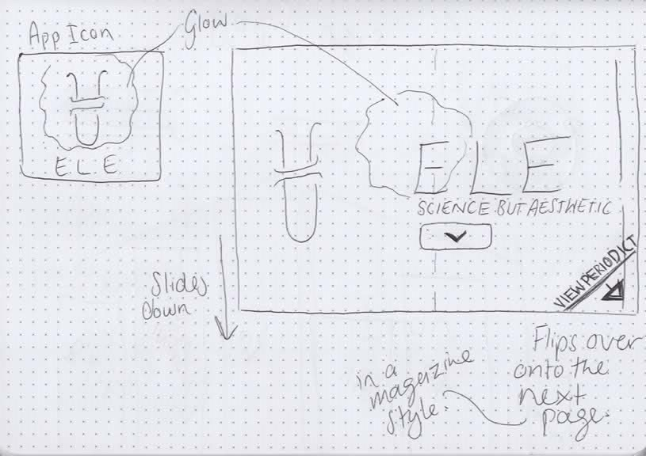
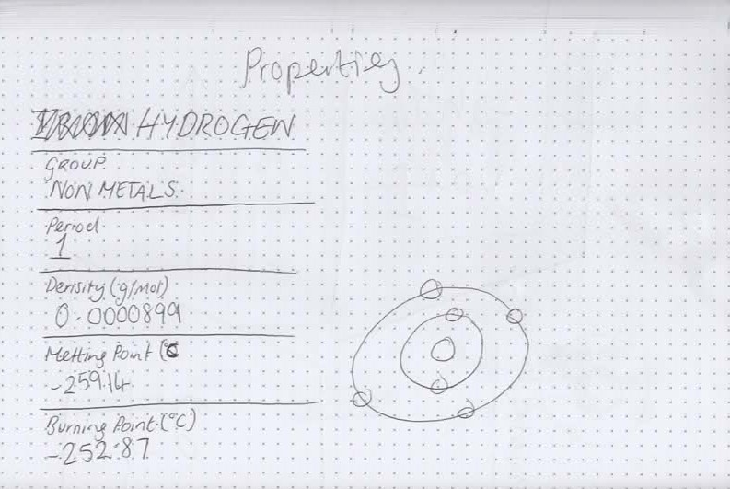
Wireframes

Slide 30
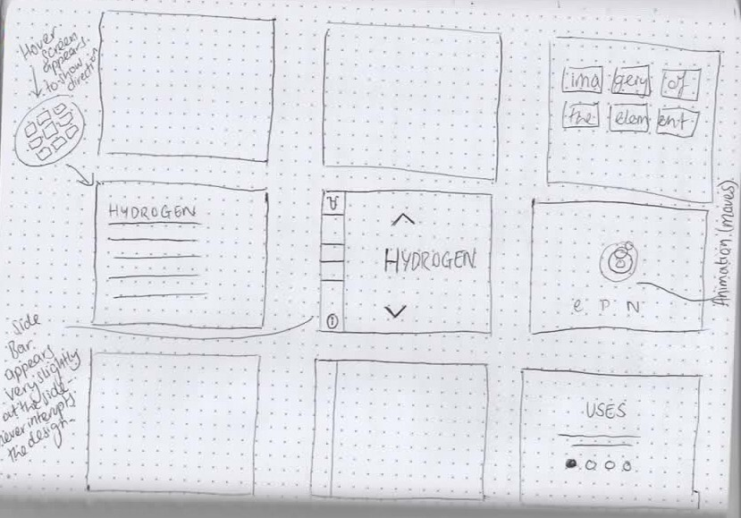
Wireframes

Slide 31
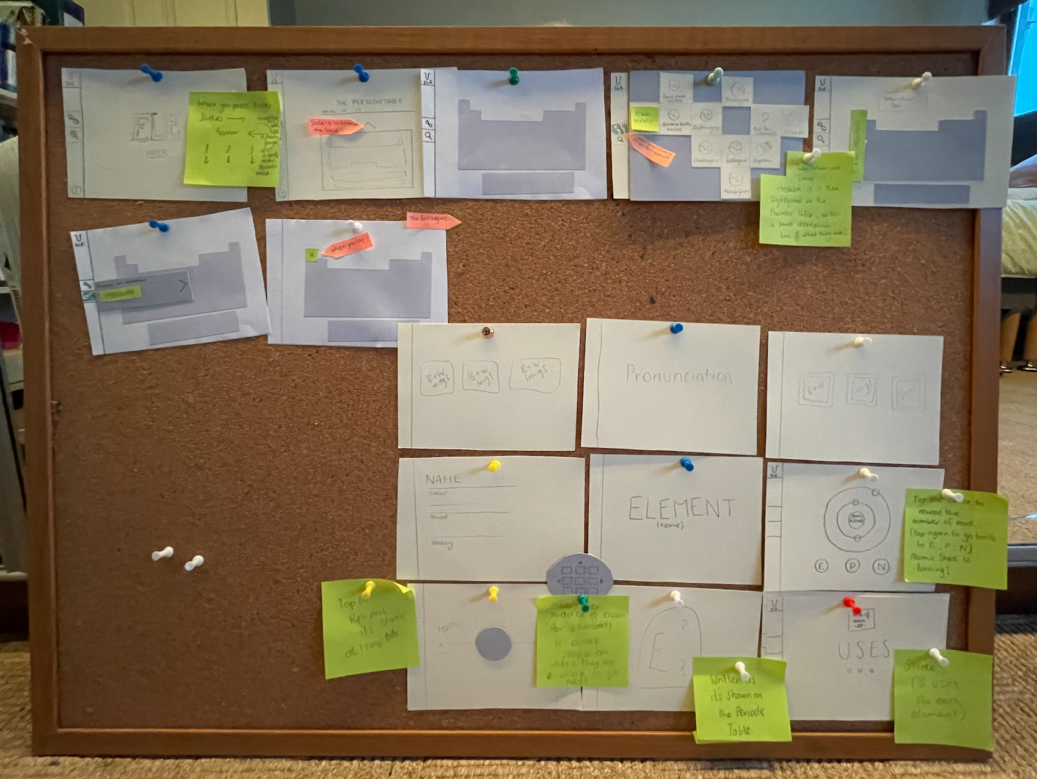
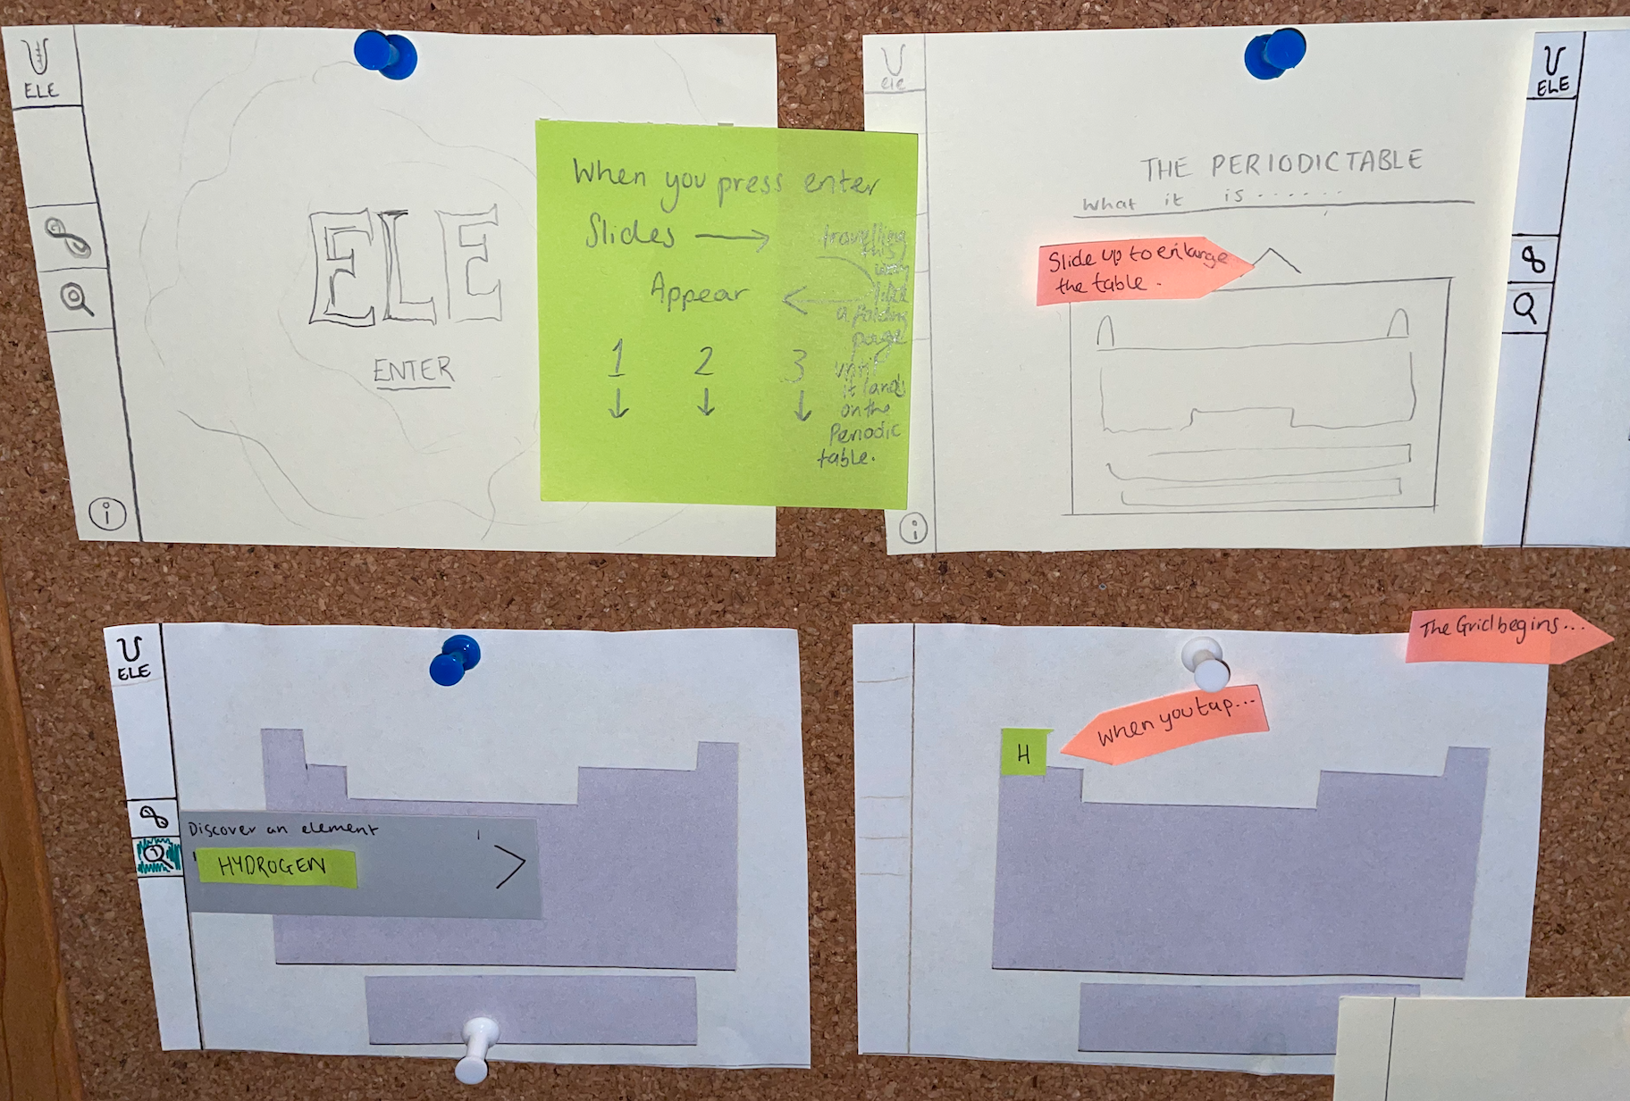
Paper Prototypes

Slide 32
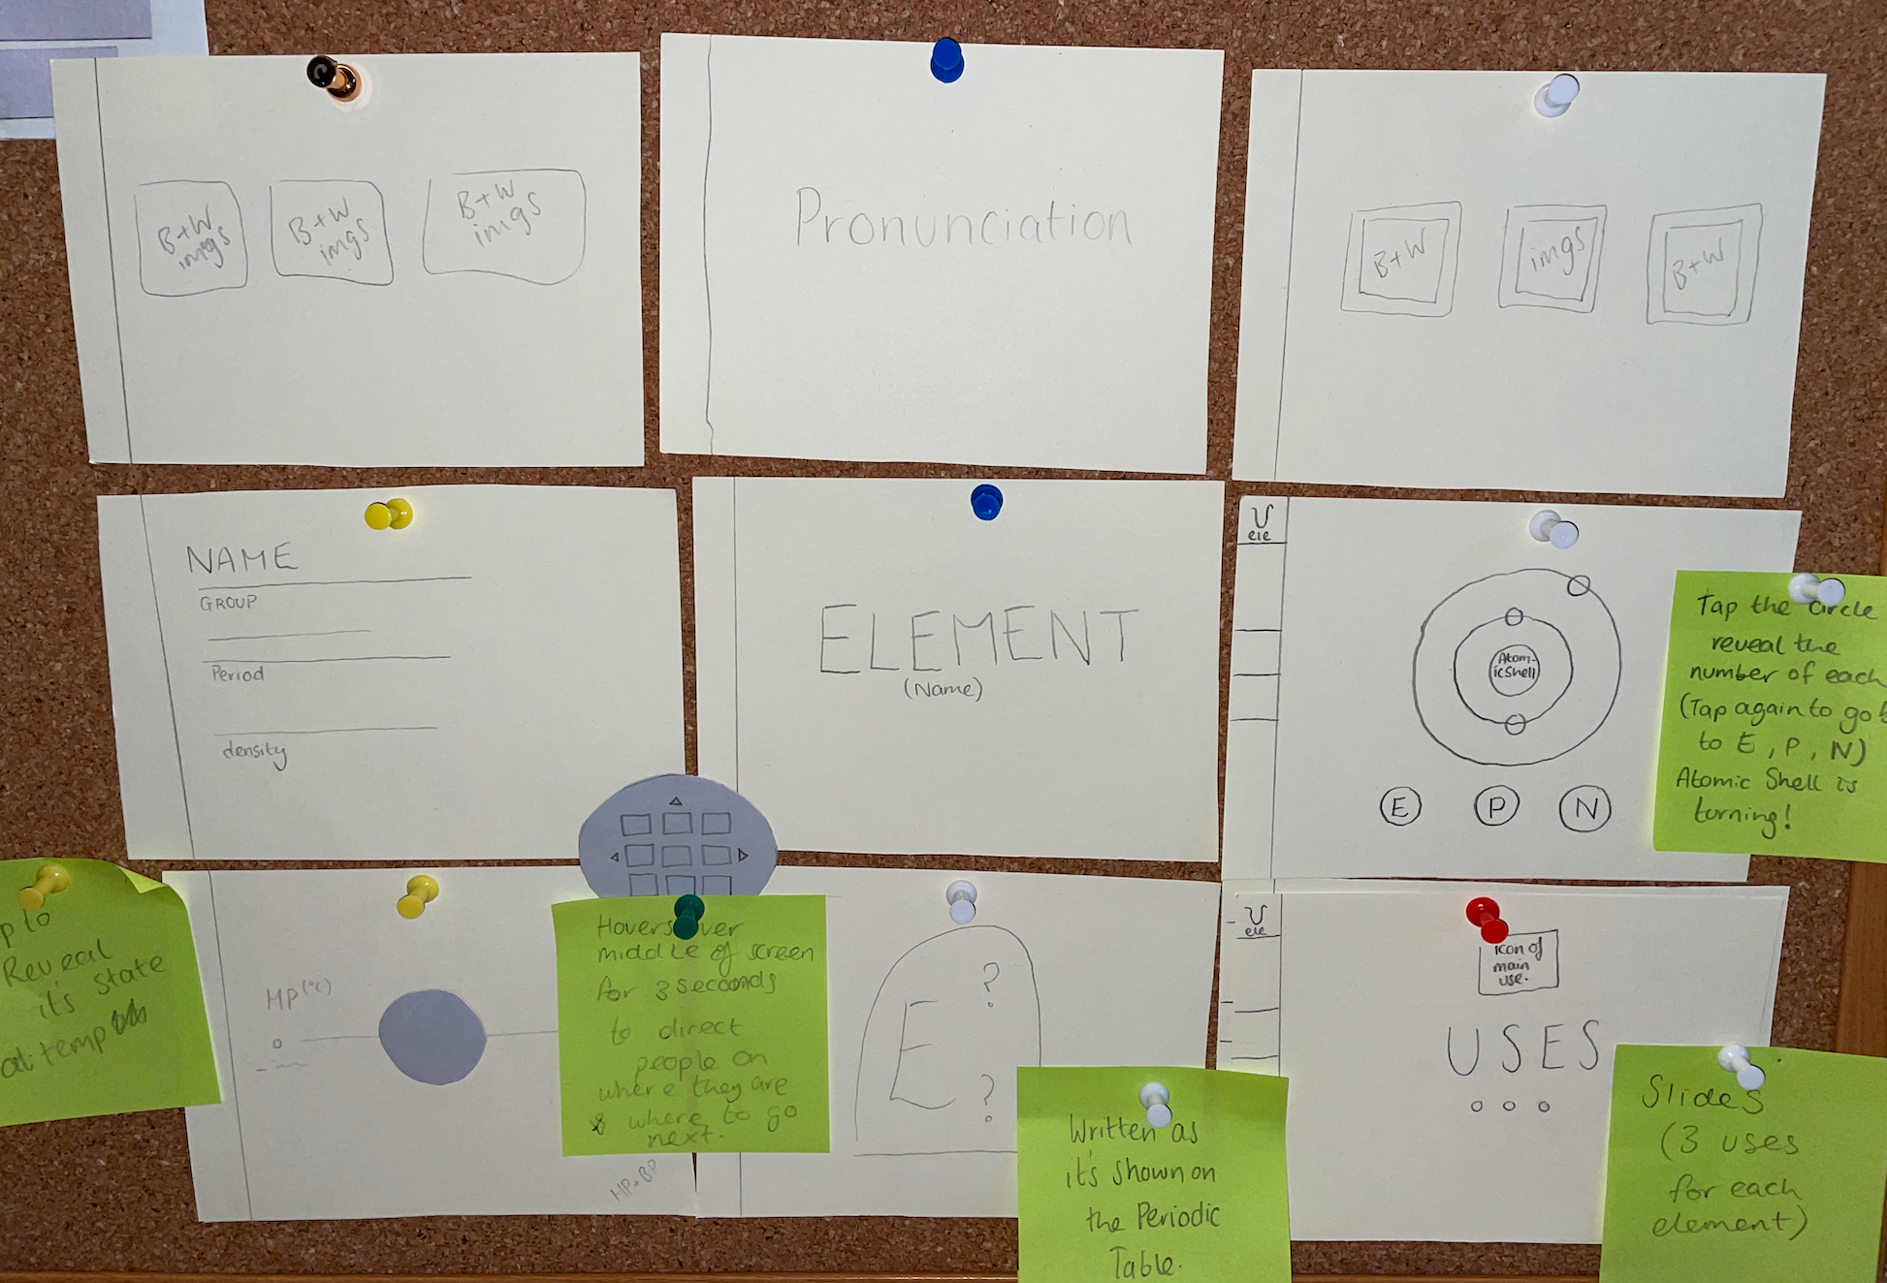
Paper Prototypes

Slide 33
Branding - the sketches

Slide 34
Branding - ELE Logo

Slide 35
Style Guidelines
and creative aspects…

Slide 37
High Resolution Mockups

Slide 41
Early Prototype walk through…

Slide 42
Elements projects review…
I am really proud of how my project has turned out so far. I found it to be a really enjoyable brief. I learned a lot about myself as a creator.
My strong points definitely lie within designing in a consistent manner.
I love sketching and planning. Through feedback last week I know there are a few adjustments I need to make and then I can complete my app.
I really enjoyed making the prototype on Adobe XD. This was my first experience and I know there is definitely room for improvement, which I will work on over the Christmas period.

Slide 43
Thanks for Listening & Have a Very Merry Christmas

