Slide 1
The power of Textless Logos
By Shakira Reid

Slide 2
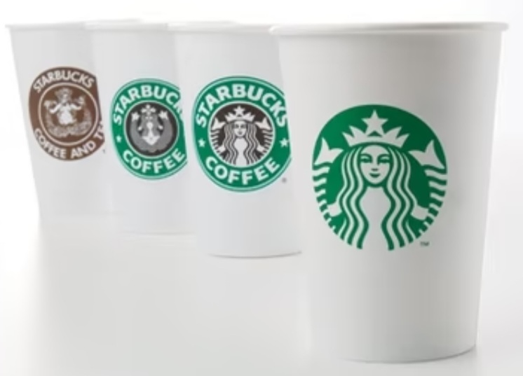
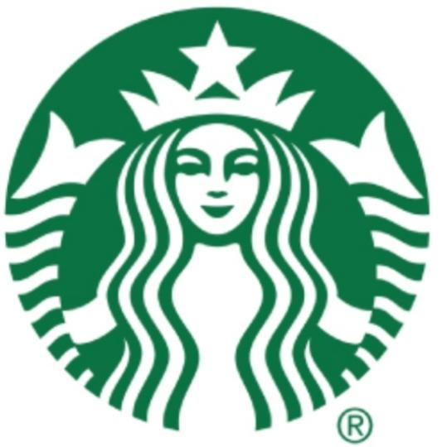
What are textless logos?
Textless logos are symbols of brands that ooze confidence
It’s a variety of components that make up a brand’s identity
They’re often simpler and more memorable
(Fig 1, The Atlantic, 2016)
(Fig 2, Wordless logos, 2019)

Slide 3
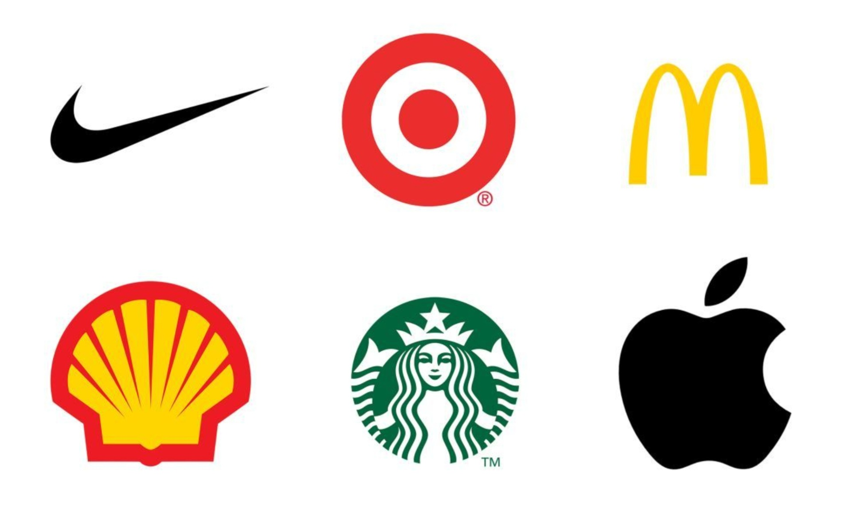
How are they recognisable?
The Colour
The Typeface
The Design
They are Simple
They’re Consistent
They’re Memorable
(Fig 3, Creative Bloq, 2022)

Slide 4
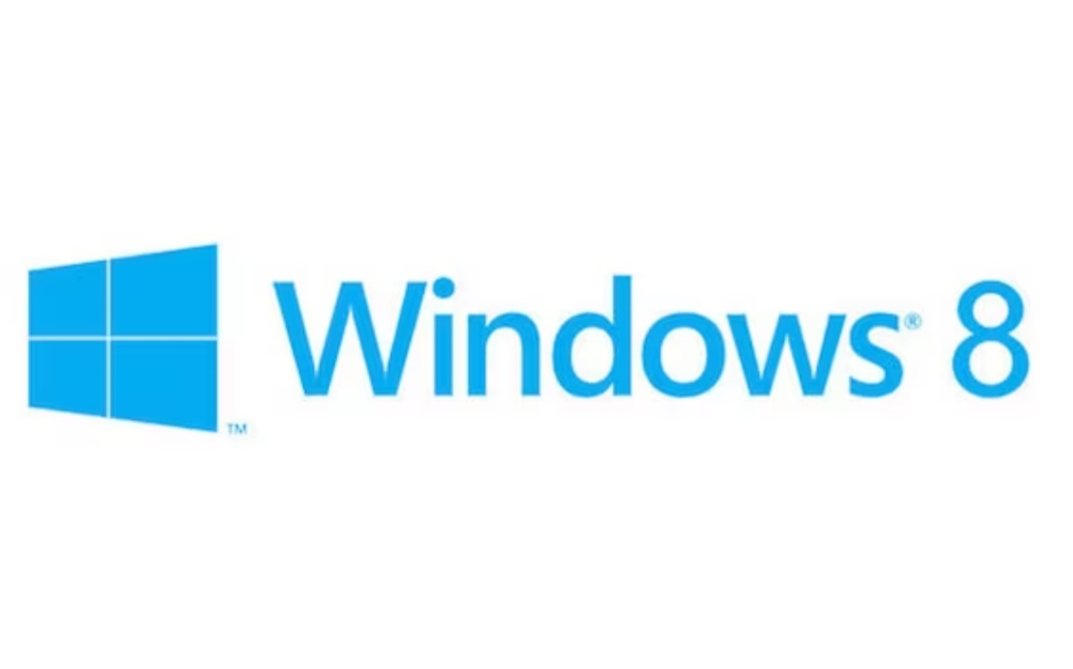
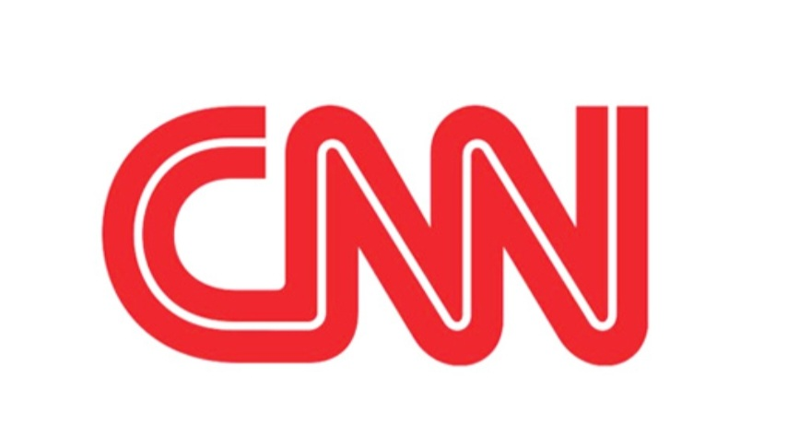
(Fig 4, 99 Designs, 2015)
(Fig 5, Paula Scher, 2015)

Slide 5
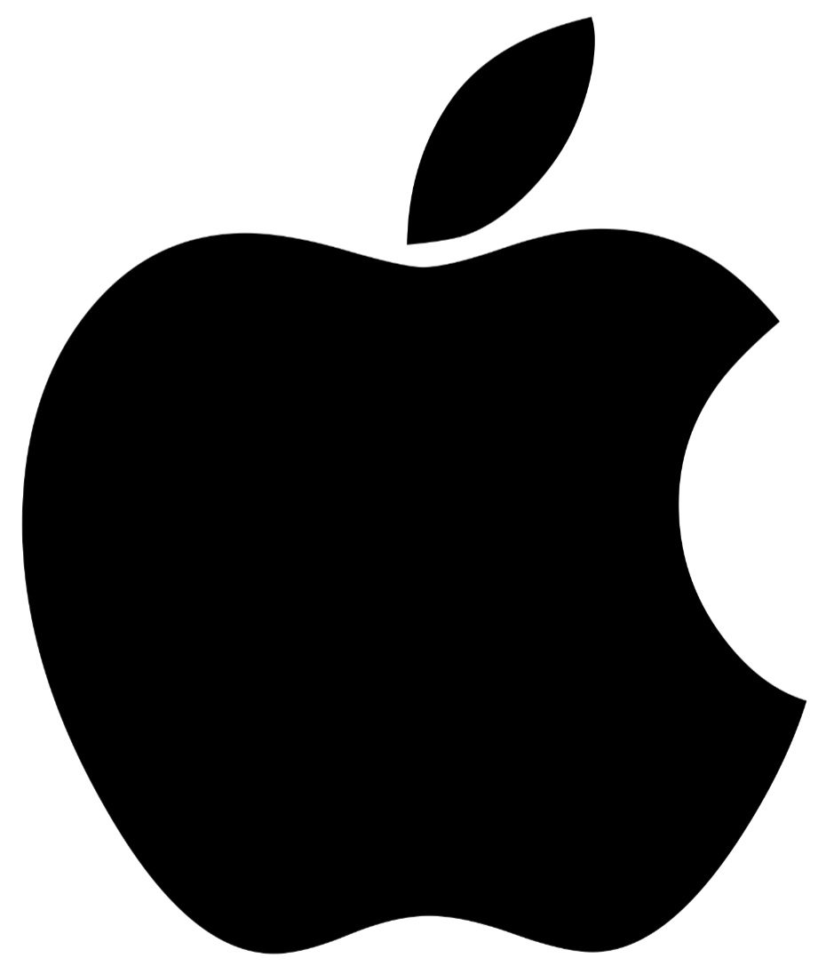
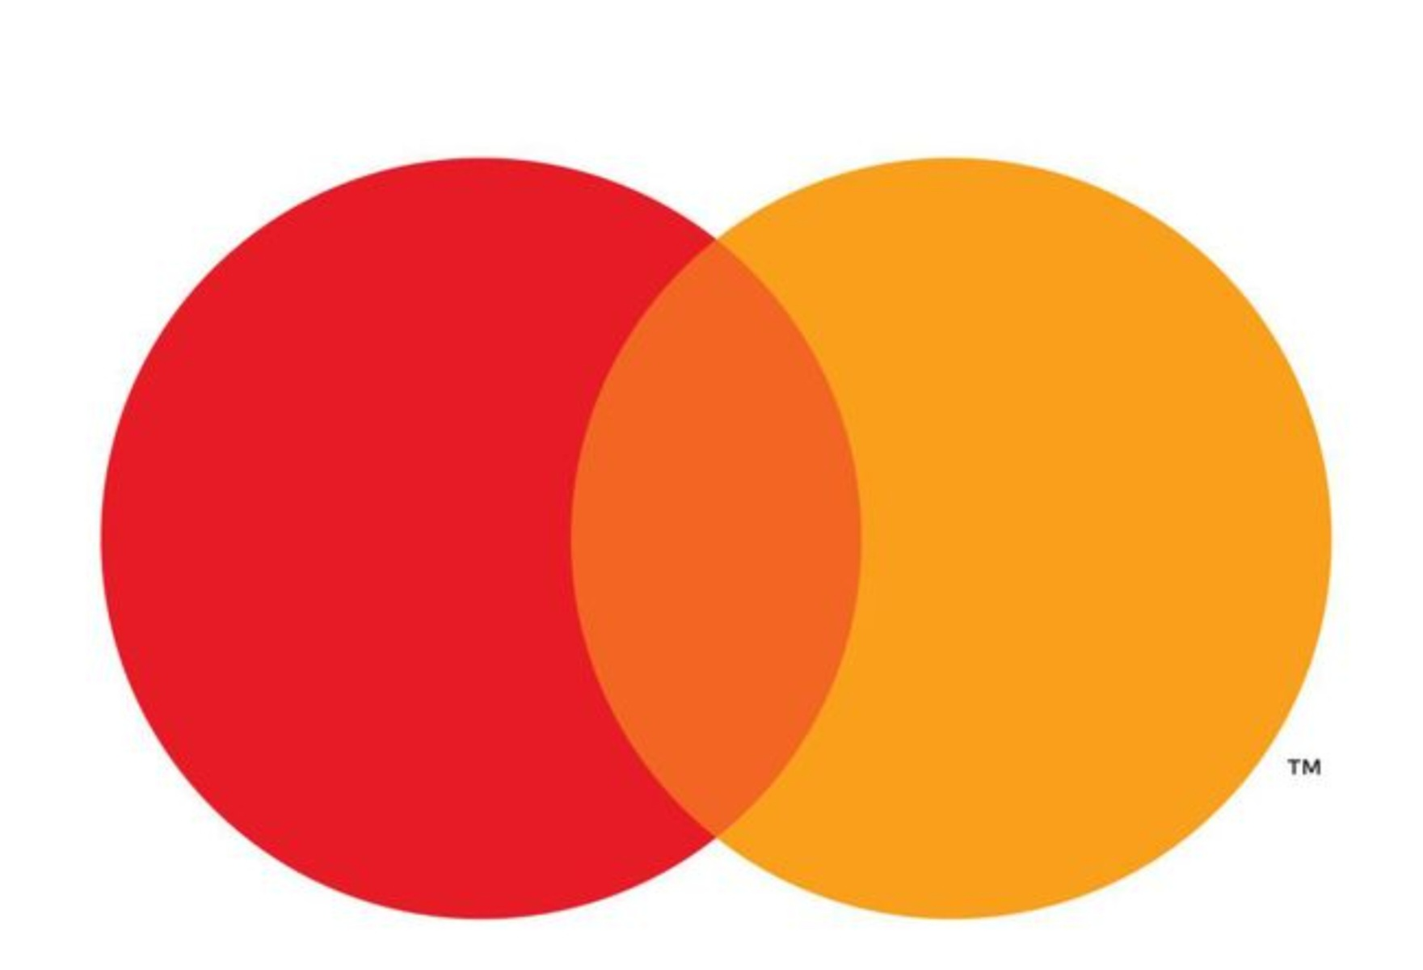
Communication
Visuals
Memorable
Versatile
Languages
Cultures
Simplicity
Modernity
Colour
Shape
Negative Space
Learning Impairments
(Fig 6, IDB, 2022)
(Fig 7, Design Host, 2019)

Slide 6
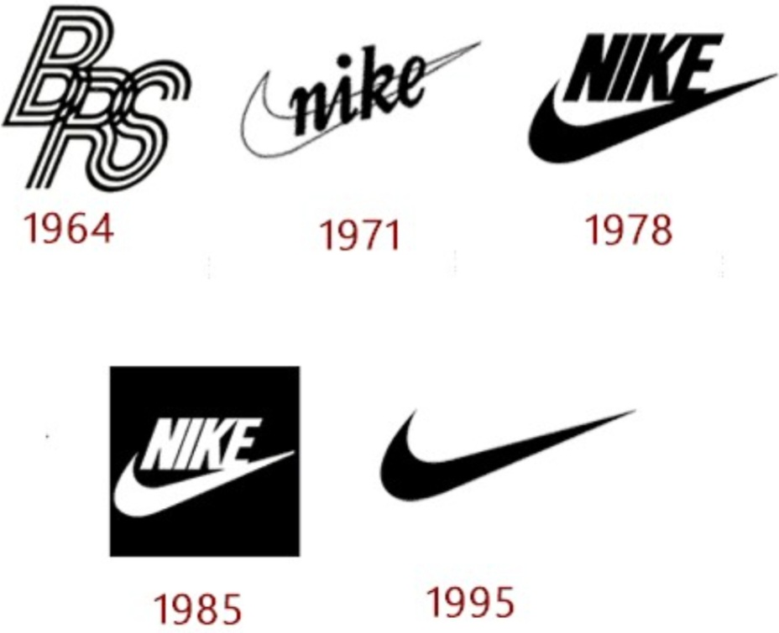
Transition
Textless logos are symbols of brands that ooze confidence
It’s a variety of components that make up a brand’s identity
They’re often simpler and more memorable
(Fig 8, LogoMyWay, 2023)

Slide 7
“Words have meaning, type has spirit”
-Paula Scher-

Slide 8
Bibliography
Alex Bigman (2015) 99 Designs: Get To Know Paula Scher Accessed On: (April 27, 2023) https://99designs.com/blog/famous-design/paula-scher-titan-of-postmodern-design/
Austin Winder (2019) 5 Reasons Why Popular Brand Logos Are So Successful, Accessed On: (April 25,2023) https://www.insightsforprofessionals.com/marketing/leadership/reasons-why-popular-brand-logos-are-successful
Christian Zibreg (2022) IDB: How To Type The Apple Logo Accessed On: (April 27, 2023) https://www.idownloadblog.com/2018/07/03/howto-type-apple-logo-symbol/
Kalle Oskari Mattila (2016) The Atlantic: Why Are So Many Of Today’s Logo’s Wordless? Accessed On: (April 26, 2023) https://www.theatlantic.com/business/archive/2016/09/the-age-of-the-wordless-logo/499166/
LogoMyWay: Nike Logo and it’s History Accessed On: (April 26, 2023) https://blog.logomyway.com/nike-logo/
Michelle Flandreau (2016) Who Is The Starbucks Siren Accessed On: (April 25, 2023) https://stories.starbucks.com/stories/2016/who-is-starbucks-siren/
Nick Carson (2022) Creative Bloq: 8 famous textless logos and why they work Accessed On: (April 29, 2023) https://www.creativebloq.com/features/6-famous-textless-logos-and-why-they-work
Paul McGlade (2015) Paula Scher: Accessed On: (April 27, 2023) https://paulmcglade.github.io/paulascher/index.html
Wordless logos: The Power It Holds And How To Leverage On It (2019) Accessed On: (April 24, 2023) https://www.logodesignteam.com/blog/wordless-logos/
Rss Bot (2019) Design Host: 6 Famous Textless Logos And Why They Work Accessed On: (April 28, 2023) https://designhost.gr/topic/10787-6-famous-textless-logos-and-why-they-work/

