Slide 1
Performances in Fashion
Taylor Swift,
British Invasion, 2013
What Is The Purpose of The Performances?
Notes:
>Welcome to the Presentation of Performances in Fashion

Slide 2
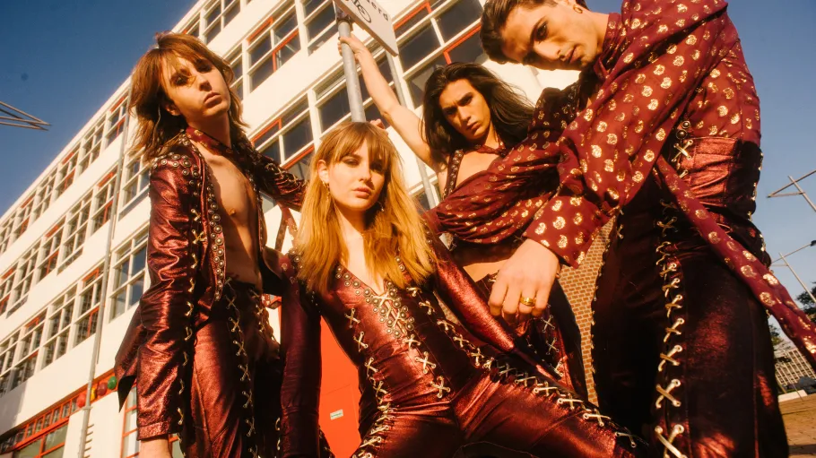
Brief From Essay
Måneskin,
Eurovision 2021
Fashion Designers VS Music Artists
Notes:
>The focus of the essay was the performances that fashion designers use in their runways to enhance the collection being displayed.
>Now looking at how music artists use a similar tactic by using fashion as a way to create a better environment for their performances.

Slide 3
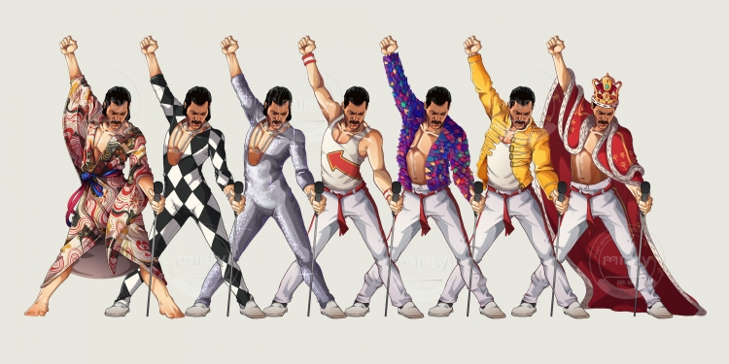
Nathaniel Rueda,
Freddie Mercury, 2018
“The influence music has on fashion has been evident throughout history. Music, much like fashion, has always been used as a way of self-expression and both are also emotional and obtainable forms of art that the masses can enjoy and partake in. Fashion, like music, is one the clearest signs of the times, and it says more about out culture than we give it credit for.” – Antonia Sardone
Notes:
>To help provide a better understanding as to why music and fashion are so intertwined with one another, their performances being similar if not the same reason why it has such a major influence in our society.
Source: article written by Antonia Sardone in 2021 on the University of Fashion Blog.

Slide 4
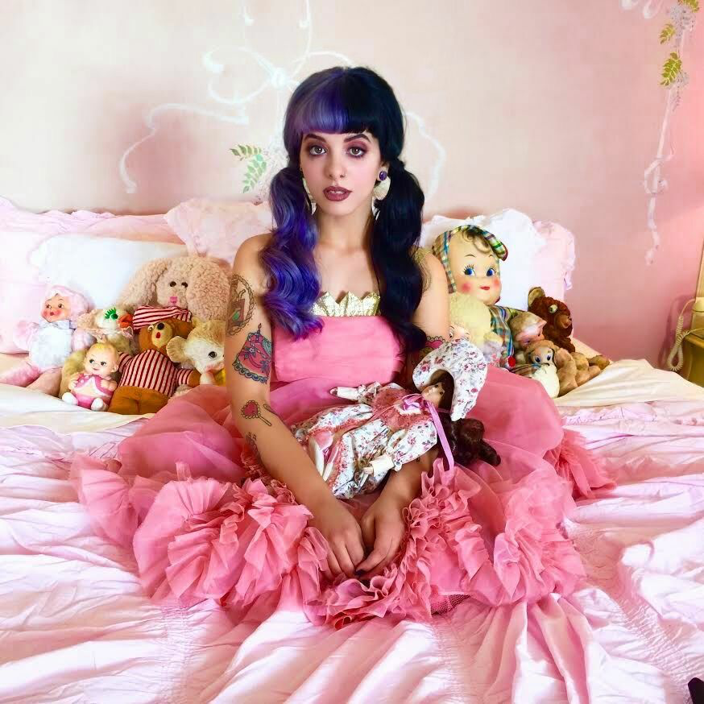
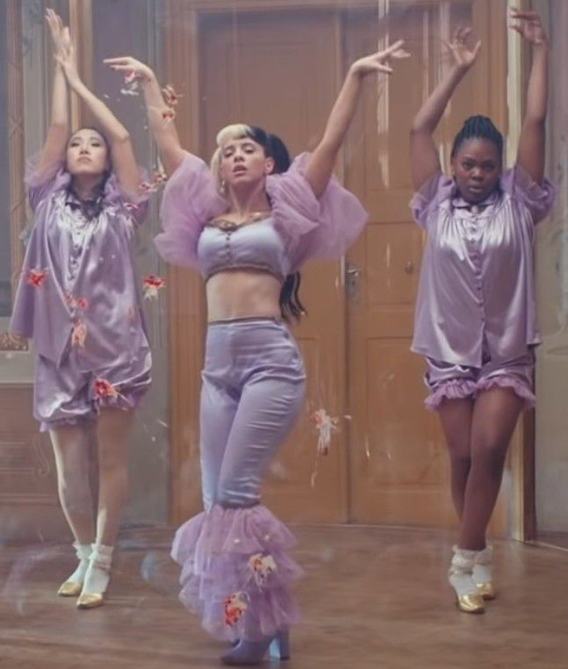
Melanie Martinez
“Keeping with the Pastel Goth vibe Martinez often mixes innocent with sexy, but not overly so. She wears very lacey, frilly, puffy, and dated clothing that could and is considered “baby-like”. – Jessica Smith
Pastel Goth With Unsettling Intentions
Figure 1
‘Pity Party’ - 2015
Figure 2
‘Detention’ – K-12 2019
Notes:
>The first music artist to be studied is Melanie Martinez who started her career with a character called Cry Baby. This was the main protagonist in multiple of her projects. The character itself was created as a fictional and fantasy version of Melanie Martinez and was introduced to be a young, sensitive girl living in a very problematic household.
>Melanie Martinez focuses her songs on heavy topics and personal issues that many people can relate to, often showing the ugly truth behind what people would assume is a ‘perfect’ life. These topics includes addiction, abuse, self-consciousness and low-self esteem, alongside with bullying.
>During her performances, both in music and on stage, Melanie Martinez uses fashion as a way to indicate what the topic of the song is. The artist even uses fine details in the stage sets for each song to enhance the emotions throughout the performance.
>Melanie Martinez has been associated with the fashion trend of ‘pastel goth’ and in the 2021 website article, Melanie Martinez and her Pastel Goth Fashion by Jessica Smith, the author explains this by stating; ‘Her hair, her clothes, and even her music somehow captures the love of the mysterious, dark, and cute that is found in the Pastel Goth subculture.’ The author details further about Melanie Martinez’s appearance with her spilt hair colors, makeup as well as natural features such as gap teeth and explains that each aspect plays a massive part in the character and stage presence.
>This is another quote from Smith in the article that explains the clothing aspect of Melanie Martinez’s.
Source: Smith, J. (2021) Melanie Martinez and her pastel goth fashion, RebelsMarket. Available at: https://www.rebelsmarket.co.uk/blog/posts/melanie-martinez-the-pastel-goth-for-the-modern-weirdo (Accessed: March 7, 2023).
>The reason behind these choices in the fashion style, set designs, topics of her songs and Melanie’s child-like performances is to bring the audience’s attention towards issues and problems that many people faces in reality but are often overlooked or ignored because people don’t wish to accept the ugly truth of what really happens in daily life such as bullying, abuse or other tragic experiences.
>With the innocence of the character Cry Baby, these focuses are empathized to showcase how horrid the topics truly are which gains sympathy from the audience, pulling their emotions out.
CONCLUSION FOR MELANIE MARTINEZ:
>The performances given by Melanie Martinez, either on stage or in a music video, can be concluded to be linked between her fashion, set designs and storytelling of a character’s experiences from dark topics. The purpose for these performances is to bring awareness of said topics of abuse, being sexualized as a well as addictions, and emphasize just how horrid these experiences really are. Melanie Martinez uses her performances within music and fashion choices to showcase her opinions as well in these topics, having experienced some herself throughout childhood and even in current daily life. The media often tries to ignore or gloss over these topics, so Melanie Martinez is forcing her audience to accept that this is reality for some people and help to create a safe environment where her fans can connect and relate to, having their own experiences being told without fear of being hurt further by peers or society.

Slide 5
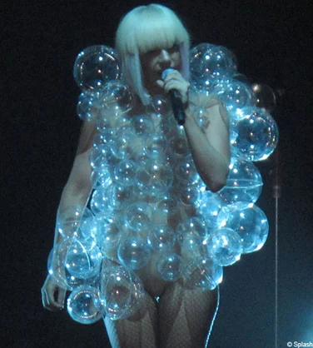
Lady Gaga
Controversial Stage Fashion
“Lady Gaga has also been known to push boundaries with her fashion choices and often incorporates elements of gender-bending and androgyny into her style.’ – Mukesh Kumar
Figure 4
Meat Dress of 2010
Figure 3
Bubble Dress of 2009
Notes:
>Moving onto looking at Lady Gaga, she is known in a similar way to Melanie Martinez for her exaggerated and over-the-top outfits showcased during her performances and red carpet events.
>In the article, Lady Gaga as a Fashion Icon by Mukesh Kumar in 2023, on the website Tutorials Point, he describes Lady Gaga’s style, stating; ‘Lady Gaga is known for her bold, eclectic, and often avant-garde fashion choices. She often incorporates elements of costume and theatre into her fashion and is known for her use of over-the-top, extravagant, and often bizarre clothing and accessories.”
Source: Kumar , M. (2023) Lady Gaga as a fashion icon, Tutorials Point. Available at: https://www.tutorialspoint.com/lady-gaga-as-a-fashion-icon# (Accessed: March 8, 2023).
>While the two mentioned artists are known for their outfits, Lady Gaga differs from Martinez as she uses her outfits to symbolize political topics and personal issues that she has her own thoughts on, instead of creating a character to help emphasize her points.
>Quite a few of Lady Gaga’s outfits have gone viral and some controversial such as the bubble dress from 2009 and her 2010 MTV Video Music Awards dress made of meat.
>The bubble dress was worn with the intentions to symbolize the idea of being trapped in one’s own fame. The dress featured large, clear plastic bubbles that covered her entire body. This dress received mixed reviews at the time but has quickly became one of her most iconic looks, compared to the meat dress that caused a craze the moment the media had seen it.
>In the same article, Kumamoto explains that the Meat dress was “entirely made of raw beef, designed by Franc Fernandez and was worn as a statement about the military’s “don’t ask, don’t tell” policy.”
Source: Kumar , M. (2023) Lady Gaga as a fashion icon, Tutorials Point. Available at: https://www.tutorialspoint.com/lady-gaga-as-a-fashion-icon# (Accessed: March 8, 2023).

Slide 6
Egg Capsule of 2011
Figure 5
Figure 6
Notes:
>Matching the exaggeration of her outfits, Lady Gaga often makes grand entrances for her appearances on stage and red carpets.
>An honorable mention of a grande entrance is the egg capsule in 2011 when Lady Gaga attended the Grammy Awards. She arrived in an egg which had to be carried on a platform by four men. Kumar explains in his article that “the egg was a symbol of the birth of her new album, “Born This Way.”
Source: Kumar , M. (2023) Lady Gaga as a fashion icon, Tutorials Point. Available at: https://www.tutorialspoint.com/lady-gaga-as-a-fashion-icon# (Accessed: March 8, 2023).
>Lady Gaga’s fashion style plays a major role in her performances as the outfits are not only to enhance the stage presence of the artist, but are performances within themselves.
>Comparing the author’s description for Lady Gaga to the one for the style of Melanie Martinez, the two, while being very similar in the terms of having an unique and almost ‘controversial’ style that people often question or criticize, are also very different with Melanie sticking to one style and aesthetic currently and Gaga having elements from multiple aesthetics, mixing and matching the ‘outrageous’ outfits.
CONCLUSION ON LADY GAGA:
>From controversial outfits, to shocking twists in her performances, Lady Gaga makes her choices for her appearance in a similar matter as Melanie Martinez. She is showcasing and proving her points and opinions on political and social matters, refusing to allow the media to sweep heavy topics under the rug like they often try to do. While Lady Gaga wasn’t the first music artist to start these sort of scandals with her fashion, she may arguably be the ‘most’ known and thought of when someone is to mention the topic of ‘outrageous fashion’.

Slide 7
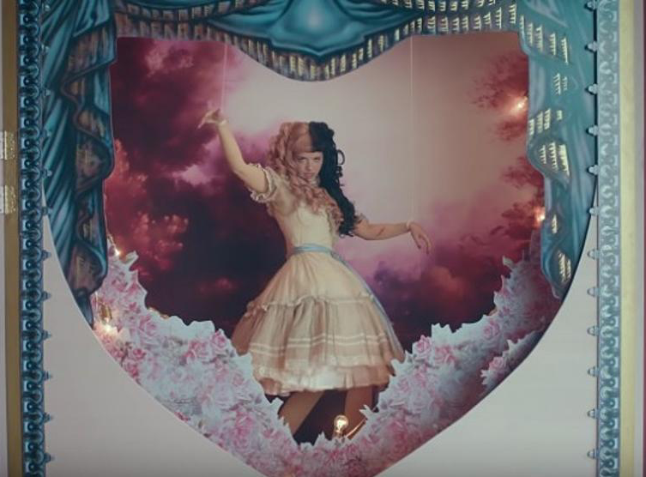
Conclusion
What Is The Purpose of The Performances?
Self-Expression
Opinions
Experiences
Melanie Martinez,
‘Show and Tell’ 2019
Lady Gaga,
‘Paparazzi’ 2009
Notes:
In conclusion, similar to Melanie Martinez and Lady Gaga, a vast majority of musicians have used fashion to enhance their self-expression, and while many may not have created characters or a story throughout their music like the two mentioned, the fashion these artists use speaks enough volume that helps their own message, be that their opinion or experience, get across to their audience.
The music industry is tough, various tragic experiences happen within, and sometimes the music artist use their clothes, fashion trends and styles as a way to protest what they believe is wrong, as a way to gain control of their own career.

Slide 8
Performances In Fashion
What Is The Purpose of The Performances?
Bibliography
Kumar , M. (2023) Lady Gaga as a fashion icon, Tutorials Point. Available at: https://www.tutorialspoint.com/lady-gaga-as-a-fashion-icon# (Accessed: March 8, 2023).
Sardone, A. (2021) A timeline of Music's influence over fashion, University of Fashion Blog. Available at: https://www.universityoffashion.com/blog/a-timeline-of-musics-influence-over-fashion/ (Accessed: March 7, 2023).
Smith, J. (2021) Melanie Martinez and her pastel goth fashion, RebelsMarket. Available at: https://www.rebelsmarket.co.uk/blog/posts/melanie-martinez-the-pastel-goth-for-the-modern-weirdo (Accessed: March 7, 2023).

Slide 9
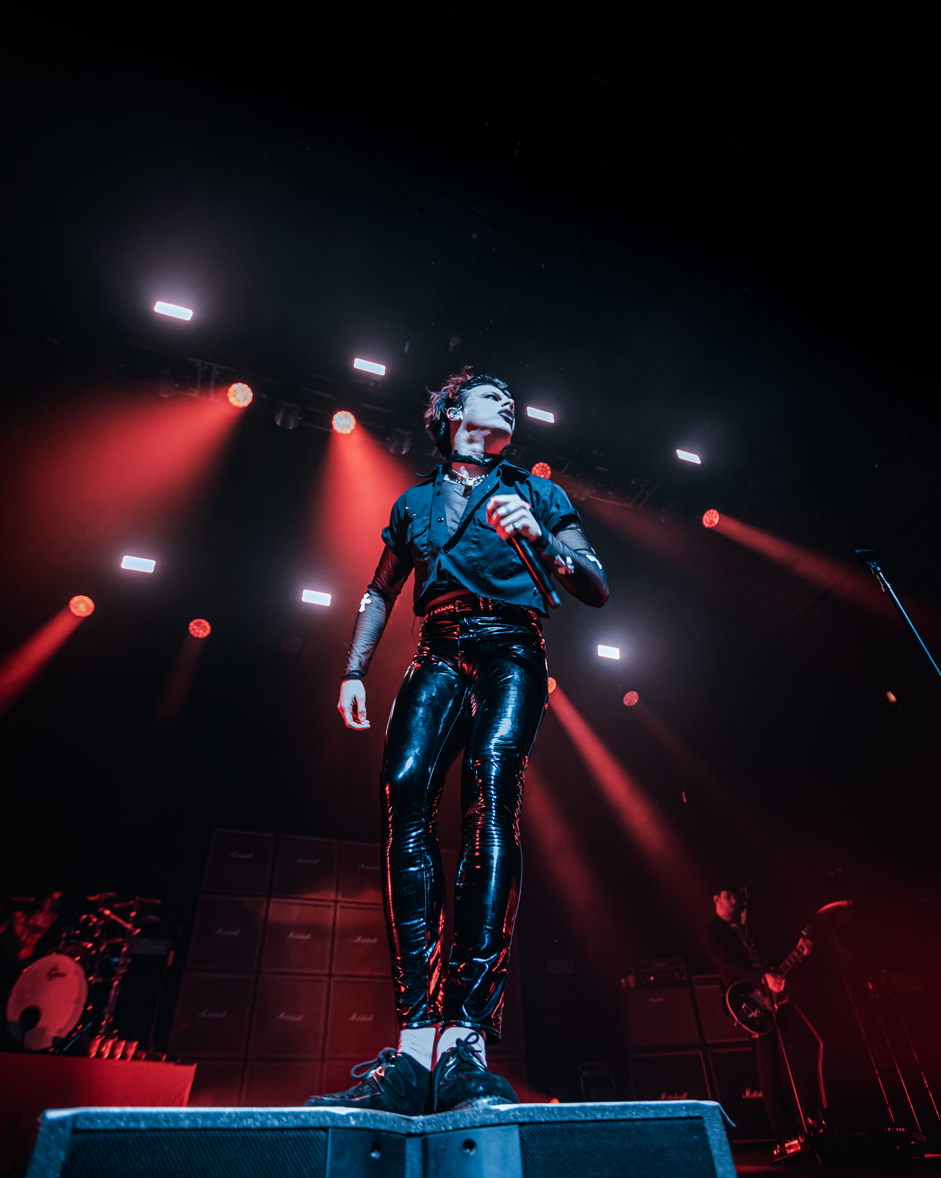
THANK YOU
YUNGBLUD,
‘Strawberry Lipstick’ 2020
Aoife Conney

