Slide 1
Why Should We Consider Sustainable or Second Hand Clothing Over Fast Fashion Brands?
Molly McVeigh-Beckett
AAD011

Slide 2
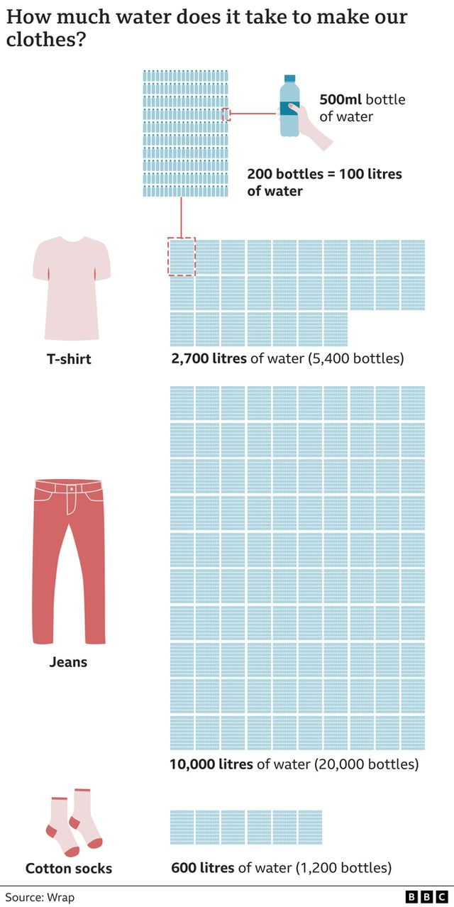
Why Is Fashion Effecting our society and environments?
Fashion is a big part of all of our lives but at what cost? Do you consider the process and impact that each garment you buy or wear has on our environment? As a society we are contributing to the overconsumption, excessive waste and environmental impacts that textiles have on our environment.
The fashion industry produces:
20% of waste water
8-10% Greenhouse gas emissions
$500 billion of discarded items each year
Figure 1: How much water is used for each item of clothing, BBC, 2022
Notes:
Why Is Fashion Effecting our society and environments?
Fashion is a big part of all of our lives but at what cost? Do you consider the process and impact that each garment you buy or wear has on our environment? As a society we are contributing to the overconsumption and excessive waste and environmental impacts that textiles have on our environment.
The fashion industry produces:
20% of waste water
8-10% Greenhouse gas emissions
500 billion dollars of discarded items each year
Figure one shows an infographic by the BBC, showing how much water is used for each garment. Today I am wearing an outfit that has used approximately thirteen thousand three hundred litres of water equivalent to (26,600 bottles of water) to produce my t-shirt, jeans and socks. That would be nearly one bottle of water per student across all 4 campuses of Ulster University with approximately 27,000 students.

Slide 3
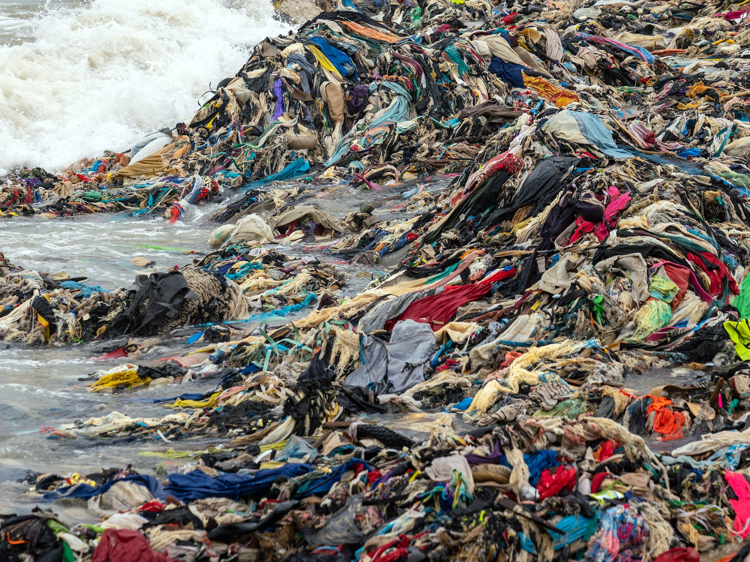
What is Fast Fashion and How can we reduce it?
Fast Fashion is the mass production of cheap clothing to keep up with regular changing trends within fashion which we are compelled to buy.
The United Nations Economic Commission for Europe (UNECE) reported that the fashion industry has grown rapidly with 60% more garments being bought than 15 years ago leading to overconsumption and excessive waste.
BBC Bitesize reports that on average some garments are only worn up to 10 times before being discarded or unused resulting in 336,000 tonnes of clothing going to landfill each year.
Figure 2: Mountains of clothes washed up on Ghana Beach, 2022
Notes:
What is Fast Fashion and How can we reduce it?
Fast Fashion is the mass production of cheap clothing to keep up with regular changing trends within fashion which we are compelled to buy.
The United Nations Economic Commission for Europe (UNECE) reported that the fashion industry has grown rapidly with 60% more garments being bought than 15 years ago leading to overconsumption and excessive waste.
BBC Bitesize reports that on average some garments are only worn up to 10 times before being discarded or unused resulting in three hundred and thirty-six thousand tonnes of clothing going to landfill each year. Figure 2 shows how detrimental this can be to our environment showing mountains of clothing that has been washed up on Ghana Beach.

Slide 4
TEXTILE CREATORS AND SCULPTORS: ALIAN GUERRA AND NERALDO DE LA PAZ (GUERRA DE LA PAZ) AND MINGA OPAZO
Figure 3: Alain Guerra and Neraldo de la Paz, Spring Sprang Sprung, 2009
Figure 4: Minga Opazo, Terron, 2021
Notes:
Textile creator and Sculptors: Alain Guerra and Neraldo de la Paz (Guerra de la Paz) and Minga Opazo
Guerra de la Paz is a collaboration with Alain Guerra and Neraldo de la Paz who create large sculptures and installations to highlight the environmental impacts of excessive consumption and disposal created by Fast Fashion. Figure 3: Spring Sprang Sprung, 2009 represents the mass volume of excessive consumption with a hope to inspire reuse and recycling of fashion garments.
Similarly, Chilean textile creator Mingo Opazo creates large installations to highlight the distress caused by environmental changes such as excessive consumption in the fashion industry. Figure 4: Terron, 2021 is made up of layers of recycled clothing and mud with grass growing on top to depict how non-biodegradable fabrics, which are disused become embedded in our natural environments. The layers she creates within her installation Terron depicts time gone by.
Within 12 years of the Guerra de la Paz installation ‘Spring Sprang Sprung’ 2009 and Minga Opazo’s installation ‘Terron’ 2021 shows that little has changed in regards to fast fashion, excessive consumption and disposal. Artists are still trying to create awareness and inspire change on the environmental consequences created by the fashion industry.

Slide 5
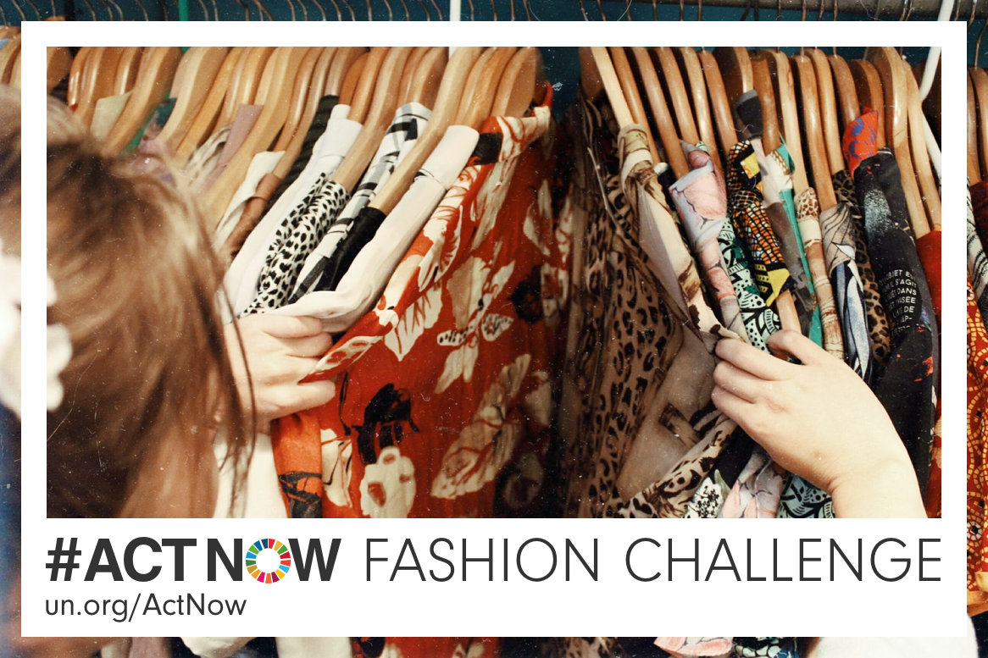
Small changes that can help make a difference
#ACTNOW Fashion Challenge aims to change habits and routines, encourage smart buying choices, bring awareness and change mindsets in regards to fashion.
Ideas for Change:
Buy second-hand
Make smart choices
Limit buying (only 8 items per year)
Wash your clothes only when necessary
Figure 5: #ACTNOW Fashion Challenge, UNECE, 2019
Notes:
Small changes that can help make a difference
#ACTNOW Fashion Challenge is on of many fashion friendly campaigns that aims to change habits and routines, encourage smart buying choices, bring awareness and change mindsets in regards to fashion.
Here are a few small changes we can make:
Ideas for Change:
Buy second-hand
Make smart choices – Ask yourself how many times you will wear it? Make do and mend by repairing and upcycling existing garments
Limit buying only 8 items per year
Wash your clothes only when necessary

Slide 6
IN CONCLUSION…
In the 12 years that passed between the artists work as shown on slide 5 the language used to describe the impact that Fast Fashion has on our environment is un changed. Minga Opazo and Guerra de la Paz’s work shows only a small fraction of a huge global issue.
Overall, the reason to consider sustainable or second hand clothing over Fast Fashion brands is to reduce the impact that Fast Fashion has on our environment.
By understanding the process involved in producing each individual garment and the consequences we can begin to make small individual changes such as those set out by the #ACTNOW fashion campaign we can help to reduce the impacts that the fashion industry has on the environment, and collectively make a difference.
Thank you for listening!
Notes:
IN CONCLUSION…
In the 12 years that passed between the artists work as shown on slide 5 the language used to describe the impact that Fast Fashion has on our environment is un changed. Minga Opazo and Guerra de la Paz’s work shows only a small fraction of a huge global issue.
Overall, the reason to consider sustainable or second hand clothing over Fast Fashion brands is to reduce the impact that Fast Fashion has on our environment.
By understanding the process involved in producing each individual garment and the consequences we can begin to make small individual changes such as those set out by the #ACTNOW fashion campaign we can help to reduce the impacts that the fashion industry has on the environment, and collectively make a difference.
Thank you for listening!

Slide 7
List of References (1 of 2):
Art Works For Change, N/D. Available on: Guerra de la Paz – Art Works for Change [Accessed on: 30th April 2023]
BBC Bitesize, 2023, How can Fashion be Better for the Planet. Available on: How can fashion be better for the planet? - KS2 - The Regenerators - BBC Bitesize [Accessed on: 30th April 2023]
Clouser Haley, 2022, Boston Art Review – Fungal Threads: Minga Opazo’s Biodegradable Textile and Mushroom Sculptures. Available on: Fungal Threads: Minga Opazo’s Biodegradable Textile and Mushroom Sculptures (bostonartreview.com) [Accessed on: 30th April 2023]
Stallard Esme, 2022, BBC – Fast Fashion: How Clothes are Linked To Climate Change. Available on: Fast fashion: How clothes are linked to climate change - BBC News [Accessed on: 30th April 2023]
UNECE, 2018, UN Alliance aims to put fashion on path to sustainability. Available on: UN Alliance aims to put fashion on path to sustainability | UNECE [Accessed on: 30th April 2023]
UNECE, 2019, #ACTNOW Fashion Challenge. Available on: ActNow for Zero-Waste Fashion - United Nations Sustainable Development [Accessed on: 30th April 2023]

Slide 8
List of References (2 of 2):
Figure 1: How much water is used for each item of clothing, BBC, 2022. Available on: Fast fashion: How clothes are linked to climate change - BBC News [Accessed on: 30th April 2023]
Figure 2: Mountains of clothes washed up on Ghana Beach, 2022. Available on: Mountains of clothes washed up on Ghana beach show cost of fast fashion | The Independent [Accessed on: 30th April 2023]
Figure 3: Alain Guerra and Neraldo de la Paz, Spring Sprang Sprung, 2009. Available on: Guerra de la Paz – Art Works for Change [Accessed on: 30th April 2023]
Figure 4: Minga Opazo, Terron, 2021. Available on: About — Minga Opazo [Accessed on: 30th April 2023]
Figure 5: #ACTNOW Fashion Challenge, UNECE, 2019. Available on: ActNow for Zero-Waste Fashion - United Nations Sustainable Development [Accessed on: 30th April 2023

